Slide 2
School Visit Overview
Notes:
Welcome class to the GAA Future Leaders Wellbeing Module

Slide 3
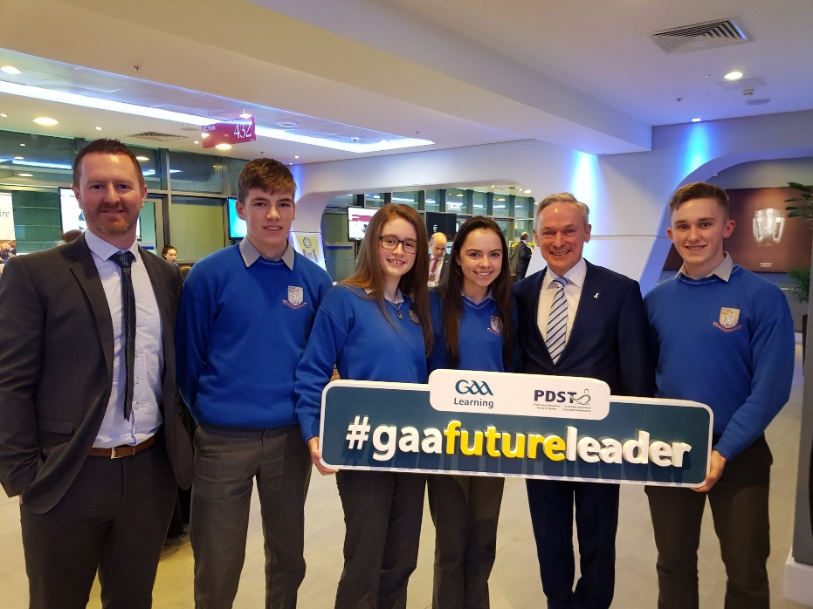
Email & Social Media
Email: futureleaders@gaa.ie
@gaafutureleader
gaafutureleader

Slide 4
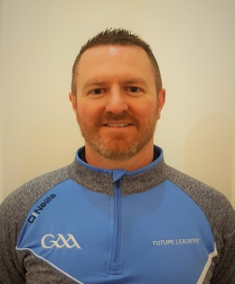
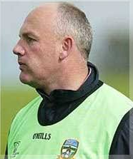
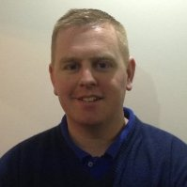
GAA Future Leaders – Regional Coordinators/Lead Tutors
Eoghan Hanley (National Coordinator / Connaught Region) – eoghan.hanley@gaa.ie
Sean Kelly (North Leinster Regional Coordinator) – seankellysk36@gmail.com
Colm Hanley (Munster Regional Coordinator) –
chanley@cco.ie

Slide 5
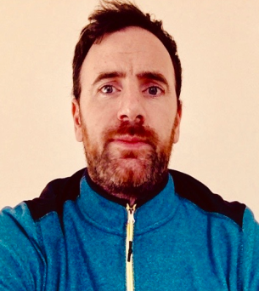
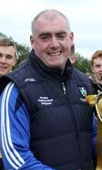
GAA Future Leaders – Regional Coordinators/Lead Tutors
Peter Beirne (South Leinster Regional Coordinator) – 1peterbeirne@gmail.com
Garrett Coyle (Ulster Regional Coordinator) – coylegarrett1@gmail.com

Slide 6
School Visit Overview
Programme Overview

Slide 7
Title: Introduction to Future Leaders
Video: Wait for video to load and then click on the screen to play
Notes:
Video Youtube Address: https://youtu.be/qy7bazG1TGQ

Slide 8
GAA Future Leaders – Course Structure
The GAA Future Leaders TY Programme is a cross-curricular programme.
The programme consists of 8 Modules.
The modules vary in length, in general they are 6 – 10 hours long.
Each module is stand alone and individually certifiable.

Slide 9
A school can choose to deliver ONE or MORE modules.
5 Modules + GAA Super Games / Go Games /
Fun & Run Blitz
=>
GAA Future Leaders Award

Slide 10
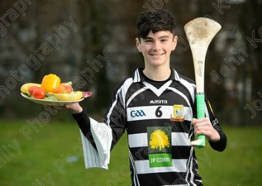
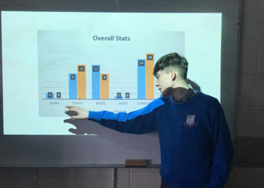
GAA Future Leaders Modules
Future Leaders FMS & Coaching of Hurling/Football Module
Future Leaders Refereeing Module
Future Leaders Administration Module
Future Leaders Sports Journalism Module
Future Leaders Performance Analysis Module
Future Leaders Nutrition Module
Future Leaders Wellbeing Module
Future Leaders Event Management Module
Pupils will receive an e-Certificate for each completed module.

Slide 11
School Visit Overview
Reflection & Gaisce
Notes:
Welcome class to the GAA Future Leaders Wellbeing Module

Slide 12
Title: Reflection
Video: Wait for video to load and then click on the screen to play
Notes:
Video Youtube Address: https://youtu.be/fk2W-TGctzk

Slide 13
Reflective Journal Vs Reflective Task
GAA Future Leaders is officially linked to Gaisce. Students using the programme to complete their Gaisce Award must make weekly entries to the Reflective Journal in their Mahara ePortfolio to log their experiences and their reflections.
The Reflective Task is at the end of each module, this is to encourage students to reflect on their learning as they go through the modules. All students must do this task.

Slide 14
End of Module Reflective Task
Reflect on your learning in this module under the following headings:
Three new things I learned were….
The most important thing I learned was… Why?
How would I rate my work a) personally and b) as part of a group, in the module? How could I improve my engagement?
How will I use what I’ve learned in the future?

Slide 15
School Visit Overview
Partnership & Shared Values
Notes:
Welcome class to the GAA Future Leaders Wellbeing Module

Slide 16
Title: Partnership & Shared Values
Video: Wait for video to load and then click on the screen to play
Notes:
Video Youtube Address: https://youtu.be/FjLdOmuW4ec

Slide 17
School Visit Overview
Leadership
Notes:
Welcome class to the GAA Future Leaders Wellbeing Module

Slide 18
Title: Leadership
Video: Wait for video to load and then click on the screen to play
Notes:
Video Youtube Address: https://youtu.be/jY-fTX5ImRM

Slide 19
Leadership Through Gaelic Games
This is a leadership course, in a GAA context. The students learn about the different roles needed in the running of a Club, team or event in the various modules, then fulfil the roles by running events related to the programme.

Slide 20
School Visit Overview
Practical Application
of Skills
& Organising an Event
Notes:
Welcome class to the GAA Future Leaders Wellbeing Module

Slide 21
Title: Practical Application of Skills
Video: Wait for video to load and then click on the screen to play
Notes:
Video Youtube Address: https://youtu.be/qhb_DE9W6pY

Slide 22
Types of Events
- Super Games Blitzes are ran by TYs for 1st & 2nd years
- Go Games Blitzes and Fun & Run are ran by TYs for Primary School pupils.

Slide 23
Students can run any event linked to any of the modules, but only the events above qualify the students for the GAA Future Leaders Award.

Slide 24
School Visit Overview
Future Leaders Committee
Notes:
Welcome class to the GAA Future Leaders Wellbeing Module

Slide 25
Practical Application of Skills Acquired
When the modules are completed the pupils hold an “AGM” and form a Future Leaders Committee.
They apply for various positions and jobs in organisation.
The Future Leaders Committee oversees the overall day to day running of the Event
They hold weekly meetings to decide who does what and when to ensure the smooth running of the Event.

Slide 26
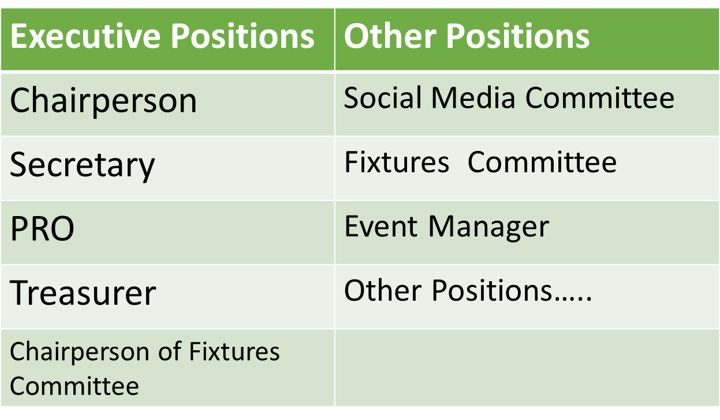
Future Leaders Committee

Slide 27
Various Event Roles & Jobs
Super Games (Event) Jobs
Team Managers | Referees / Umpires / Linesmen
Nutritionists | Performance Analysts
Journalists | Ground Staff
Photographers | Equipment Managers
Etc….

Slide 28
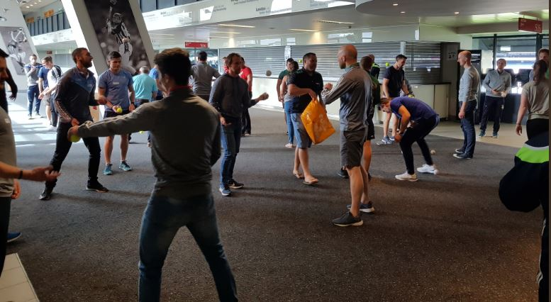
School Visit Overview
Icebreakers, Energisers, Harvesting
& Feedback
Notes:
Welcome class to the GAA Future Leaders Wellbeing Module

Slide 29
The LUNDY Model
We want students to enjoy their GAA Future Leaders classes and to know that they are learning course material in a different way to
the more conventional class.
To empower them and get them to take ownership of their learning, we need to put them at the centre of everything.

Slide 30
Use Icebreakers & Energisers
We encourage the use of icebreakers & energisers to get the pupils out of their comfort zone.
We also encourage you to get feedback from them in a variety of different ways.
There are examples of these and how to use them in the “Teacher Zone”.

Slide 31
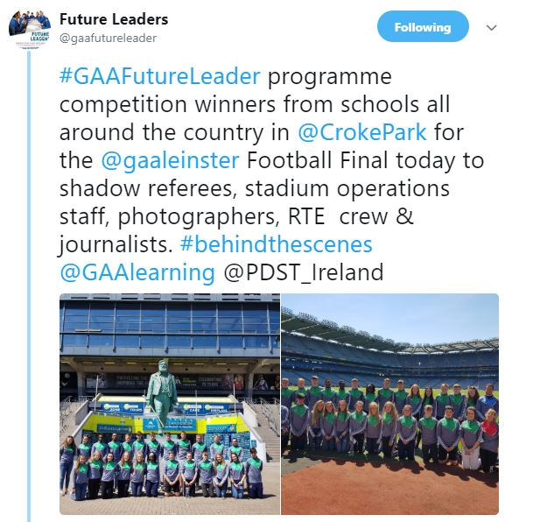
School Visit Overview
Competitions
Notes:
Welcome class to the GAA Future Leaders Wellbeing Module

Slide 32
Title: Competitions
Video: Wait for video to load and then click on the screen to play
Notes:
Video Youtube Address: https://youtu.be/yUSrbrs4fyA

Slide 33
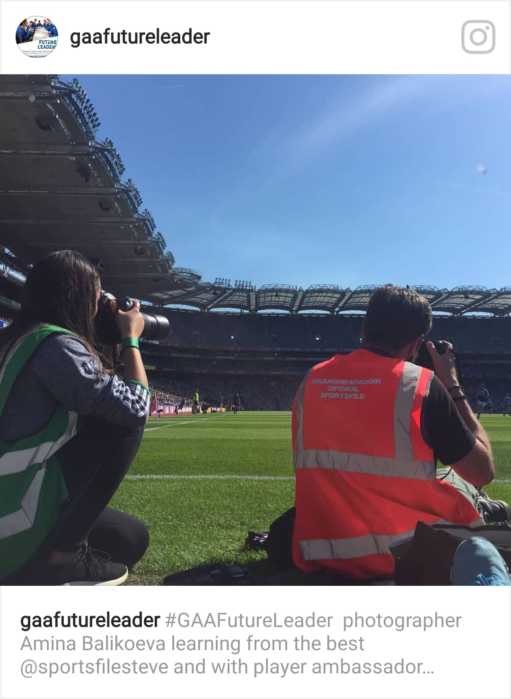
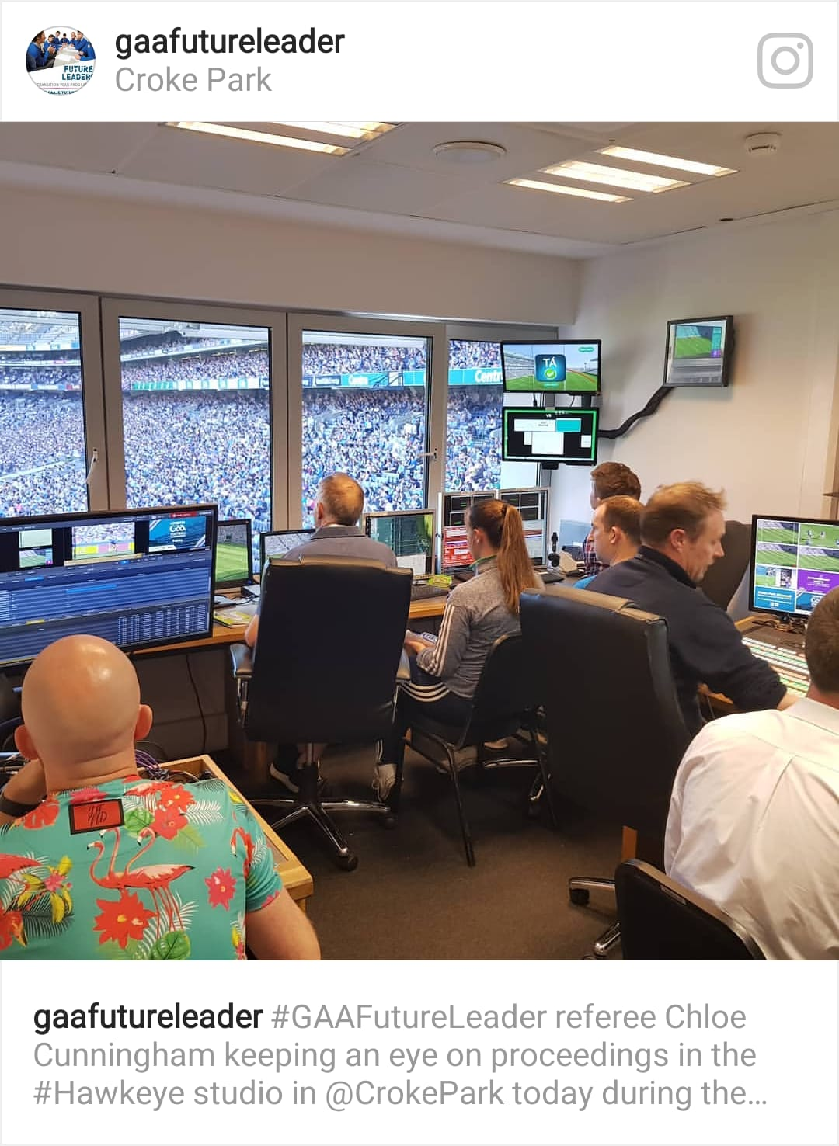
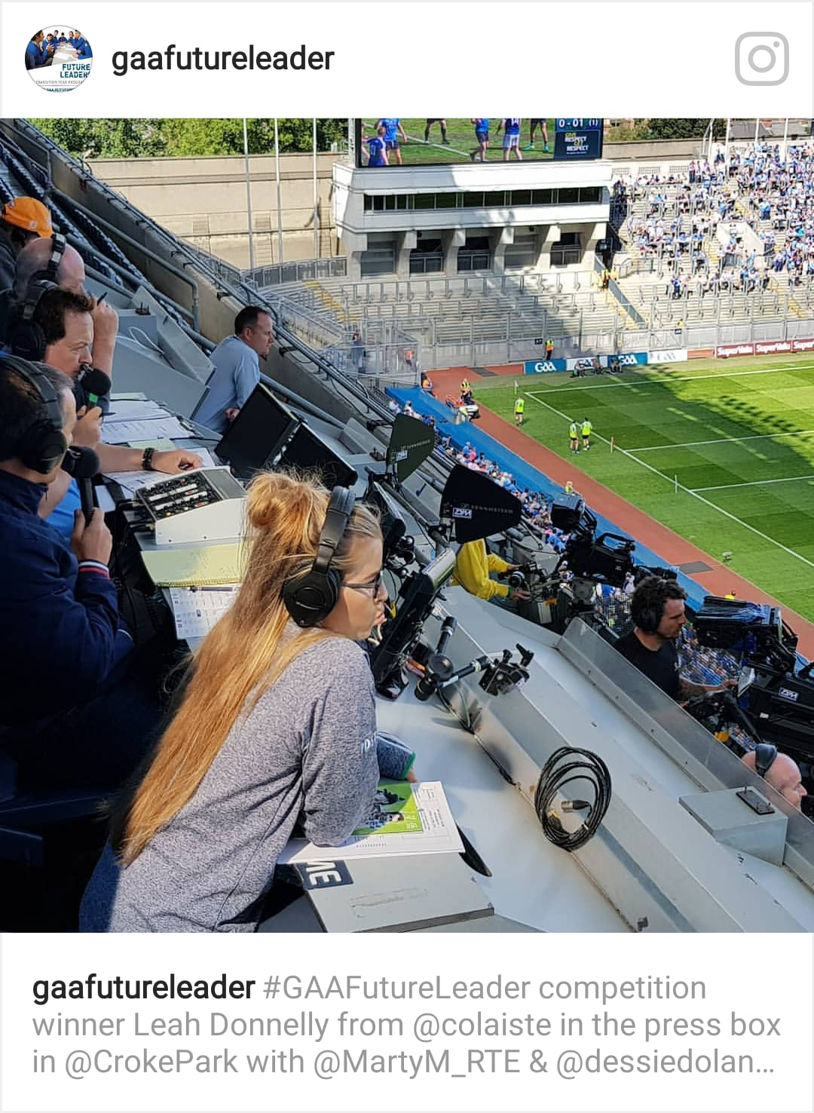
Competition Winners at the Leinster Football Final 2018 in Croke Park

Slide 34
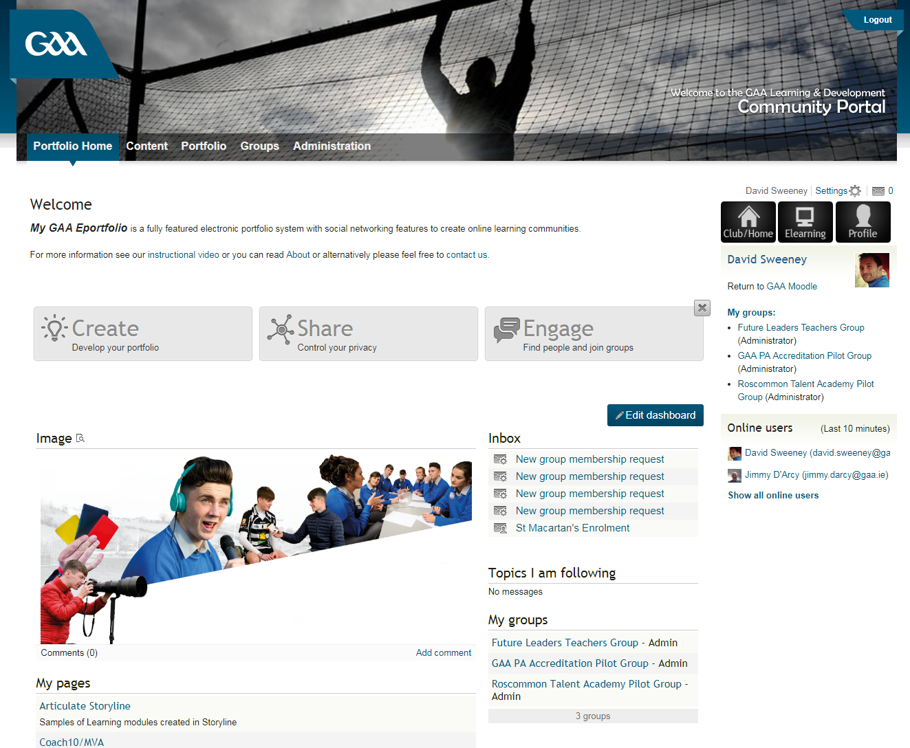
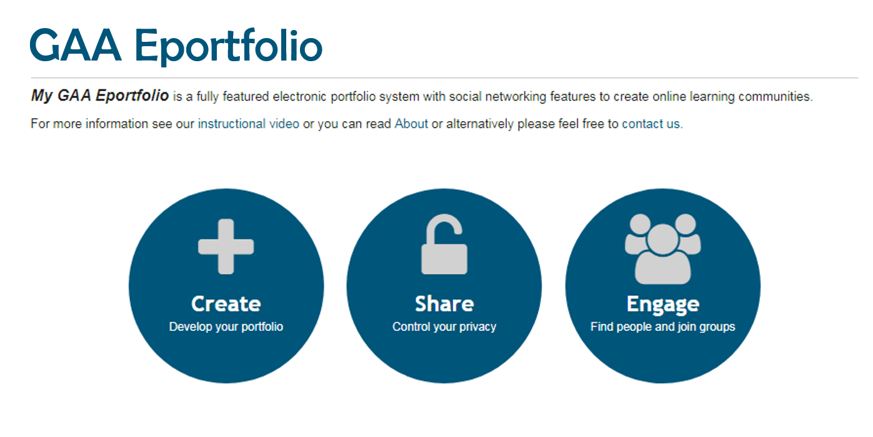
Competitions:
The winners of these competitions will be picked from the work submitted to the pupils’ e-portfolio.
Each school is entitled to one entry to each competition.
The schools GAA Future Leaders Coordinator emails the students work to;
gaafutureleaderscompetitions@gmail.com
All information will be on our website
=>=>=>=>

Slide 35
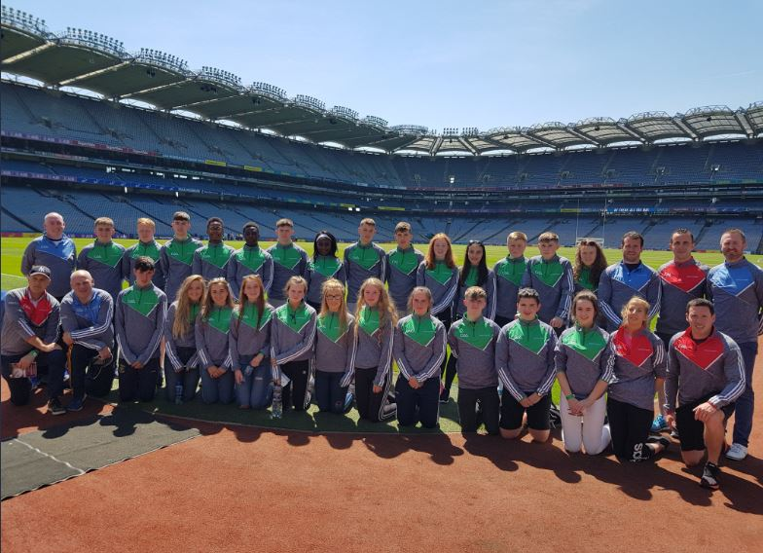
Prizes:
Leinster Hurling Final Experience 2019
Sports Journalism & Broadcasting
Shadow;
a journalist in the press box.
a Sportsfile photographer pitchside.
RTE / Sky tv crew.
Refereeing Module
Shadow the Referee & Officials for the day.
Event Management
Shadow the Stadium Operations team for the day.

Slide 36
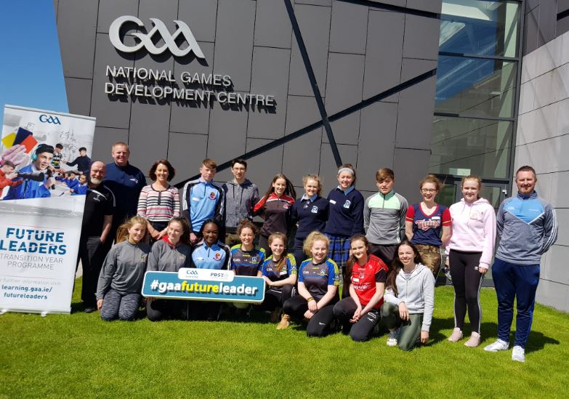
Prizes:
National Games Development Centre Workshops
Performance Analysis:
Performance Analysis workshop with Inter-county analysts.
Coaching:
Coaching workshop with Inter-county coaches and tutors.
Nutrition:
Nutrition workshop with Inter-county nutritionist.

Slide 37
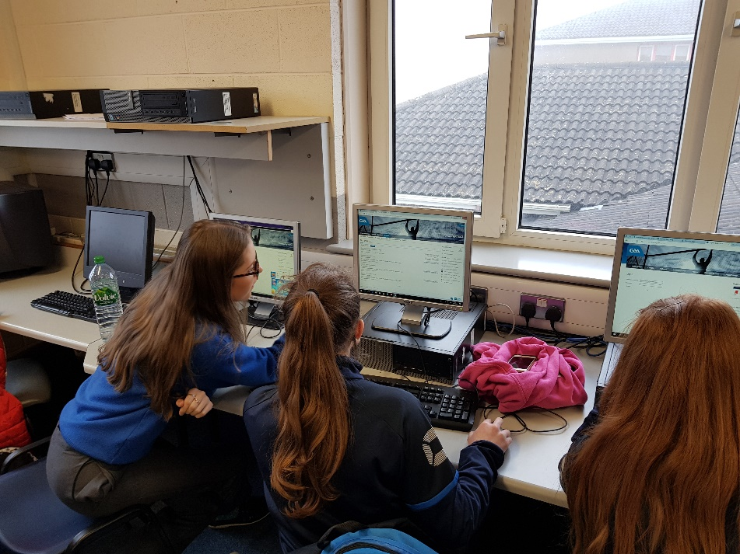
School Visit Overview
GAA Learning
School Zone & Mahara ePortfolio
Notes:
Welcome class to the GAA Future Leaders Wellbeing Module

Slide 38
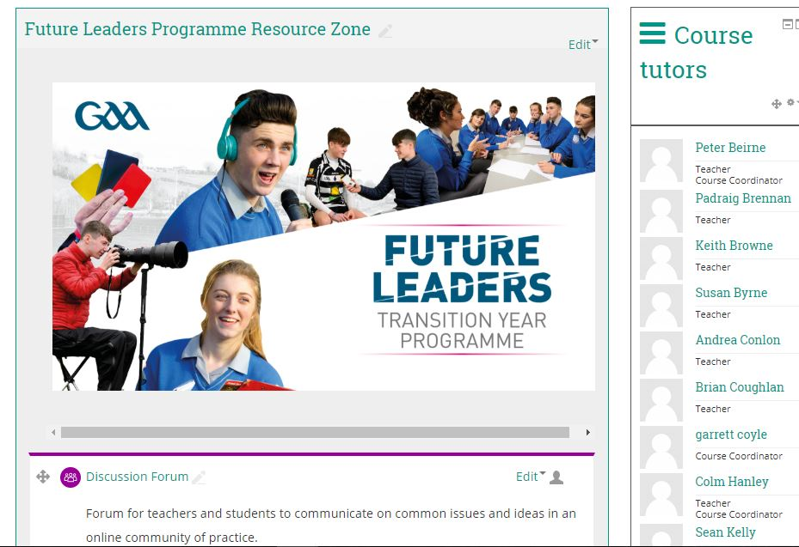
GAA Learning School Zone
Each school will have their own School Zone on learning.gaa.ie/futureleaders for Teachers and Students to access Resources

Slide 39
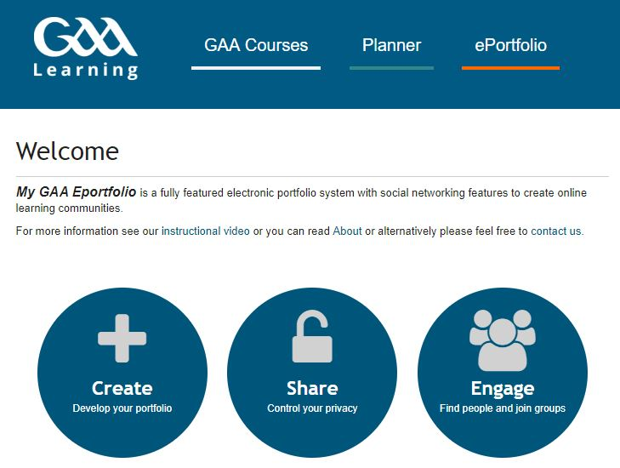
GAA Learning ePortfolio
Students create a page on their Mahara ePortfolio for each task and upload it to the School Zone for assessment.

Slide 40
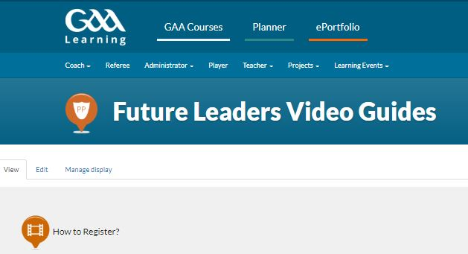
GAA Learning Video Guides
Videos are available to guide Teachers and Students through use of the School Zone and the ePortfolio
https://learning.gaa.ie/futureleaders/videoguides

Slide 41
School Visit Overview
Assessment & Certification
Notes:
Welcome class to the GAA Future Leaders Wellbeing Module

Slide 42
Tasks Vs Activities
- A task is something the students must upload for assessment and certification.
- An activity is something done in class or as homework. These do not go towards certification.
Denotes a Task

Slide 43
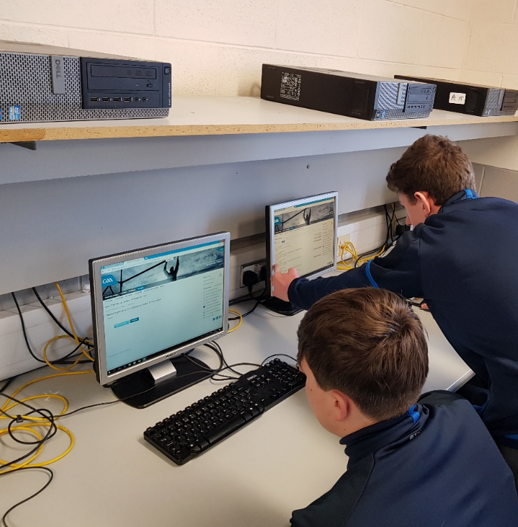
Assessment
Each pupil gets an online e-Portfolio to store and share documentation and assignments on learning.gaa.ie/futureleaders
As pupils complete tasks for each module, they upload them to their e-Portfolio to be assessed.
Pupils receive certification for each module when all the tasks are completed and submitted to Moodle.
Students receive e-Certificates for each completed module.

Slide 44
School Visit Overview
Programme Aim
Notes:
Welcome class to the GAA Future Leaders Wellbeing Module

Slide 45
Biological (Bio)
Social
Psychological (Psycho)
A Bio-Psycho-Social-Spiritual Model
The Programme is based on a Holistic Model of Health & Wellbeing
Wellbeing

Slide 46
Biological (Bio)
Social
Psychological (Psycho)
Benefits to the individual: - Responsibility
Initiative
Maturity
Inclusivity
Fosters a sense of belonging in the child
Wellbeing

Slide 47
Community
Family
Work
Education
Club membership
Biological
Social
Psychological
Benefits to Society:
There are benefits to the pupil, the school, to the local community, to the country as a whole.
Wellbeing

Slide 48
Educational Benefits:
The Programme embraces all the Key Skills of the New Junior Cycle
By engaging with the Future Leaders
Programme pupils enhance their;
Physical Literacy Skills
Digital Literacy Skills
Literacy Skills
Numeracy Skills
Presentation Skills
Communication Skills

Slide 49
Community
Family
Work
Education
Club membership
Biological
Social
Psychological
This Programme will future proof our games in towns and villages countrywide by developing capacities in young people to empower them to take ownership of the games and carry them forward for the next generation.
Wellbeing

Slide 50
Title: Empower our Future Leaders
Video: Wait for video to load and then click on the screen to play
Notes:
Video Youtube Address: https://youtu.be/gYPIMpR_xS8

Slide 51
Email & Social Media
Email: futureleaders@gaa.ie
@gaafutureleader
gaafutureleader
Website:

Slide 52
Go Raibh Maith Agaibh

