Slide 2
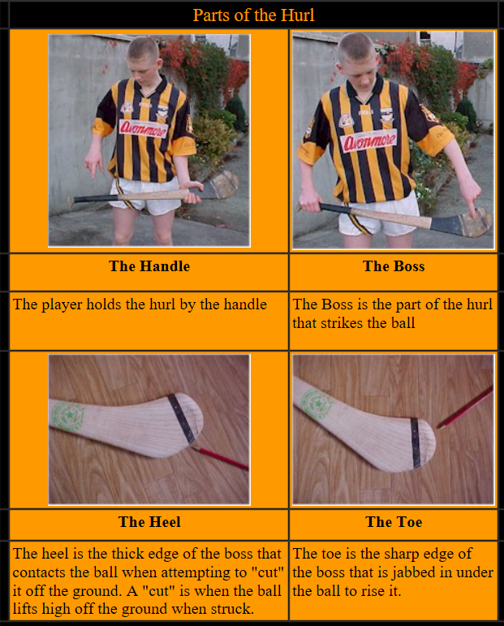
1 Parts: Parts of a Hurl
2 Grip: Correct Grip
3 Dribble
4 Strike: Ground Strike
5 Strike: Doubling on a Ground Ball
6 Strike: Striking from the Hand
7 Strike: Striking on the Run
8 Lift: Roll Lift
9 Lift: Jab Lift
10 Lift: Rising a Moving Ball
11 Hand Pass
12 Catch: Chest Catch
13 Catch: Low Catch
14 Catch: High Catch
15 Block: Blocking a Ground Ball
16 Block: Batting/Stopping a High Ball
17 Block: High Block
18 Block: Low Block
19 Block: Frontal Block
20 Snig: High Snig/Flick
21 Snig: Low Snig/Flick
22 Clash & Jostle
23 Solo: Balancing the Ball
24 Solo: Solo Run
25 Strike: Free
26 Strike: Doubling in the Air
27 Strike: Drop Puck
28 Strike: Side-line Cut
29 Tackle: Ground Tackle
30 Tackle: High Tackle
31 Hooking

Slide 3
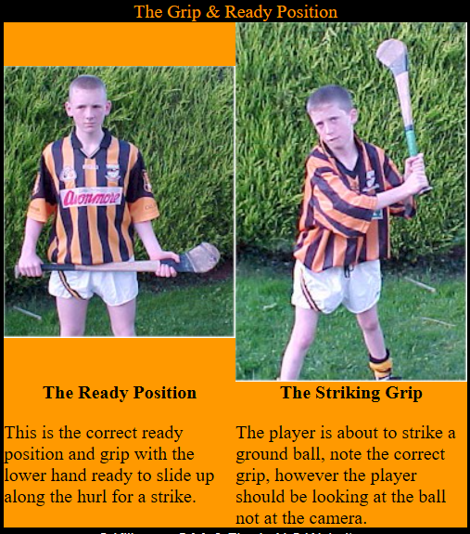
1 Parts: Parts of a Hurl
2 Grip: Correct Grip
3 Dribble
4 Strike: Ground Strike
5 Strike: Doubling on a Ground Ball
6 Strike: Striking from the Hand
7 Strike: Striking on the Run
8 Lift: Roll Lift
9 Lift: Jab Lift
10 Lift: Rising a Moving Ball
11 Hand Pass
12 Catch: Chest Catch
13 Catch: Low Catch
14 Catch: High Catch
15 Block: Blocking a Ground Ball
16 Block: Batting/Stopping a High Ball
17 Block: High Block
18 Block: Low Block
19 Block: Frontal Block
20 Snig: High Snig/Flick
21 Snig: Low Snig/Flick
22 Clash & Jostle
23 Solo: Balancing the Ball
24 Solo: Solo Run
25 Strike: Free
26 Strike: Doubling in the Air
27 Strike: Drop Puck
28 Strike: Side-line Cut
29 Tackle: Ground Tackle
30 Tackle: High Tackle
31 Hooking

Slide 4
1 Parts: Parts of a Hurl
2 Grip: Correct Grip
3 Dribble
4 Strike: Ground Strike
5 Strike: Doubling on a Ground Ball
6 Strike: Striking from the Hand
7 Strike: Striking on the Run
8 Lift: Roll Lift
9 Lift: Jab Lift
10 Lift: Rising a Moving Ball
11 Hand Pass
12 Catch: Chest Catch
13 Catch: Low Catch
14 Catch: High Catch
15 Block: Blocking a Ground Ball
16 Block: Batting/Stopping a High Ball
17 Block: High Block
18 Block: Low Block
19 Block: Frontal Block
20 Snig: High Snig/Flick
21 Snig: Low Snig/Flick
22 Clash & Jostle
23 Solo: Balancing the Ball
24 Solo: Solo Run
25 Strike: Free
26 Strike: Doubling in the Air
27 Strike: Drop Puck
28 Strike: Side-line Cut
29 Tackle: Ground Tackle
30 Tackle: High Tackle
31 Hooking

Slide 5
1 Parts: Parts of a Hurl
2 Grip: Correct Grip
3 Dribble
4 Strike: Ground Strike
5 Strike: Doubling on a Ground Ball
6 Strike: Striking from the Hand
7 Strike: Striking on the Run
8 Lift: Roll Lift
9 Lift: Jab Lift
10 Lift: Rising a Moving Ball
11 Hand Pass
12 Catch: Chest Catch
13 Catch: Low Catch
14 Catch: High Catch
15 Block: Blocking a Ground Ball
16 Block: Batting/Stopping a High Ball
17 Block: High Block
18 Block: Low Block
19 Block: Frontal Block
20 Snig: High Snig/Flick
21 Snig: Low Snig/Flick
22 Clash & Jostle
23 Solo: Balancing the Ball
24 Solo: Solo Run
25 Strike: Free
26 Strike: Doubling in the Air
27 Strike: Drop Puck
28 Strike: Side-line Cut
29 Tackle: Ground Tackle
30 Tackle: High Tackle
31 Hooking

Slide 6
1 Parts: Parts of a Hurl
2 Grip: Correct Grip
3 Dribble
4 Strike: Ground Strike
5 Strike: Doubling on a Ground Ball
6 Strike: Striking from the Hand
7 Strike: Striking on the Run
8 Lift: Roll Lift
9 Lift: Jab Lift
10 Lift: Rising a Moving Ball
11 Hand Pass
12 Catch: Chest Catch
13 Catch: Low Catch
14 Catch: High Catch
15 Block: Blocking a Ground Ball
16 Block: Batting/Stopping a High Ball
17 Block: High Block
18 Block: Low Block
19 Block: Frontal Block
20 Snig: High Snig/Flick
21 Snig: Low Snig/Flick
22 Clash & Jostle
23 Solo: Balancing the Ball
24 Solo: Solo Run
25 Strike: Free
26 Strike: Doubling in the Air
27 Strike: Drop Puck
28 Strike: Side-line Cut
29 Tackle: Ground Tackle
30 Tackle: High Tackle
31 Hooking

Slide 7
1 Parts: Parts of a Hurl
2 Grip: Correct Grip
3 Dribble
4 Strike: Ground Strike
5 Strike: Doubling on a Ground Ball
6 Strike: Striking from the Hand
7 Strike: Striking on the Run
8 Lift: Roll Lift
9 Lift: Jab Lift
10 Lift: Rising a Moving Ball
11 Hand Pass
12 Catch: Chest Catch
13 Catch: Low Catch
14 Catch: High Catch
15 Block: Blocking a Ground Ball
16 Block: Batting/Stopping a High Ball
17 Block: High Block
18 Block: Low Block
19 Block: Frontal Block
20 Snig: High Snig/Flick
21 Snig: Low Snig/Flick
22 Clash & Jostle
23 Solo: Balancing the Ball
24 Solo: Solo Run
25 Strike: Free
26 Strike: Doubling in the Air
27 Strike: Drop Puck
28 Strike: Side-line Cut
29 Tackle: Ground Tackle
30 Tackle: High Tackle
31 Hooking

Slide 8
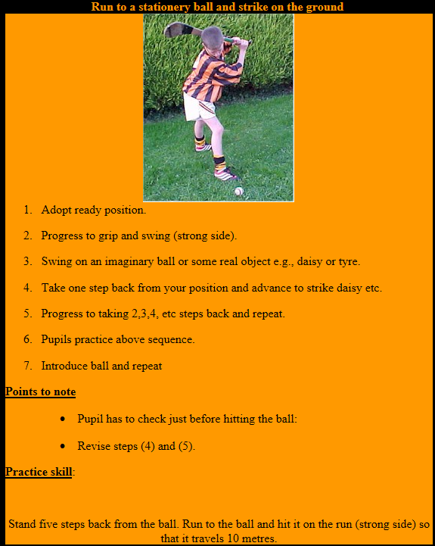
1 Parts: Parts of a Hurl
2 Grip: Correct Grip
3 Dribble
4 Strike: Ground Strike
5 Strike: Doubling on a Ground Ball
6 Strike: Striking from the Hand
7 Strike: Striking on the Run
8 Lift: Roll Lift
9 Lift: Jab Lift
10 Lift: Rising a Moving Ball
11 Hand Pass
12 Catch: Chest Catch
13 Catch: Low Catch
14 Catch: High Catch
15 Block: Blocking a Ground Ball
16 Block: Batting/Stopping a High Ball
17 Block: High Block
18 Block: Low Block
19 Block: Frontal Block
20 Snig: High Snig/Flick
21 Snig: Low Snig/Flick
22 Clash & Jostle
23 Solo: Balancing the Ball
24 Solo: Solo Run
25 Strike: Free
26 Strike: Doubling in the Air
27 Strike: Drop Puck
28 Strike: Side-line Cut
29 Tackle: Ground Tackle
30 Tackle: High Tackle
31 Hooking
Striking on the Run from the Hand

Slide 9
1 Parts: Parts of a Hurl
2 Grip: Correct Grip
3 Dribble
4 Strike: Ground Strike
5 Strike: Doubling on a Ground Ball
6 Strike: Striking from the Hand
7 Strike: Striking on the Run
8 Lift: Roll Lift
9 Lift: Jab Lift
10 Lift: Rising a Moving Ball
11 Hand Pass
12 Catch: Chest Catch
13 Catch: Low Catch
14 Catch: High Catch
15 Block: Blocking a Ground Ball
16 Block: Batting/Stopping a High Ball
17 Block: High Block
18 Block: Low Block
19 Block: Frontal Block
20 Snig: High Snig/Flick
21 Snig: Low Snig/Flick
22 Clash & Jostle
23 Solo: Balancing the Ball
24 Solo: Solo Run
25 Strike: Free
26 Strike: Doubling in the Air
27 Strike: Drop Puck
28 Strike: Side-line Cut
29 Tackle: Ground Tackle
30 Tackle: High Tackle
31 Hooking

Slide 10
1 Parts: Parts of a Hurl
2 Grip: Correct Grip
3 Dribble
4 Strike: Ground Strike
5 Strike: Doubling on a Ground Ball
6 Strike: Striking from the Hand
7 Strike: Striking on the Run
8 Lift: Roll Lift
9 Lift: Jab Lift
10 Lift: Rising a Moving Ball
11 Hand Pass
12 Catch: Chest Catch
13 Catch: Low Catch
14 Catch: High Catch
15 Block: Blocking a Ground Ball
16 Block: Batting/Stopping a High Ball
17 Block: High Block
18 Block: Low Block
19 Block: Frontal Block
20 Snig: High Snig/Flick
21 Snig: Low Snig/Flick
22 Clash & Jostle
23 Solo: Balancing the Ball
24 Solo: Solo Run
25 Strike: Free
26 Strike: Doubling in the Air
27 Strike: Drop Puck
28 Strike: Side-line Cut
29 Tackle: Ground Tackle
30 Tackle: High Tackle
31 Hooking

Slide 11
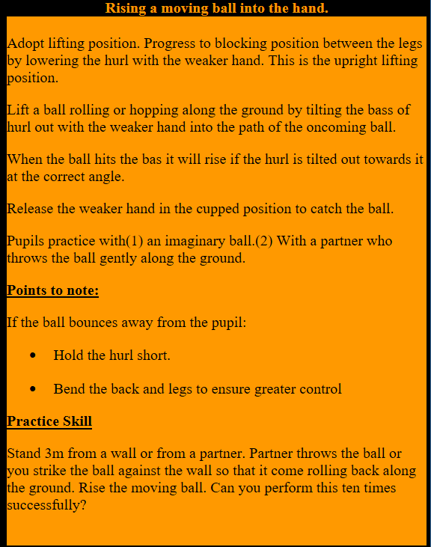
1 Parts: Parts of a Hurl
2 Grip: Correct Grip
3 Dribble
4 Strike: Ground Strike
5 Strike: Doubling on a Ground Ball
6 Strike: Striking from the Hand
7 Strike: Striking on the Run
8 Lift: Roll Lift
9 Lift: Jab Lift
10 Lift: Rising a Moving Ball
11 Hand Pass
12 Catch: Chest Catch
13 Catch: Low Catch
14 Catch: High Catch
15 Block: Blocking a Ground Ball
16 Block: Batting/Stopping a High Ball
17 Block: High Block
18 Block: Low Block
19 Block: Frontal Block
20 Snig: High Snig/Flick
21 Snig: Low Snig/Flick
22 Clash & Jostle
23 Solo: Balancing the Ball
24 Solo: Solo Run
25 Strike: Free
26 Strike: Doubling in the Air
27 Strike: Drop Puck
28 Strike: Side-line Cut
29 Tackle: Ground Tackle
30 Tackle: High Tackle
31 Hooking

Slide 12
1 Parts: Parts of a Hurl
2 Grip: Correct Grip
3 Dribble
4 Strike: Ground Strike
5 Strike: Doubling on a Ground Ball
6 Strike: Striking from the Hand
7 Strike: Striking on the Run
8 Lift: Roll Lift
9 Lift: Jab Lift
10 Lift: Rising a Moving Ball
11 Hand Pass
12 Catch: Chest Catch
13 Catch: Low Catch
14 Catch: High Catch
15 Block: Blocking a Ground Ball
16 Block: Batting/Stopping a High Ball
17 Block: High Block
18 Block: Low Block
19 Block: Frontal Block
20 Snig: High Snig/Flick
21 Snig: Low Snig/Flick
22 Clash & Jostle
23 Solo: Balancing the Ball
24 Solo: Solo Run
25 Strike: Free
26 Strike: Doubling in the Air
27 Strike: Drop Puck
28 Strike: Side-line Cut
29 Tackle: Ground Tackle
30 Tackle: High Tackle
31 Hooking

Slide 13
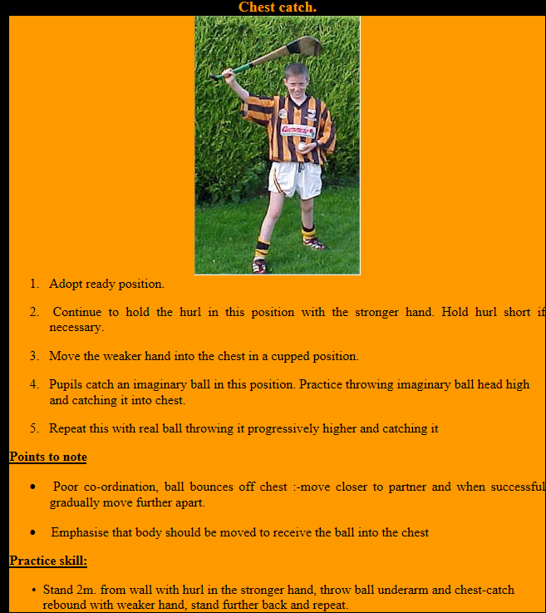
1 Parts: Parts of a Hurl
2 Grip: Correct Grip
3 Dribble
4 Strike: Ground Strike
5 Strike: Doubling on a Ground Ball
6 Strike: Striking from the Hand
7 Strike: Striking on the Run
8 Lift: Roll Lift
9 Lift: Jab Lift
10 Lift: Rising a Moving Ball
11 Hand Pass
12 Catch: Chest Catch
13 Catch: Low Catch
14 Catch: High Catch
15 Block: Blocking a Ground Ball
16 Block: Batting/Stopping a High Ball
17 Block: High Block
18 Block: Low Block
19 Block: Frontal Block
20 Snig: High Snig/Flick
21 Snig: Low Snig/Flick
22 Clash & Jostle
23 Solo: Balancing the Ball
24 Solo: Solo Run
25 Strike: Free
26 Strike: Doubling in the Air
27 Strike: Drop Puck
28 Strike: Side-line Cut
29 Tackle: Ground Tackle
30 Tackle: High Tackle
31 Hooking

Slide 14
1 Parts: Parts of a Hurl
2 Grip: Correct Grip
3 Dribble
4 Strike: Ground Strike
5 Strike: Doubling on a Ground Ball
6 Strike: Striking from the Hand
7 Strike: Striking on the Run
8 Lift: Roll Lift
9 Lift: Jab Lift
10 Lift: Rising a Moving Ball
11 Hand Pass
12 Catch: Chest Catch
13 Catch: Low Catch
14 Catch: High Catch
15 Block: Blocking a Ground Ball
16 Block: Batting/Stopping a High Ball
17 Block: High Block
18 Block: Low Block
19 Block: Frontal Block
20 Snig: High Snig/Flick
21 Snig: Low Snig/Flick
22 Clash & Jostle
23 Solo: Balancing the Ball
24 Solo: Solo Run
25 Strike: Free
26 Strike: Doubling in the Air
27 Strike: Drop Puck
28 Strike: Side-line Cut
29 Tackle: Ground Tackle
30 Tackle: High Tackle
31 Hooking

Slide 15
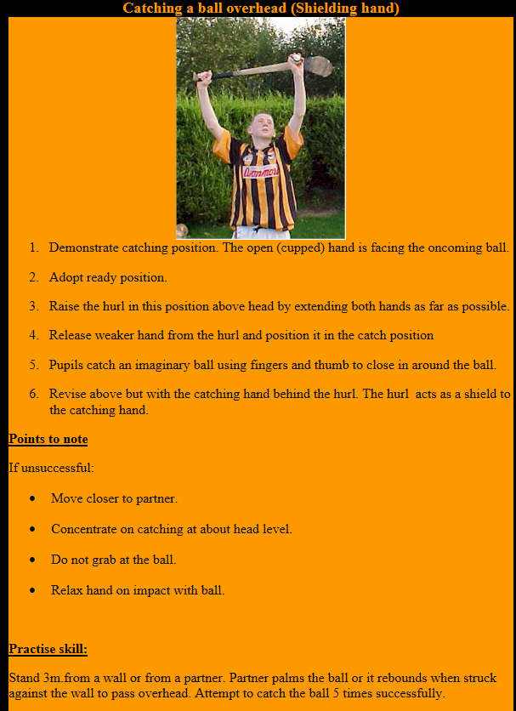
1 Parts: Parts of a Hurl
2 Grip: Correct Grip
3 Dribble
4 Strike: Ground Strike
5 Strike: Doubling on a Ground Ball
6 Strike: Striking from the Hand
7 Strike: Striking on the Run
8 Lift: Roll Lift
9 Lift: Jab Lift
10 Lift: Rising a Moving Ball
11 Hand Pass
12 Catch: Chest Catch
13 Catch: Low Catch
14 Catch: High Catch
15 Block: Blocking a Ground Ball
16 Block: Batting/Stopping a High Ball
17 Block: High Block
18 Block: Low Block
19 Block: Frontal Block
20 Snig: High Snig/Flick
21 Snig: Low Snig/Flick
22 Clash & Jostle
23 Solo: Balancing the Ball
24 Solo: Solo Run
25 Strike: Free
26 Strike: Doubling in the Air
27 Strike: Drop Puck
28 Strike: Side-line Cut
29 Tackle: Ground Tackle
30 Tackle: High Tackle
31 Hooking

Slide 16
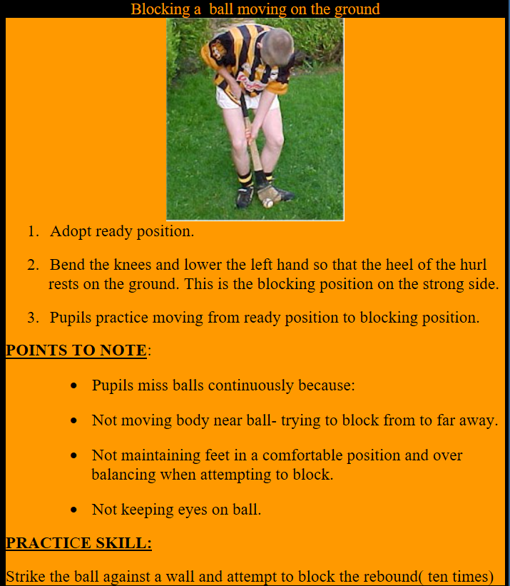
1 Parts: Parts of a Hurl
2 Grip: Correct Grip
3 Dribble
4 Strike: Ground Strike
5 Strike: Doubling on a Ground Ball
6 Strike: Striking from the Hand
7 Strike: Striking on the Run
8 Lift: Roll Lift
9 Lift: Jab Lift
10 Lift: Rising a Moving Ball
11 Hand Pass
12 Catch: Chest Catch
13 Catch: Low Catch
14 Catch: High Catch
15 Block: Blocking a Ground Ball
16 Block: Batting/Stopping a High Ball
17 Block: High Block
18 Block: Low Block
19 Block: Frontal Block
20 Snig: High Snig/Flick
21 Snig: Low Snig/Flick
22 Clash & Jostle
23 Solo: Balancing the Ball
24 Solo: Solo Run
25 Strike: Free
26 Strike: Doubling in the Air
27 Strike: Drop Puck
28 Strike: Side-line Cut
29 Tackle: Ground Tackle
30 Tackle: High Tackle
31 Hooking

Slide 17
1 Parts: Parts of a Hurl
2 Grip: Correct Grip
3 Dribble
4 Strike: Ground Strike
5 Strike: Doubling on a Ground Ball
6 Strike: Striking from the Hand
7 Strike: Striking on the Run
8 Lift: Roll Lift
9 Lift: Jab Lift
10 Lift: Rising a Moving Ball
11 Hand Pass
12 Catch: Chest Catch
13 Catch: Low Catch
14 Catch: High Catch
15 Block: Blocking a Ground Ball
16 Block: Batting/Stopping a High Ball
17 Block: High Block
18 Block: Low Block
19 Block: Frontal Block
20 Snig: High Snig/Flick
21 Snig: Low Snig/Flick
22 Clash & Jostle
23 Solo: Balancing the Ball
24 Solo: Solo Run
25 Strike: Free
26 Strike: Doubling in the Air
27 Strike: Drop Puck
28 Strike: Side-line Cut
29 Tackle: Ground Tackle
30 Tackle: High Tackle
31 Hooking
Batting
Blocking
Stopping

Slide 18
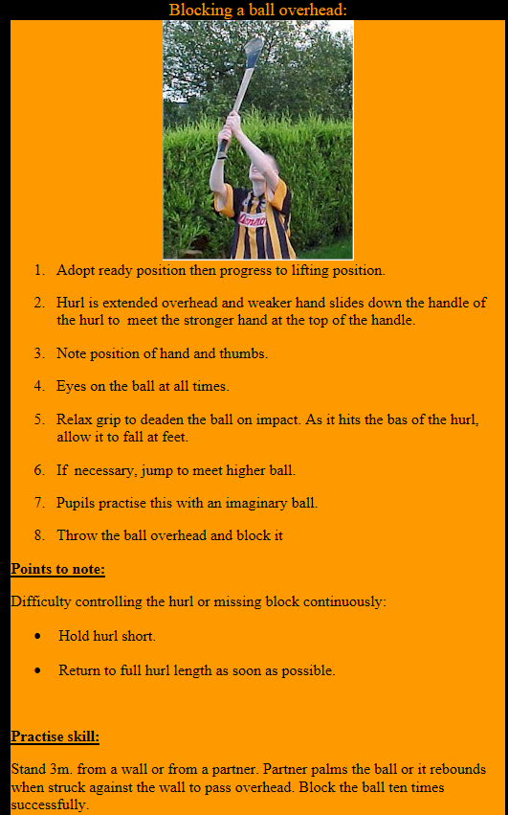
1 Parts: Parts of a Hurl
2 Grip: Correct Grip
3 Dribble
4 Strike: Ground Strike
5 Strike: Doubling on a Ground Ball
6 Strike: Striking from the Hand
7 Strike: Striking on the Run
8 Lift: Roll Lift
9 Lift: Jab Lift
10 Lift: Rising a Moving Ball
11 Hand Pass
12 Catch: Chest Catch
13 Catch: Low Catch
14 Catch: High Catch
15 Block: Blocking a Ground Ball
16 Block: Batting/Stopping a High Ball
17 Block: High Block
18 Block: Low Block
19 Block: Frontal Block
20 Snig: High Snig/Flick
21 Snig: Low Snig/Flick
22 Clash & Jostle
23 Solo: Balancing the Ball
24 Solo: Solo Run
25 Strike: Free
26 Strike: Doubling in the Air
27 Strike: Drop Puck
28 Strike: Side-line Cut
29 Tackle: Ground Tackle
30 Tackle: High Tackle
31 Hooking

Slide 19
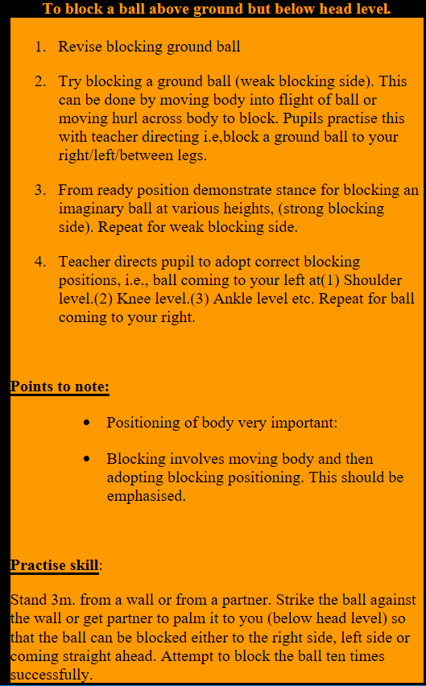
1 Parts: Parts of a Hurl
2 Grip: Correct Grip
3 Dribble
4 Strike: Ground Strike
5 Strike: Doubling on a Ground Ball
6 Strike: Striking from the Hand
7 Strike: Striking on the Run
8 Lift: Roll Lift
9 Lift: Jab Lift
10 Lift: Rising a Moving Ball
11 Hand Pass
12 Catch: Chest Catch
13 Catch: Low Catch
14 Catch: High Catch
15 Block: Blocking a Ground Ball
16 Block: Batting/Stopping a High Ball
17 Block: High Block
18 Block: Low Block
19 Block: Frontal Block
20 Snig: High Snig/Flick
21 Snig: Low Snig/Flick
22 Clash & Jostle
23 Solo: Balancing the Ball
24 Solo: Solo Run
25 Strike: Free
26 Strike: Doubling in the Air
27 Strike: Drop Puck
28 Strike: Side-line Cut
29 Tackle: Ground Tackle
30 Tackle: High Tackle
31 Hooking

Slide 20
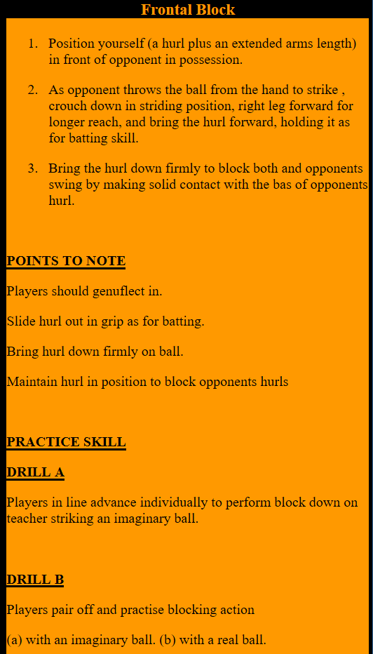
1 Parts: Parts of a Hurl
2 Grip: Correct Grip
3 Dribble
4 Strike: Ground Strike
5 Strike: Doubling on a Ground Ball
6 Strike: Striking from the Hand
7 Strike: Striking on the Run
8 Lift: Roll Lift
9 Lift: Jab Lift
10 Lift: Rising a Moving Ball
11 Hand Pass
12 Catch: Chest Catch
13 Catch: Low Catch
14 Catch: High Catch
15 Block: Blocking a Ground Ball
16 Block: Batting/Stopping a High Ball
17 Block: High Block
18 Block: Low Block
19 Block: Frontal Block
20 Snig: High Snig/Flick
21 Snig: Low Snig/Flick
22 Clash & Jostle
23 Solo: Balancing the Ball
24 Solo: Solo Run
25 Strike: Free
26 Strike: Doubling in the Air
27 Strike: Drop Puck
28 Strike: Side-line Cut
29 Tackle: Ground Tackle
30 Tackle: High Tackle
31 Hooking
Blocking a ball that your opponent is Striking

Slide 21
1 Parts: Parts of a Hurl
2 Grip: Correct Grip
3 Dribble
4 Strike: Ground Strike
5 Strike: Doubling on a Ground Ball
6 Strike: Striking from the Hand
7 Strike: Striking on the Run
8 Lift: Roll Lift
9 Lift: Jab Lift
10 Lift: Rising a Moving Ball
11 Hand Pass
12 Catch: Chest Catch
13 Catch: Low Catch
14 Catch: High Catch
15 Block: Blocking a Ground Ball
16 Block: Batting/Stopping a High Ball
17 Block: High Block
18 Block: Low Block
19 Block: Frontal Block
20 Snig: High Snig/Flick
21 Snig: Low Snig/Flick
22 Clash & Jostle
23 Solo: Balancing the Ball
24 Solo: Solo Run
25 Strike: Free
26 Strike: Doubling in the Air
27 Strike: Drop Puck
28 Strike: Side-line Cut
29 Tackle: Ground Tackle
30 Tackle: High Tackle
31 Hooking

Slide 22
1 Parts: Parts of a Hurl
2 Grip: Correct Grip
3 Dribble
4 Strike: Ground Strike
5 Strike: Doubling on a Ground Ball
6 Strike: Striking from the Hand
7 Strike: Striking on the Run
8 Lift: Roll Lift
9 Lift: Jab Lift
10 Lift: Rising a Moving Ball
11 Hand Pass
12 Catch: Chest Catch
13 Catch: Low Catch
14 Catch: High Catch
15 Block: Blocking a Ground Ball
16 Block: Batting/Stopping a High Ball
17 Block: High Block
18 Block: Low Block
19 Block: Frontal Block
20 Snig: High Snig/Flick
21 Snig: Low Snig/Flick
22 Clash & Jostle
23 Solo: Balancing the Ball
24 Solo: Solo Run
25 Strike: Free
26 Strike: Doubling in the Air
27 Strike: Drop Puck
28 Strike: Side-line Cut
29 Tackle: Ground Tackle
30 Tackle: High Tackle
31 Hooking

Slide 23
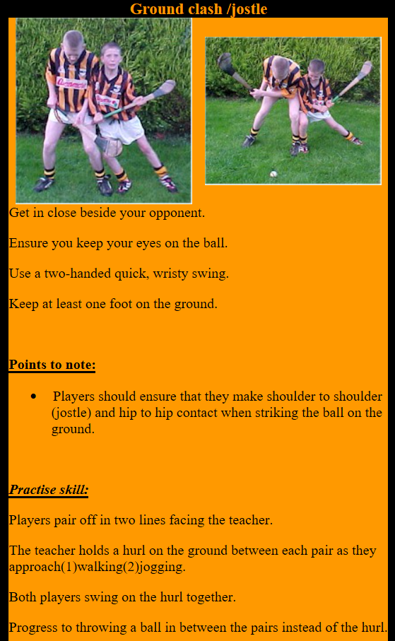
1 Parts: Parts of a Hurl
2 Grip: Correct Grip
3 Dribble
4 Strike: Ground Strike
5 Strike: Doubling on a Ground Ball
6 Strike: Striking from the Hand
7 Strike: Striking on the Run
8 Lift: Roll Lift
9 Lift: Jab Lift
10 Lift: Rising a Moving Ball
11 Hand Pass
12 Catch: Chest Catch
13 Catch: Low Catch
14 Catch: High Catch
15 Block: Blocking a Ground Ball
16 Block: Batting/Stopping a High Ball
17 Block: High Block
18 Block: Low Block
19 Block: Frontal Block
20 Snig: High Snig/Flick
21 Snig: Low Snig/Flick
22 Clash & Jostle
23 Solo: Balancing the Ball
24 Solo: Solo Run
25 Strike: Free
26 Strike: Doubling in the Air
27 Strike: Drop Puck
28 Strike: Side-line Cut
29 Tackle: Ground Tackle
30 Tackle: High Tackle
31 Hooking
Clash of the Ash
Jostle

Slide 24
1 Parts: Parts of a Hurl
2 Grip: Correct Grip
3 Dribble
4 Strike: Ground Strike
5 Strike: Doubling on a Ground Ball
6 Strike: Striking from the Hand
7 Strike: Striking on the Run
8 Lift: Roll Lift
9 Lift: Jab Lift
10 Lift: Rising a Moving Ball
11 Hand Pass
12 Catch: Chest Catch
13 Catch: Low Catch
14 Catch: High Catch
15 Block: Blocking a Ground Ball
16 Block: Batting/Stopping a High Ball
17 Block: High Block
18 Block: Low Block
19 Block: Frontal Block
20 Snig: High Snig/Flick
21 Snig: Low Snig/Flick
22 Clash & Jostle
23 Solo: Balancing the Ball
24 Solo: Solo Run
25 Strike: Free
26 Strike: Doubling in the Air
27 Strike: Drop Puck
28 Strike: Side-line Cut
29 Tackle: Ground Tackle
30 Tackle: High Tackle
31 Hooking

Slide 25
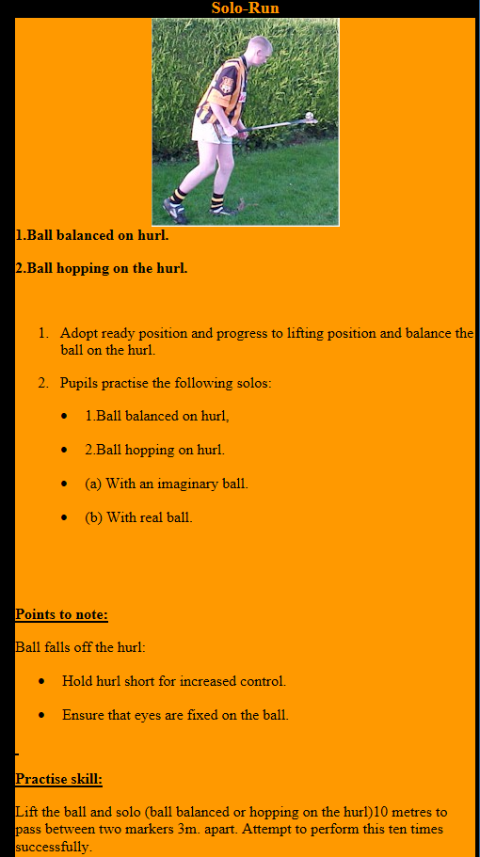
1 Parts: Parts of a Hurl
2 Grip: Correct Grip
3 Dribble
4 Strike: Ground Strike
5 Strike: Doubling on a Ground Ball
6 Strike: Striking from the Hand
7 Strike: Striking on the Run
8 Lift: Roll Lift
9 Lift: Jab Lift
10 Lift: Rising a Moving Ball
11 Hand Pass
12 Catch: Chest Catch
13 Catch: Low Catch
14 Catch: High Catch
15 Block: Blocking a Ground Ball
16 Block: Batting/Stopping a High Ball
17 Block: High Block
18 Block: Low Block
19 Block: Frontal Block
20 Snig: High Snig/Flick
21 Snig: Low Snig/Flick
22 Clash & Jostle
23 Solo: Balancing the Ball
24 Solo: Solo Run
25 Strike: Free
26 Strike: Doubling in the Air
27 Strike: Drop Puck
28 Strike: Side-line Cut
29 Tackle: Ground Tackle
30 Tackle: High Tackle
31 Hooking

Slide 26
1 Parts: Parts of a Hurl
2 Grip: Correct Grip
3 Dribble
4 Strike: Ground Strike
5 Strike: Doubling on a Ground Ball
6 Strike: Striking from the Hand
7 Strike: Striking on the Run
8 Lift: Roll Lift
9 Lift: Jab Lift
10 Lift: Rising a Moving Ball
11 Hand Pass
12 Catch: Chest Catch
13 Catch: Low Catch
14 Catch: High Catch
15 Block: Blocking a Ground Ball
16 Block: Batting/Stopping a High Ball
17 Block: High Block
18 Block: Low Block
19 Block: Frontal Block
20 Snig: High Snig/Flick
21 Snig: Low Snig/Flick
22 Clash & Jostle
23 Solo: Balancing the Ball
24 Solo: Solo Run
25 Strike: Free
26 Strike: Doubling in the Air
27 Strike: Drop Puck
28 Strike: Side-line Cut
29 Tackle: Ground Tackle
30 Tackle: High Tackle
31 Hooking

Slide 27
1 Parts: Parts of a Hurl
2 Grip: Correct Grip
3 Dribble
4 Strike: Ground Strike
5 Strike: Doubling on a Ground Ball
6 Strike: Striking from the Hand
7 Strike: Striking on the Run
8 Lift: Roll Lift
9 Lift: Jab Lift
10 Lift: Rising a Moving Ball
11 Hand Pass
12 Catch: Chest Catch
13 Catch: Low Catch
14 Catch: High Catch
15 Block: Blocking a Ground Ball
16 Block: Batting/Stopping a High Ball
17 Block: High Block
18 Block: Low Block
19 Block: Frontal Block
20 Snig: High Snig/Flick
21 Snig: Low Snig/Flick
22 Clash & Jostle
23 Solo: Balancing the Ball
24 Solo: Solo Run
25 Strike: Free
26 Strike: Doubling in the Air
27 Strike: Drop Puck
28 Strike: Side-line Cut
29 Tackle: Ground Tackle
30 Tackle: High Tackle
31 Hooking

Slide 28
1 Parts: Parts of a Hurl
2 Grip: Correct Grip
3 Dribble
4 Strike: Ground Strike
5 Strike: Doubling on a Ground Ball
6 Strike: Striking from the Hand
7 Strike: Striking on the Run
8 Lift: Roll Lift
9 Lift: Jab Lift
10 Lift: Rising a Moving Ball
11 Hand Pass
12 Catch: Chest Catch
13 Catch: Low Catch
14 Catch: High Catch
15 Block: Blocking a Ground Ball
16 Block: Batting/Stopping a High Ball
17 Block: High Block
18 Block: Low Block
19 Block: Frontal Block
20 Snig: High Snig/Flick
21 Snig: Low Snig/Flick
22 Clash & Jostle
23 Solo: Balancing the Ball
24 Solo: Solo Run
25 Strike: Free
26 Strike: Doubling in the Air
27 Strike: Drop Puck
28 Strike: Side-line Cut
29 Tackle: Ground Tackle
30 Tackle: High Tackle
31 Hooking

Slide 29
1 Parts: Parts of a Hurl
2 Grip: Correct Grip
3 Dribble
4 Strike: Ground Strike
5 Strike: Doubling on a Ground Ball
6 Strike: Striking from the Hand
7 Strike: Striking on the Run
8 Lift: Roll Lift
9 Lift: Jab Lift
10 Lift: Rising a Moving Ball
11 Hand Pass
12 Catch: Chest Catch
13 Catch: Low Catch
14 Catch: High Catch
15 Block: Blocking a Ground Ball
16 Block: Batting/Stopping a High Ball
17 Block: High Block
18 Block: Low Block
19 Block: Frontal Block
20 Snig: High Snig/Flick
21 Snig: Low Snig/Flick
22 Clash & Jostle
23 Solo: Balancing the Ball
24 Solo: Solo Run
25 Strike: Free
26 Strike: Doubling in the Air
27 Strike: Drop Puck
28 Strike: Side-line Cut
29 Tackle: Ground Tackle
30 Tackle: High Tackle
31 Hooking

Slide 30
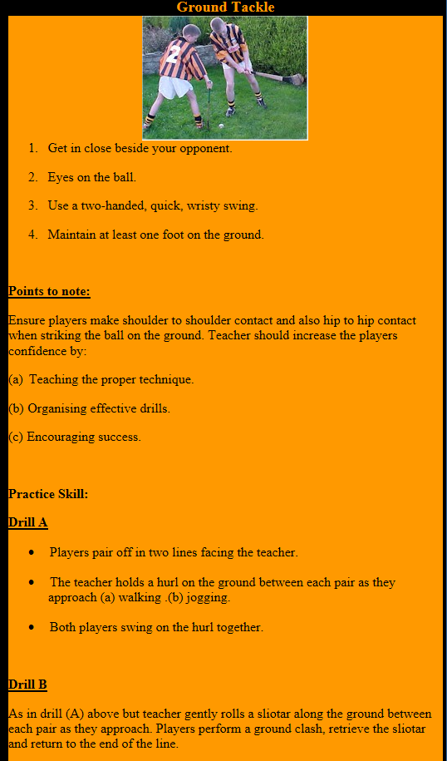
1 Parts: Parts of a Hurl
2 Grip: Correct Grip
3 Dribble
4 Strike: Ground Strike
5 Strike: Doubling on a Ground Ball
6 Strike: Striking from the Hand
7 Strike: Striking on the Run
8 Lift: Roll Lift
9 Lift: Jab Lift
10 Lift: Rising a Moving Ball
11 Hand Pass
12 Catch: Chest Catch
13 Catch: Low Catch
14 Catch: High Catch
15 Block: Blocking a Ground Ball
16 Block: Batting/Stopping a High Ball
17 Block: High Block
18 Block: Low Block
19 Block: Frontal Block
20 Snig: High Snig/Flick
21 Snig: Low Snig/Flick
22 Clash & Jostle
23 Solo: Balancing the Ball
24 Solo: Solo Run
25 Strike: Free
26 Strike: Doubling in the Air
27 Strike: Drop Puck
28 Strike: Side-line Cut
29 Tackle: Ground Tackle
30 Tackle: High Tackle
31 Hooking

Slide 31
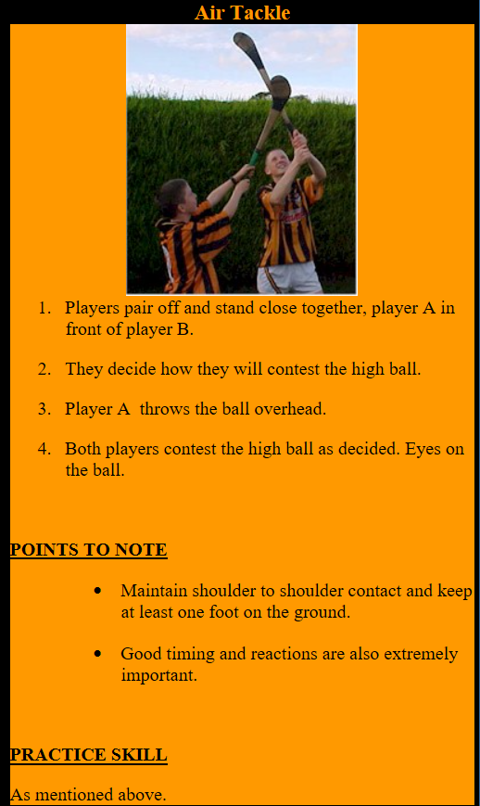
1 Parts: Parts of a Hurl
2 Grip: Correct Grip
3 Dribble
4 Strike: Ground Strike
5 Strike: Doubling on a Ground Ball
6 Strike: Striking from the Hand
7 Strike: Striking on the Run
8 Lift: Roll Lift
9 Lift: Jab Lift
10 Lift: Rising a Moving Ball
11 Hand Pass
12 Catch: Chest Catch
13 Catch: Low Catch
14 Catch: High Catch
15 Block: Blocking a Ground Ball
16 Block: Batting/Stopping a High Ball
17 Block: High Block
18 Block: Low Block
19 Block: Frontal Block
20 Snig: High Snig/Flick
21 Snig: Low Snig/Flick
22 Clash & Jostle
23 Solo: Balancing the Ball
24 Solo: Solo Run
25 Strike: Free
26 Strike: Doubling in the Air
27 Strike: Drop Puck
28 Strike: Side-line Cut
29 Tackle: Ground Tackle
30 Tackle: High Tackle
31 Hooking

Slide 32
1 Parts: Parts of a Hurl
2 Grip: Correct Grip
3 Dribble
4 Strike: Ground Strike
5 Strike: Doubling on a Ground Ball
6 Strike: Striking from the Hand
7 Strike: Striking on the Run
8 Lift: Roll Lift
9 Lift: Jab Lift
10 Lift: Rising a Moving Ball
11 Hand Pass
12 Catch: Chest Catch
13 Catch: Low Catch
14 Catch: High Catch
15 Block: Blocking a Ground Ball
16 Block: Batting/Stopping a High Ball
17 Block: High Block
18 Block: Low Block
19 Block: Frontal Block
20 Snig: High Snig/Flick
21 Snig: Low Snig/Flick
22 Clash & Jostle
23 Solo: Balancing the Ball
24 Solo: Solo Run
25 Strike: Free
26 Strike: Doubling in the Air
27 Strike: Drop Puck
28 Strike: Side-line Cut
29 Tackle: Ground Tackle
30 Tackle: High Tackle
31 Hooking

