Slide 1
Moving Well-Being Well Classroom Activity Tutorial
Teacher’s Guide

Slide 2
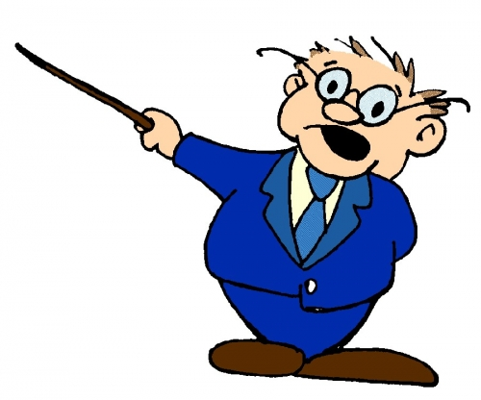
Outline
This short presentation is just a short guide into helping you understand the classroom activity PowerPoint.
There are 8 weeks in total with 1 activity to be done each day! However, you can chose to do it as many times as you like per day!
The aim of the activity is to get kids up and active during the day where they would usually be sitting for quite a long period of time!

Slide 3
Why do it?
The classroom activities play an integral part in the intervention! Each activity you do each day will focus on one of the key Fundamental Movement Skills that the kids will be doing in their PE class.
Not only that but research has shown that after doing the short classroom activity and being up and active for a few minutes, students behaviour in class improved, they were more focused and also more engaged in class.
We have found it to be great when used as a transition from one subject to another! It breaks up the lesson and allows the kids a short break to relax their minds! We hope it works just as well for you!

Slide 4
How does it work?
The whole thing is done from the PowerPoint!
What do you need to know? Simple….nothing! It’s designed so that you just read it, and keep clicking until the activity is finished!
Some activities contain videos and questions pop-up after the activity so it’s probably best you have a quick look over it first just so you know what comes up and how far to go so that you don’t miss anything!
Feel free to ask any of your own questions along with it too! We hope you and the kids enjoy it and find it beneficial!

Slide 5
Walk through
Each week starts like this:
Each day is represented by a lock:
At the end of each week a letter is revealed too and the students have to guess the word and you can discuss what it means!
This then disappears to reveal an icon related to the activity:
On the last day of each week they get to follow along to a Go Noodle video, these are great fun to just jump around to!

Slide 6
The Daily Activities
Sometimes questions or tips can pop up during the activity so look out for those!
Each day then looks something like this:
Pictures should help you and the kids know what to look like:
Instructions can literally be read from the board:

Slide 7
The Daily Activities
As well as tips, other challenges or questions can pop up after the activity!
Feel free to add questions to this part of the activity to get them thinking even more!

Slide 8
Your Role
Your most important job for this:
Just make sure that nobody ends up like Mr.Bump!

