Slide 1


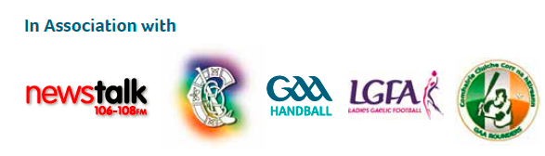
Special K’s: Behind the Strength of Kerry and Kilkenny
Dr. John Considine (University College Cork)
Brian Ryan (Games Manager, Kilkenny)
Micheál Quirke (GDA, Kerry)

Slide 2


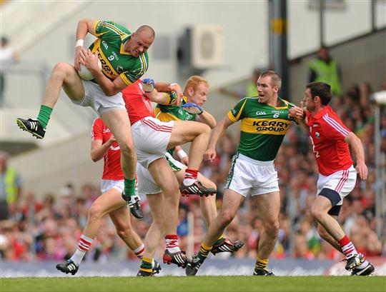
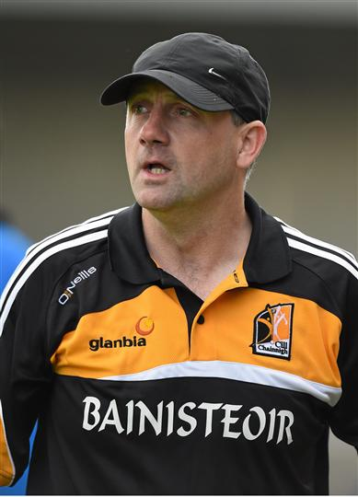
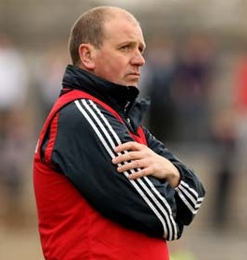
Speakers
John Considine,
All Ireland Senior Winner and All Star 1990
Micheál Quirke
Games Development Administrator, Kerry
All Ireland Senior Winner 2006/7/9
Brian Ryan
Games Development Manager, Kilkenny
All Ireland Minor Winner 1988, Senior Winner 1993

Slide 3
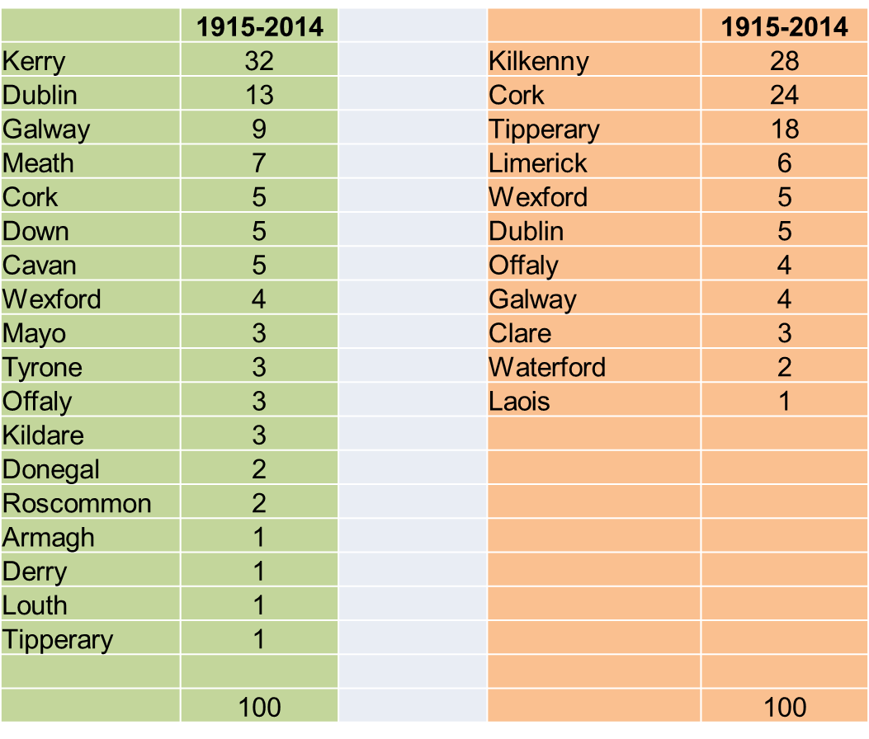
100 Years of Senior All Irelands

Slide 4
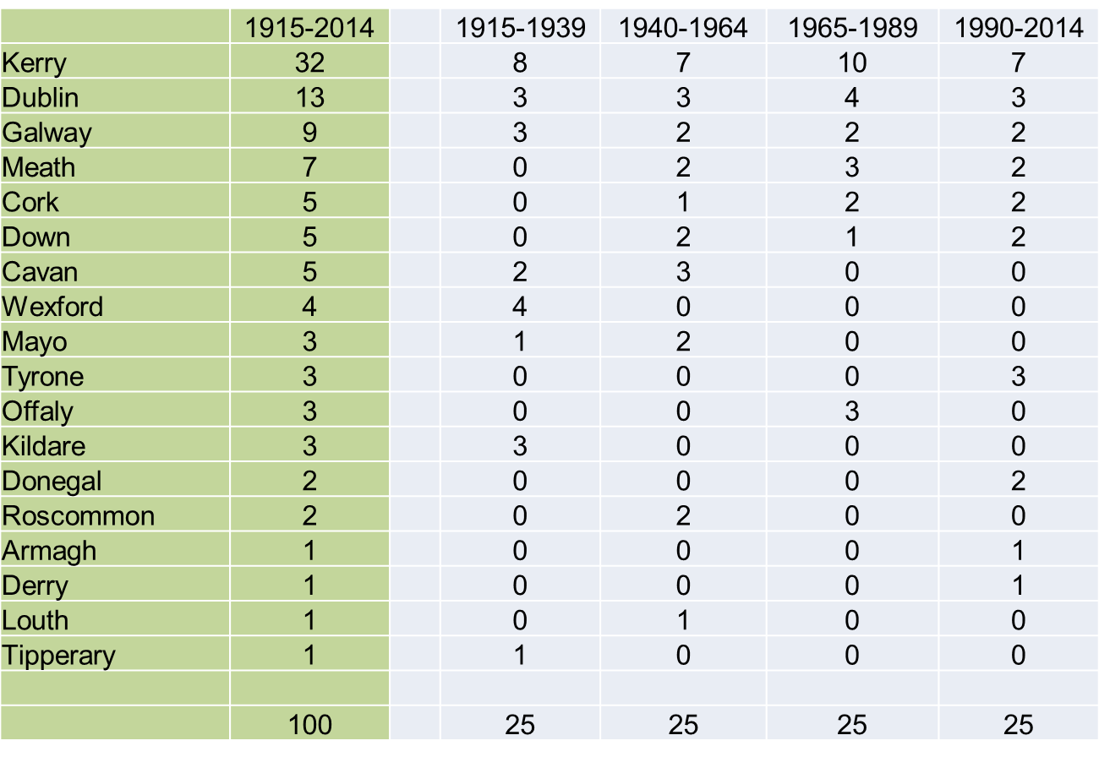
100 Years of Senior All Irelands

Slide 5
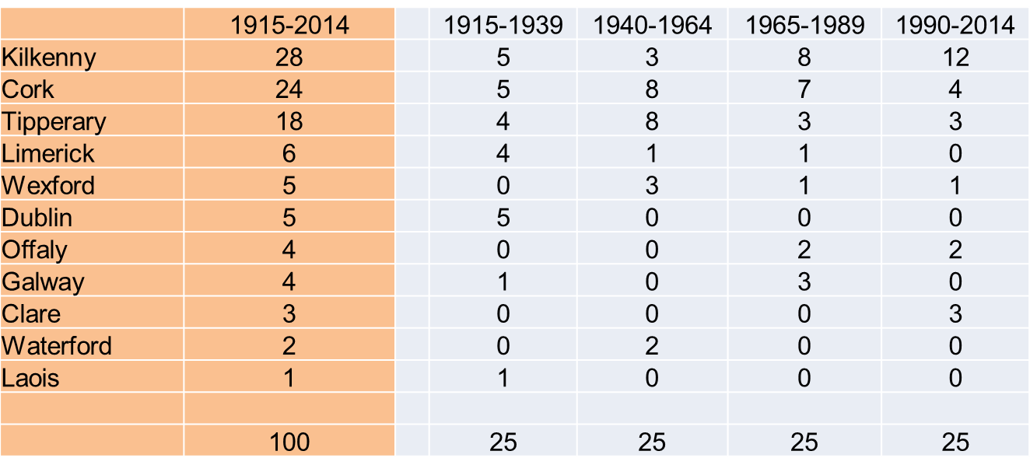
100 Years of Senior All Irelands

Slide 6
Common Features
Games Programme
Clubs and Schools
Games Development Structure
Traditions

Slide 7
Games Programme
Opportunities to Play
Go Games
Primary Schools
Post Primary Schools
Squads
U-14 /U-16 /Minor
Senior x 12 , Intermediate x 12 and Junior x 12

Slide 8
Club Senior Games Structure
  Meaningful games for club players at all levels.
  5 divisions of senior of county league, 3 up 3 down
  Junior, intermediate and senior championships very competitive
  Munster clubs champions at all grades this year
  Meaningful divisional club competitions

Slide 9
Clubs and Schools
Primary Schools
Post Primary Schools
Urban
Rural

Slide 10
Urban Structure
Urban Area | Population | No of Clubs | Average Population Per Club
Kilkenny City | 24, 423 | 3 | 8, 141
Tralee | 23, 692 | 4 | 5, 923
Killarney | 14, 219 | 3 | 4, 740

Slide 11
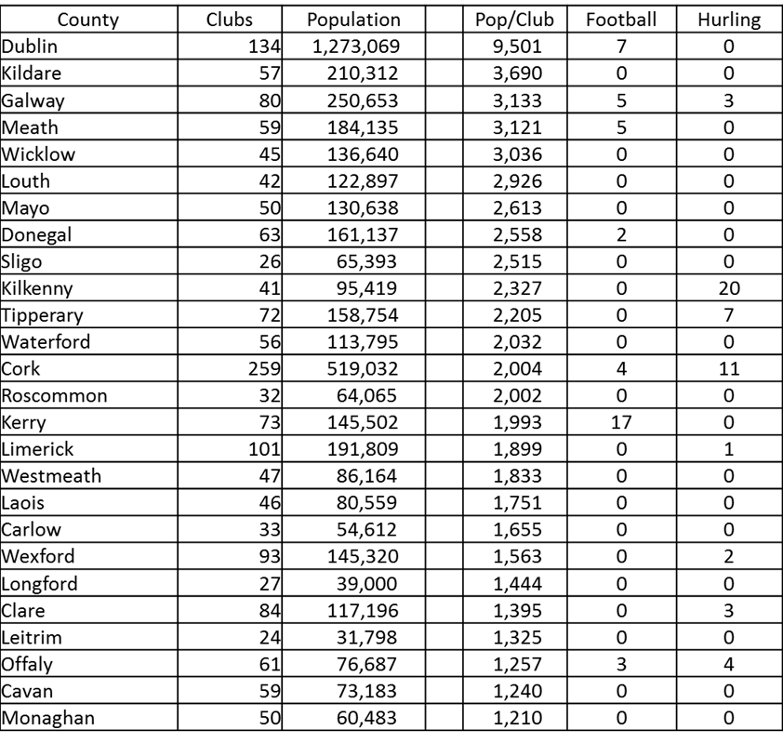
Urban Structure

Slide 12
Games Development
Structure
Foundation - GDA’s covering 100% of national schools in the county
Coach education – huge appetite for learning & improvement amongst club coaches
  (80+ at Award one Adult course in December)

Slide 13
Games Development
Structure
Development squads
  ‘Regular fishing with a wide net’.
  Strength & conditioning (Body weight exercises, flexibility & core)
  Bi lateral co-ordination & skill set
  An acceptance of sampling
  Games based coaching (High IQ footballers)

Slide 14
Tradition
The importance of tradition is difficult to quantify, and even more difficult to acquire without success
In Kerry, your interaction with football becomes intrinsically linked to your self worth
A culture of playing, developing and winning

Slide 15
Tradition
A mastery climate, created by coaches, of sustained effort to improve at child and youth level (individual practice etc.)
Winning Sam Maguire in Croke Park is the only measure of success in Kerry
  Fitzmaurice medal presentation
  Gifts for my kids

Slide 16
Senior, U. 21 and
Minor Hurling 1964 - 2014
 | Senior | U21 | U18
Kilkenny | 20 | 11 | 14
Cork | 11 | 11 | 12
Tipperary | 7 | 9 | 7
Offaly | 4 | 0 | 3
Galway | 3 | 10 | 9
Clare | 3 | 4 | 1
Wexford | 2 | 1 | 2
Limerick | 1 | 4 | 1
Waterford | 0 | 1 | 1
Dublin | 0 | 0 | 1
 | 51 | 51 | 51

Slide 17
Senior, U. 21 and
Minor Football 1964 - 2014
 | Senior | U21 | U18
Kerry | 17 | 9 | 5
Dublin | 7 | 4 | 4
Galway | 5 | 5 | 4
Cork | 4 | 11 | 9
Down | 3 | 2 | 4
Meath | 5 | 1 | 2
Tyrone | 3 | 4 | 6
Offaly | 3 | 1 | 1
Derry | 1 | 2 | 4
Donegal | 2 | 2 | 0
Armagh | 1 | 1 | 1
Westmeath | 0 | 1 | 1
Mayo | 0 | 4 | 5
Laois | 0 | 0 | 3
Tipperary | 0 | 0 | 1
Roscommon | 0 | 2 | 1
Kildare | 0 | 1 | 0
Antrim | 0 | 1 | 0
 | 51 | 51 | 51

Slide 18
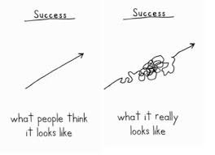
Senior, U. 21 and
Minor Football 1964 - 2014
Since the introduction of the u21 All-Ireland in 1964
Only 9 minor winners won the All-Ireland FOOTBALL title 3 years later.
Since 1995 only 1 team has won the u21 title three years after the minor football title. Kerry have never won u21 three years after minor.
only 15 minor winners won the All-Ireland HURLING title 3 years later.
Since 1995, only 4 teams have won the u21 title three years after the minor hurling title

Slide 19
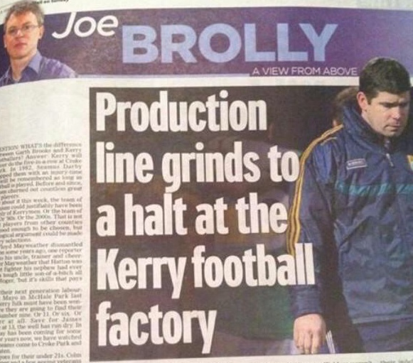
What a Difference a
Year Makes…
Popular misconceptions;
No Structures
No coaching
No talent coming through
A FAMINE far worse than any potato blight was coming to Kerry GAA!!

Slide 20
Kerry U. 21’s 2011
11 players part of the All Ireland winning Kerry senior panel 2014
  9 of them played in the semi final and / or final.
  B. Kelly, P. Crowley, J. O’Donoghue, B.J. Keane, S. O’Brien, P. Geaney, J. Lyne, P. Kilkenny, M. Griffin [D. Casey & A. Fitzgerald])
2 All Stars 2014 and footballer of the year from that 2011 team

Slide 21
37, 12 and counting…
Judging by the statistics, underage success is no longer a reliable determinant of senior success
  Before 2014: 20 years since last minor title
  In that time: 11 senior All Ireland Final appearances (winning 7 titles)

Slide 22
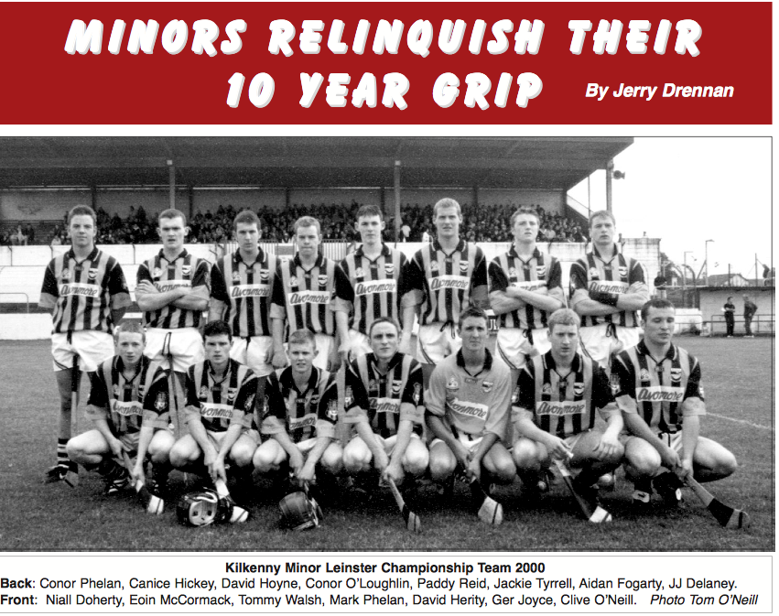
39 All Ireland Senior Medals

Slide 23
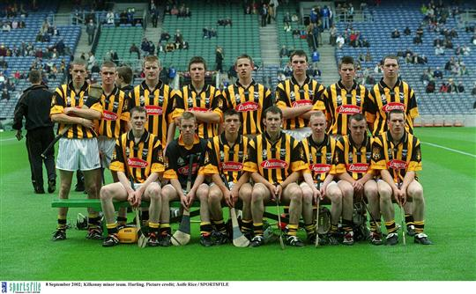
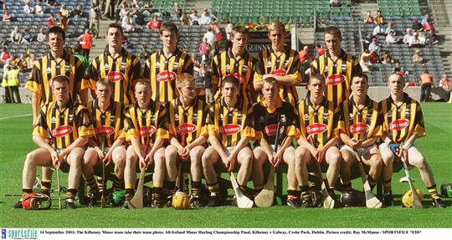
Kilkenny Minor Hurlers 2002/3

Slide 24
Underage Inter County Hurling
Tournaments
The Tony Forrestal U. 14 Hurling tournament
  Commemorates a great Waterford Hurling man tragically
  Killed returning from a match with the Waterford U. 21 team whom he was training a the time

Slide 25
Underage Inter County Hurling
Tournaments
Over 70% of all underage titles have been won by Kilkenny, Tipperary and Galway
  Over 80% if Cork is included
Since 1982 there has been NO WINNER of the Tony Forristal Tournament (U14) that has won the All-Ireland minor title four years later.

Slide 26
Underage Inter County Hurling
Tournaments
Only 5 winners of the U16 tournament have gone to win the All-Ireland minor tournament two years later:
  Tipperary (minor winners in 1996 and 2012);
  Galway (minor winner in 2000 and 2005)
  Kilkenny (2003).
None of the “weaker” counties got a follow through.

Slide 27
Kilkenny Academy
U-14 – 3 Regional Squads
U-15 – 2 Regional Squads
U-16 2 Regional Squads
U-17 1 Regional Squad

Slide 28
Kilkenny Academy
Development Squads Compliment Club/School activity
  "Develop the player in all various aspects of the game"
  "Have a better player going back to his club"
  "Expose the player to various coaching styles"
  "Prepare the player for his next stage of development"

Slide 29
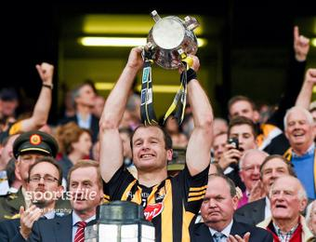
Kilkenny Academy

Slide 30
What Science Says…
“Concentrating solely on the final score as the important outcome of games causes people to develop a very narrow definition of winning.” R. B. Williams; Psychology Today
Early specialisation is not desirable, both in terms of sports and playing positions - 10,000 hours by 20 years old is not a rule!!

Slide 31
What Science Says…
Ice cream flavours > The GAA is chocolate
A 2013 American Medical Society for Sports Medicine survey found that 88% of college athletes surveyed participated in more than one sport as a child

Slide 32
What Science Says…
In a study of 1200 youth athletes,
  early specialization in a single sport is one of the strongest predictors of injury.
  70% to 93% more likely to be injured than children who played multiple sports
Michael Jordan, Tomás O Leary, Keith Wood, Shane Long, Kieran Donaghy, Jason Sherlock, Colm Cooper, John Galvin, Darragh Joyce

Slide 33
What Science Says…
“Youth sport often claims to respond to the needs and wishes of children. Far too often, however, it exists to satisfy adults. Even more than their peers, children involved in competitive sports grow up in a world dominated by adults with little space for freedom, self-initiative, and creativity”.
David (2005) Human Rights in Youth Sport

Slide 34
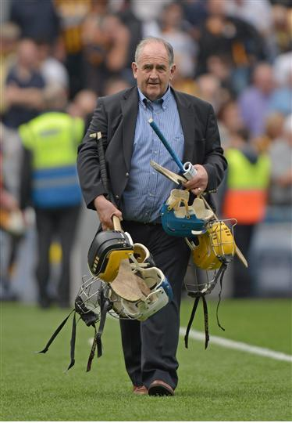
Administration/Misc
If there was a transfer market in the GAA the one man that I would buy is Ned Quinn
(Liam Griffin)

Slide 35
Club Coaching Templates
"Meeting all clubs to provide guidance in all their areas of activities and also to learn from them"

Slide 36
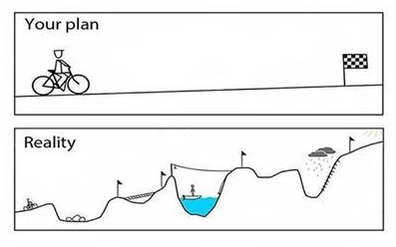
Summary
Development is not linear
Early Specialisation is counter productive

Slide 37
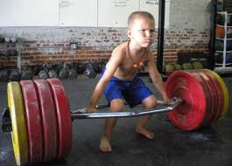
Summary
An over emphasis on winning as the outcome of sport before kids can emotionally cope with the process, is similar to loading their muscles with
weights they are incapable of lifting.

