Slide 1
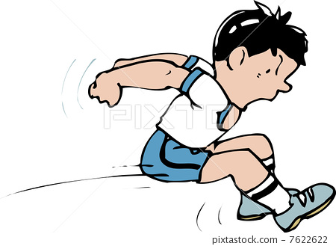
Week 8
Horizontal jump & Throw 2
Notes:
These can be changed to reflect your school’s specific rules.

Slide 2
ready
Are you
For activity?

Slide 3
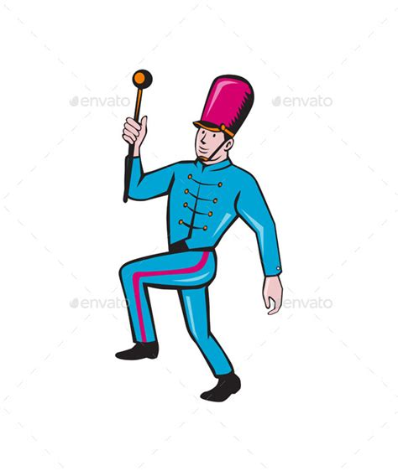
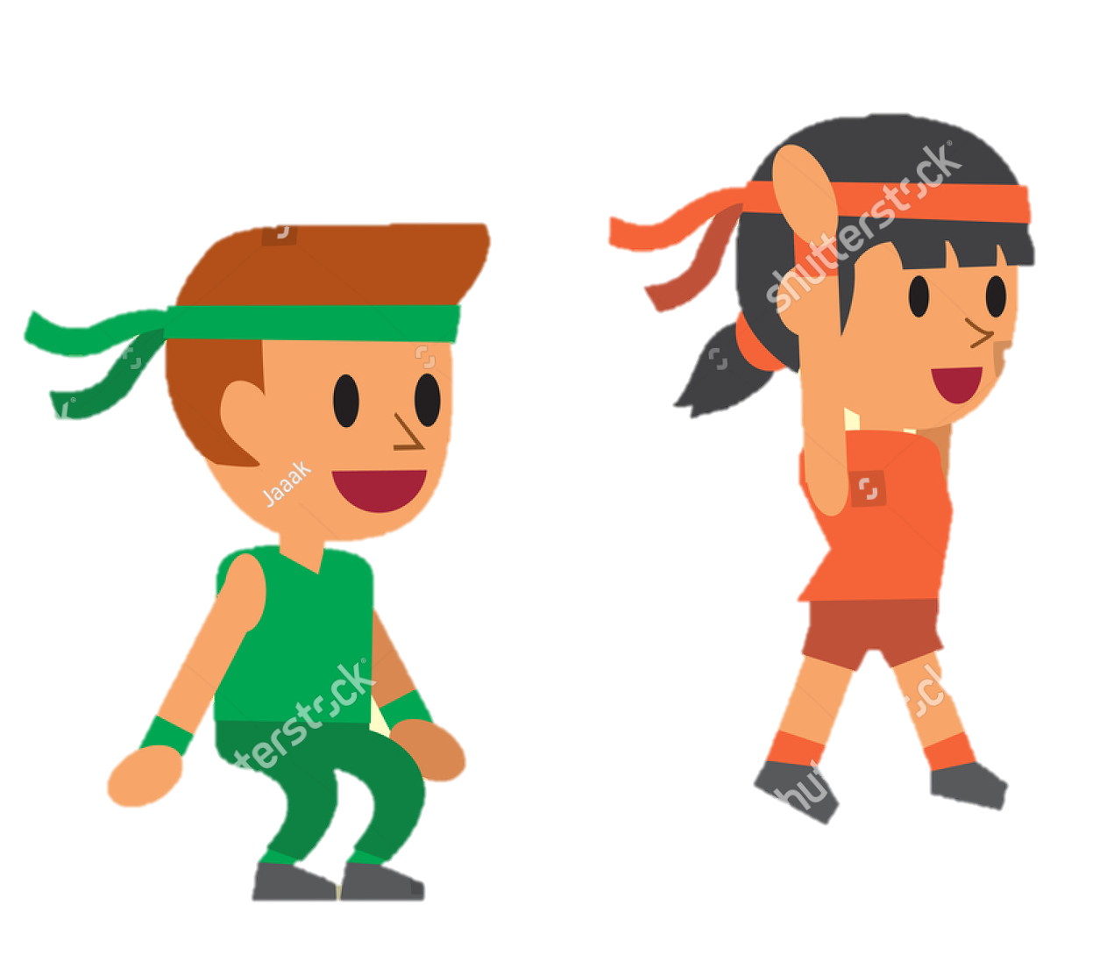
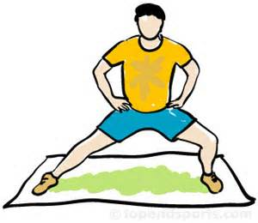
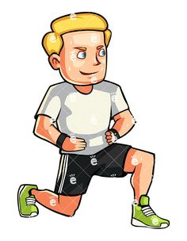
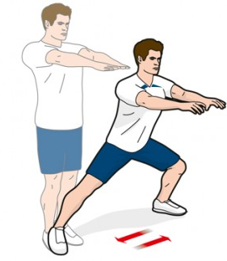
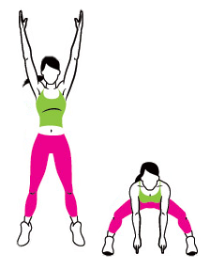
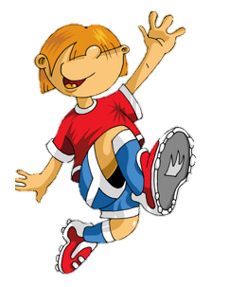
P
H
Y
S
I
C
A
Week 1
Week 2
Week 3
Week 4
Week 5
Week 6
Week 7
Week 8

Slide 4
Forward and back jumps
Start with two feet on the floor, hands by your side and you can put your feet apart or together.
Bend your knees to help you jump!
Jump forwards and backwards whilst keeping your body all in a line.
Got that? Why not put your pencil case on the round and see can you jump over that! Be careful not to trip though!
Nice hopping guys! Can you remember why bending your knees helps you jump and land?
TIP: Think how a spring works!

Slide 5
P
H
Y
S
I
C
A
Week 1
Week 2
Week 3
Week 4
Week 5
Week 6
Week 7
Week 8

Slide 6
Side throw action
Put your feet about shoulder width apart and put your hands on your hips.
Lean over to one side and use your opposite arm to reach over your head in that direction.
Imagine you are throwing a ball over the side of your head.
Keep changing sides and try to do 10 on each!
Super work guys! Once you’ve practiced your side throw you can now try and practice a forward throw! Just imagine you’re throwing an imaginary ball!

Slide 7
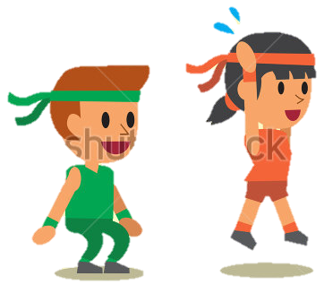
P
H
Y
S
I
C
A
Week 1
Week 2
Week 3
Week 4
Week 5
Week 6
Week 7
Week 8

Slide 8
Jump squat using arms
Great work you guys! What muscles feel tired after all that jumping? Can you name them? Do you think the muscles that feel tired are the most important for jumping? Do your arms help too?
Put your feet shoulder width apart.
Squat down by lowering your bum towards the ground, bend your knees and keep your arms out for balance.
When you are in the bottom position, throw your hands above your head as if you are throwing a ball up into the air and jump up as high as you can!
Remember to land safely and try and do 10 of them!
Notes:
*Change this verbiage to the language your school uses.

Slide 9
P
H
Y
S
I
C
A
Week 1
Week 2
Week 3
Week 4
Week 5
Week 6
Week 7
Week 8

Slide 10
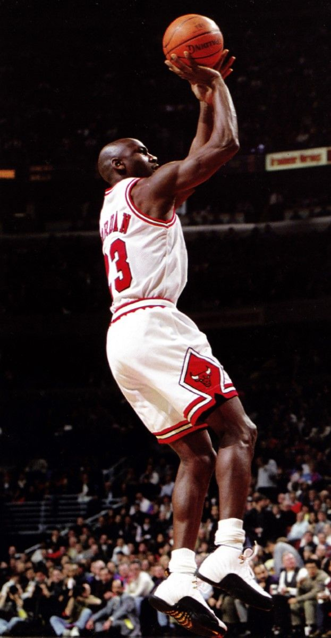
Nice throwing! Keep practicing though!
If you think you’re really good why not try show everyone your jump shot…just like a basketball player!
Over/under arm throw
Everyone gets one sheet of paper.
Crumple it up into a ball.
Form a line in front of the recycling bin about 5 big steps back from it.
One at a time everyone throw the paper ball into the bin. You can throw it either over/under arm. Collect your paper and go to the back of the line.
Try doing it with the other hand the next time!

Slide 11
P
H
Y
S
I
C
A
Week 1
Week 2
Week 3
Week 4
Week 5
Week 6
Week 7
Week 8

Slide 13
Nice Work!

