Slide 1
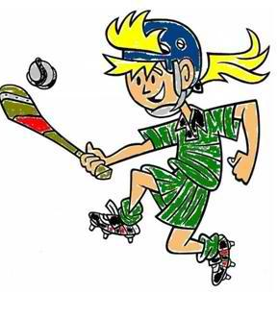
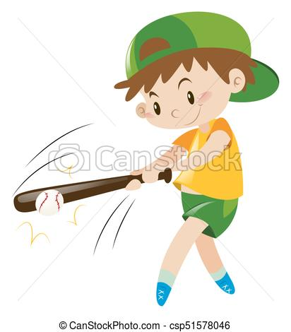
Week 7
Skip & Strike 2
Notes:
These can be changed to reflect your school’s specific rules.

Slide 2
ready
Are you
For activity?

Slide 3
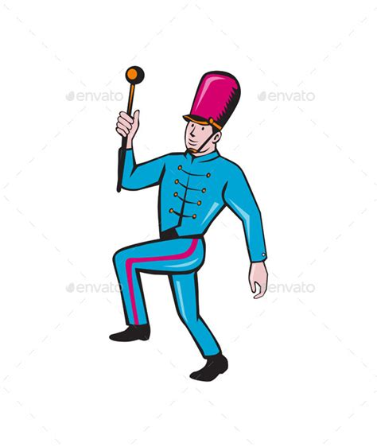
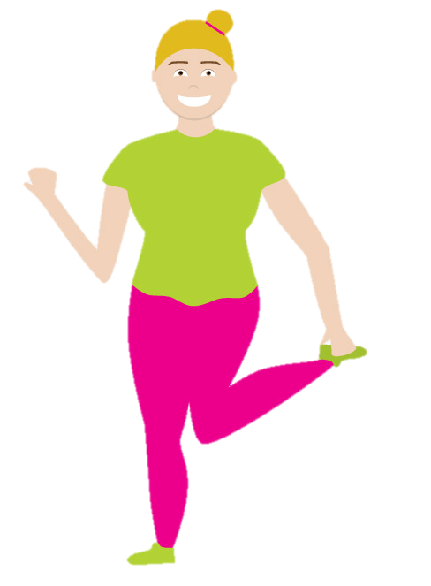
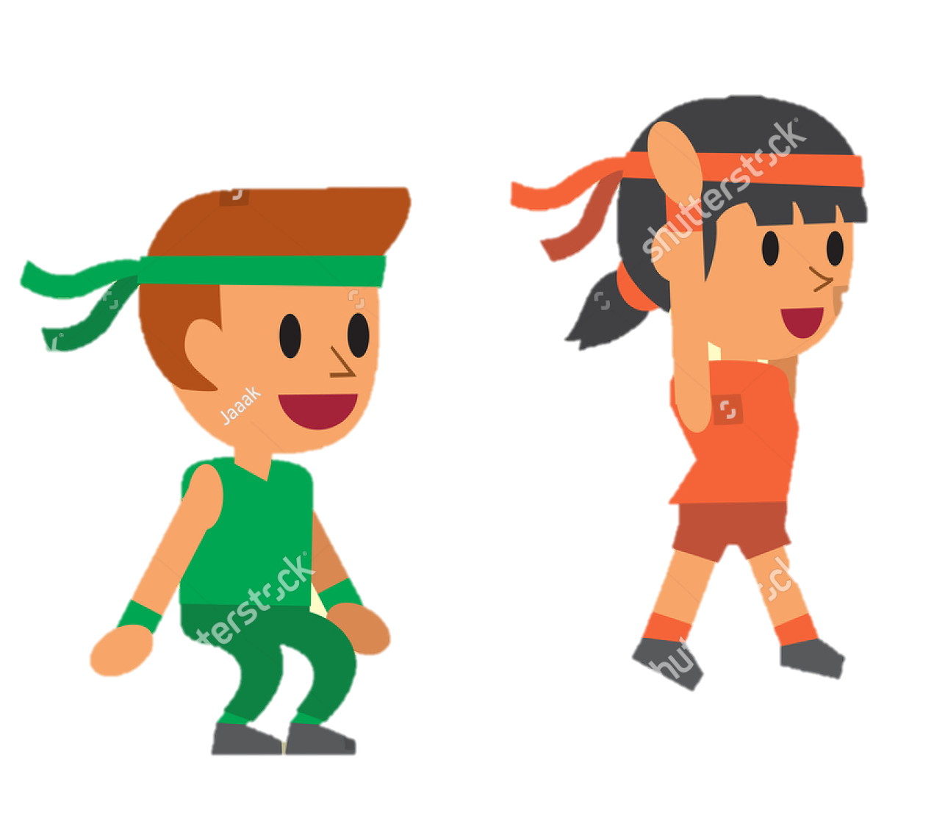
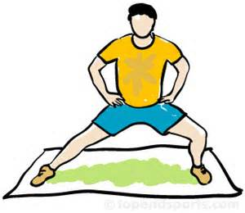
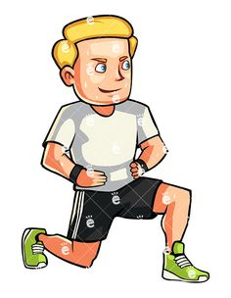
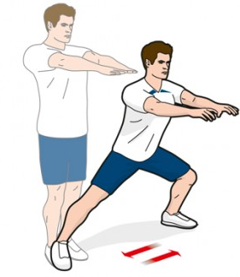
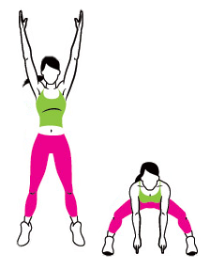
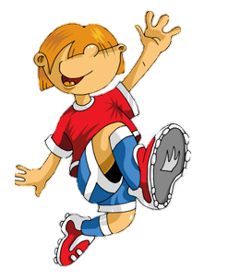
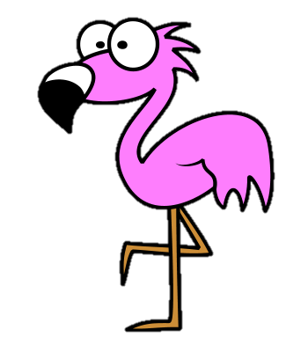
P
H
Y
S
I
C
Week 1
Week 2
Week 3
Week 4
Week 5
Week 6
Week 7
Week 8

Slide 4
The Piggy dance/ hand to foot
Get your teacher to put on some fun music to dance to.
Start by standing up nice and straight.
Lift your knee up as high as you can. At the same time lift the opposite arm up to your head.
Then try the same on the opposite side!
Got that? GREAT! Now try to add a little hop with your standing leg when you lift your knee up.
Then try and put it all together with some music!
Look at you guys Piggy dancing! You look great! Can you add in any Piggy noises?
DON’T FORGET: Opposite arms and legs move together!
DJ’s recommendation – Paolo Nutini: Pencil Full of Lead (Maybe don’t show the video!)

Slide 5
P
H
Y
S
I
C
Week 1
Week 2
Week 3
Week 4
Week 5
Week 6
Week 7
Week 8

Slide 6
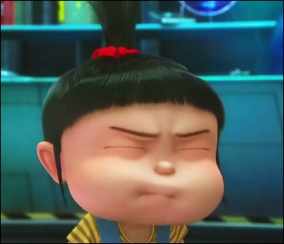
Warrior side lunge and turn
AND REMEMBER…..
Don’t forget to breath!
Plant both feet firmly on the ground and put your hands on your hips.
Step out to one side and lean over to the other. Reach over your head with the arm on the side you stepped with.
Imagine you are throwing a ball over the side of your head.
Keep changing sides and try to do 10 on each!

Slide 7
P
H
Y
S
I
C
Week 1
Week 2
Week 3
Week 4
Week 5
Week 6
Week 7
Week 8

Slide 8
Upper body rotations
Put both feet firmly on the ground.
Hold both arms straight out in front of you with your hands together.
Swing both hands around together and try to spin all the way around!
Pretend you have an imaginary bat and you have to swing around and hit a pinata!
IMPORTANT
Take a break after each one to make sure you don’t get dizzy!
Make sure you don’t fall over!
Notes:
*Change this verbiage to the language your school uses.

Slide 9
P
H
Y
S
I
C
Week 1
Week 2
Week 3
Week 4
Week 5
Week 6
Week 7
Week 8

Slide 10
QUESTION TIME!
Do you know what the main muscles in your legs are called and which help you jump?
DID YOU KNOW??
You can jump higher when your muscles are warm! That’s why you have to warm up to play sports! Your muscles are like spaghetti. When its cold they don’t bend and can break (you could get hurt), but when they’re warm they can bend and are nice and springy. Interesting right!
Forward lunge and jump
Stand nice and tall with your hands on your hips.
Take a big step forward with one leg and lower the other knee close to the ground without touching it.
Then spring up as high as you can using your arms to help you get higher!
Land safely on both feet and try to 10 on both sides!

Slide 11
P
H
Y
S
I
C
A
Week 1
Week 2
Week 3
Week 4
Week 5
Week 6
Week 7
Week 8

Slide 13
Nice Work!

