Slide 1
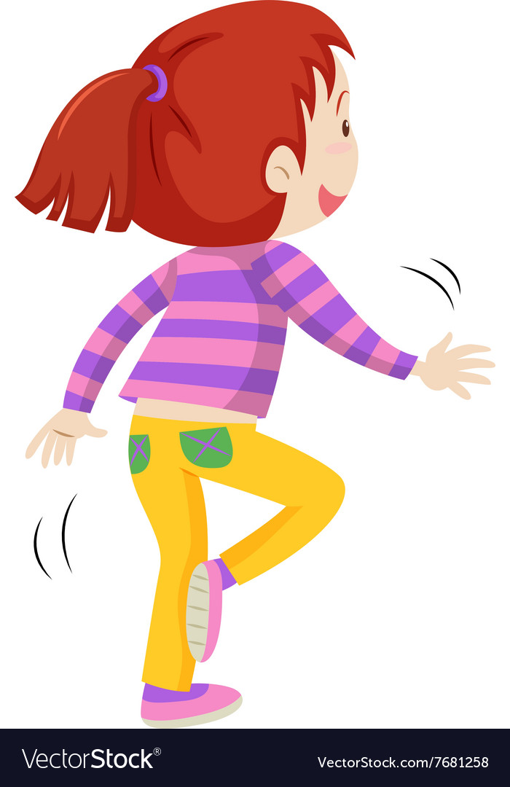
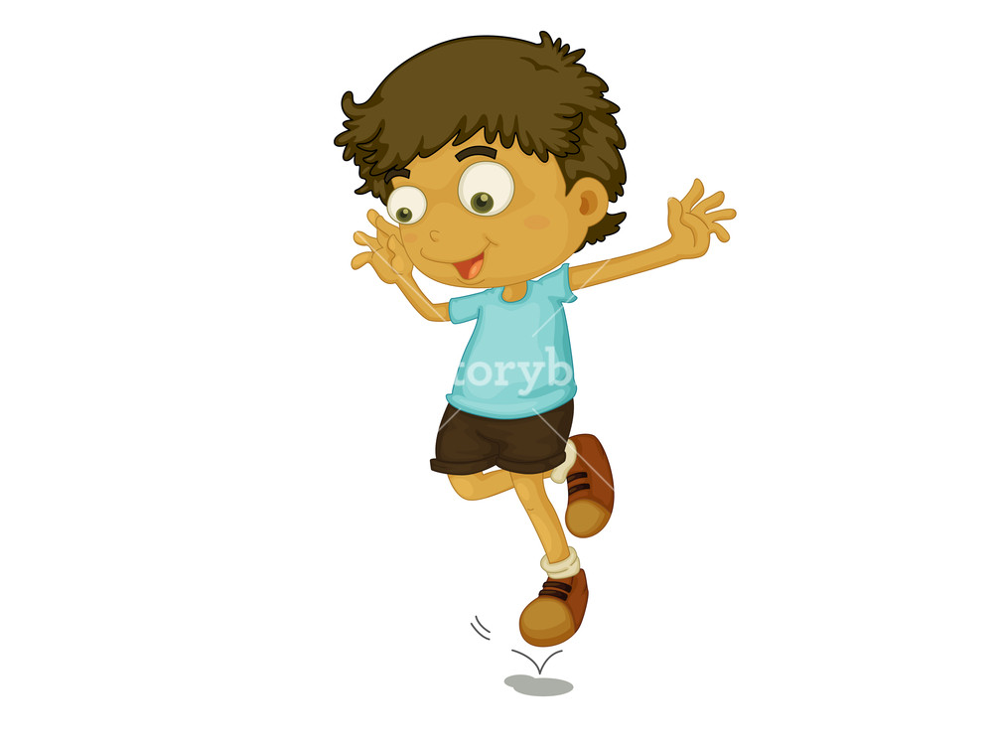
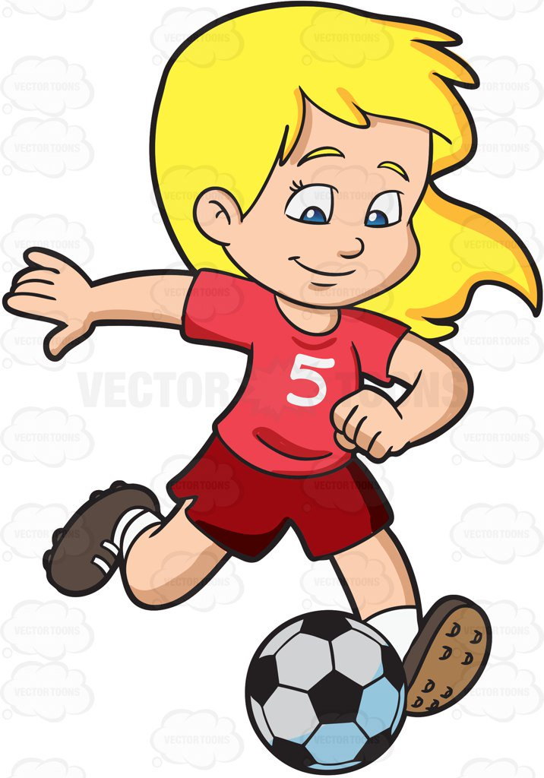
Week 6
Hop & Kick 2
Notes:
These can be changed to reflect your school’s specific rules.

Slide 2
ready
Are you
For activity?

Slide 3
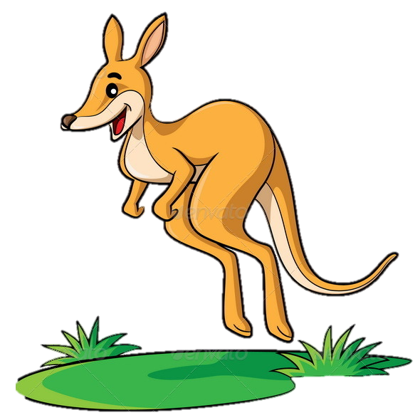
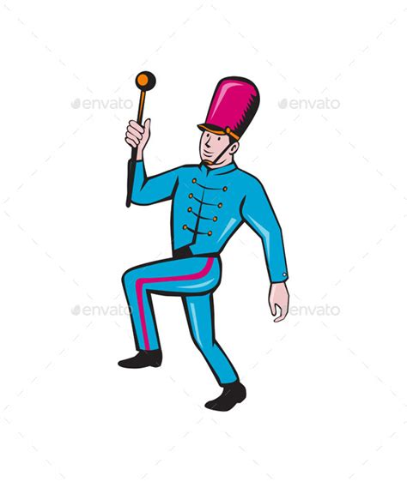
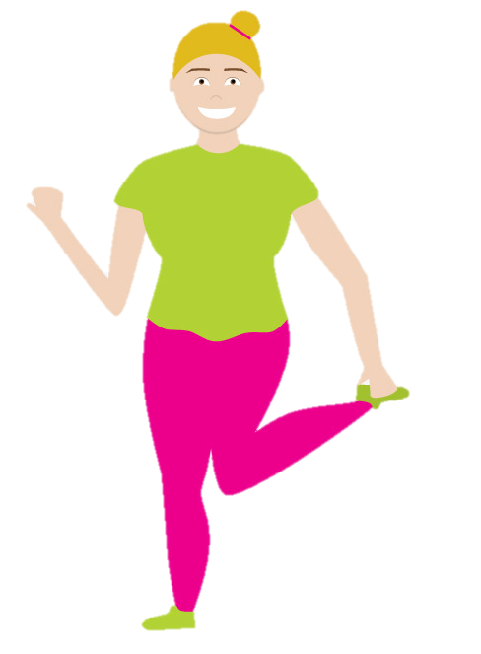
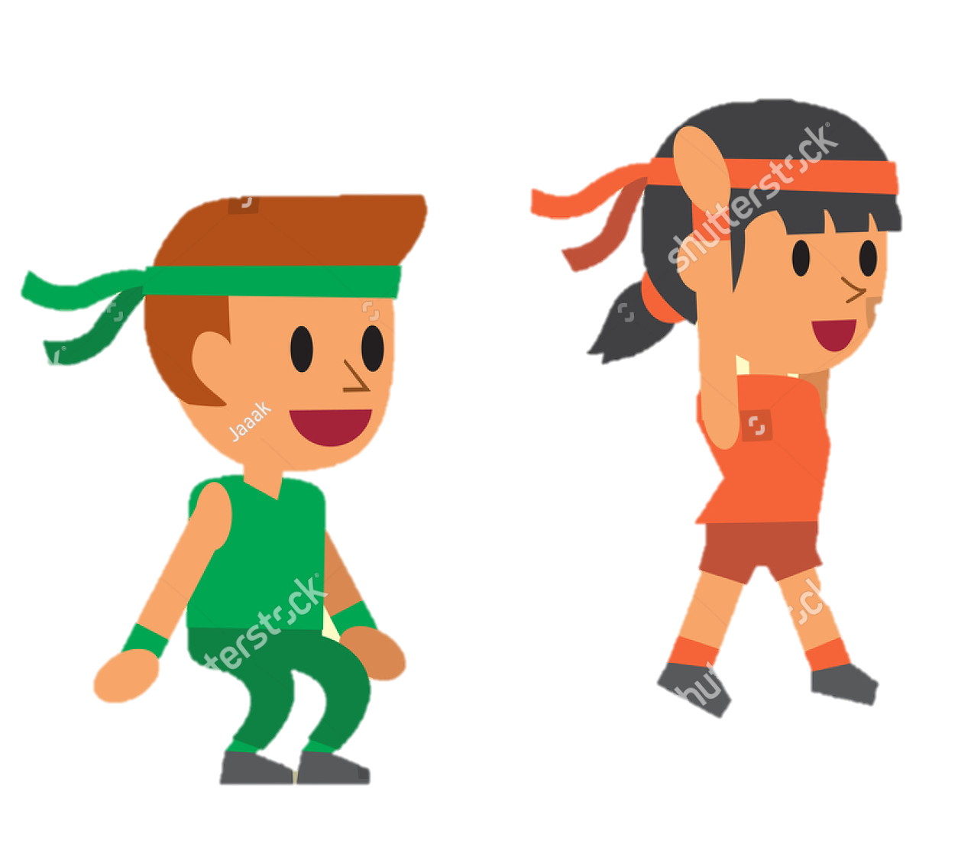
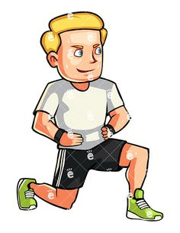
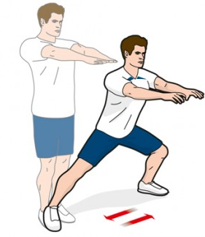
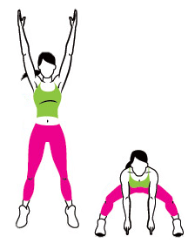
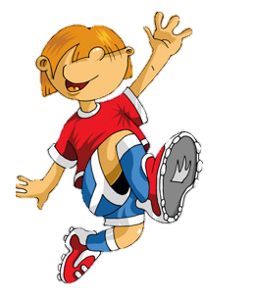
P
H
Y
S
I
Week 1
Week 2
Week 3
Week 4
Week 5
Week 6
Week 7
Week 8

Slide 4
Single leg row/yoga position
Place your two feet facing forward on the ground.
Hold both hands out by your side like an aeroplanes wings.
Lean forward, lifting one leg back behind you and keeping the other one as straight as you can to hold you up!
Lean forward until you are looking at the floor (or as far as you can go whilst saying balanced).
Can you balance better on one side?
Why do you think that is?
How could you improve that?
Got it? See can you do it on both legs!
TOP TIP: Try to keep your body as straight as possible. So lean forward and lift your leg at the same time.
Practice
Practice
Practice!
Tricky isn’t it! Hold it for as long as you can!

Slide 5
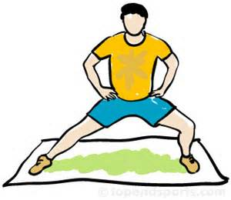
P
H
Y
S
I
Week 1
Week 2
Week 3
Week 4
Week 5
Week 6
Week 7
Week 8

Slide 6
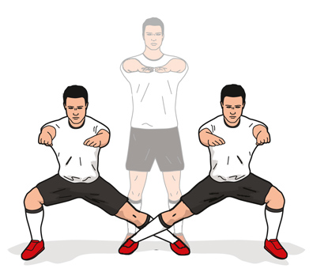
Warrior jumps
Put your two feet widely apart on the ground.
Bend your knees lean to one side.
Hold that position for 5 seconds!
Now lean to the other side and hold for another 5 seconds.
Too easy? Try jumping between sides. But remember! You must land properly and safely!
QUESTION TIME!
What can we do to jump and land safely?

Slide 7
P
H
Y
S
I
Week 1
Week 2
Week 3
Week 4
Week 5
Week 6
Week 7
Week 8

Slide 8
Single leg hop to yoga balance
Bring one leg up beside your bum and grab it so that you are standing on one leg.
Hop as high as you can whilst still holding your leg.
When you land, get your balance, straighten your leg back behind you and lean forward into the balance we done before!
Then swap legs and see can you do it on both sides!
Jump as high as you can!
But remember to land safely and don’t fall!
Notes:
*Change this verbiage to the language your school uses.

Slide 9
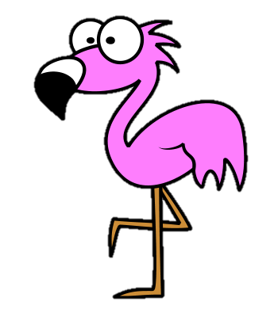
P
H
Y
S
I
Week 1
Week 2
Week 3
Week 4
Week 5
Week 6
Week 7
Week 8

Slide 10
Continuous jumping!
Great work!
You guys are excellent jumpers!
Remember when you counted your breaths before? Here is what we’re going to do with it!
When your teacher says go, jump on one leg as many times as you can for 1min!
When the teacher says stop, count how many breaths you take now for another minute!
Did it change?
Why do you think this is?
Lets do an experiment too! Sit quietly for 1min and count how many times you breath!
(Your teacher can time it for you)
Don’t forget to write down your answer….you will need it soon!
Balance on one leg just like a flamingo!
Start hopping using your arms for balance.
When your teacher calls out what direction to jump, turn and hop that way until they say stop!
Got that? Then you can try it on the other leg, jumping as high as you can, jumping as far as you can or just doing loads of tiny jumps!
Try them all and see the difference!

Slide 11
P
H
Y
S
I
C
Week 1
Week 2
Week 3
Week 4
Week 5
Week 6
Week 7
Week 8

Slide 13
Nice Work!

