Slide 1
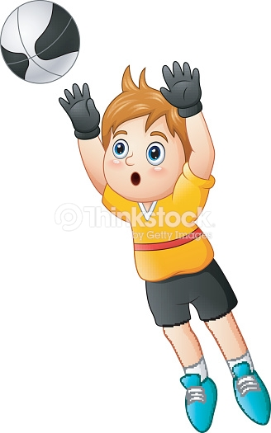
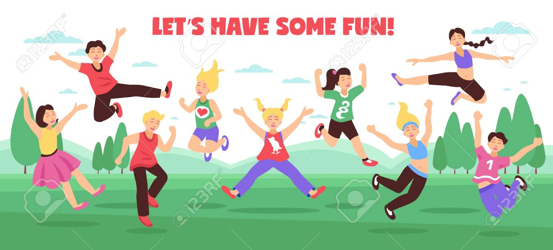
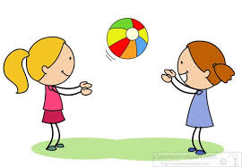
Week 5
Vertical Jump & Catch
Notes:
These can be changed to reflect your school’s specific rules.

Slide 2


ready
Are you
For activity?

Slide 3
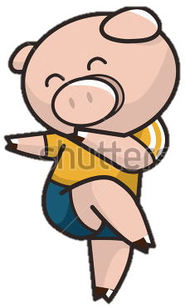
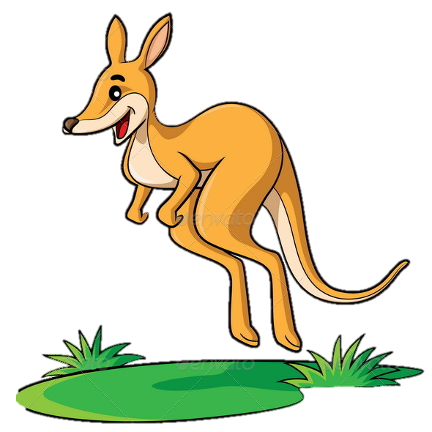
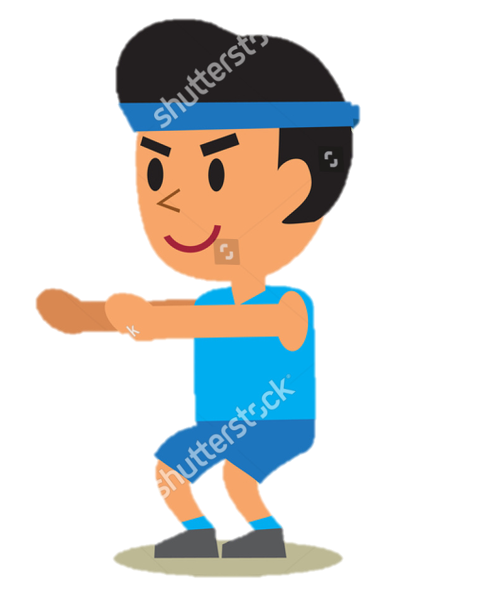

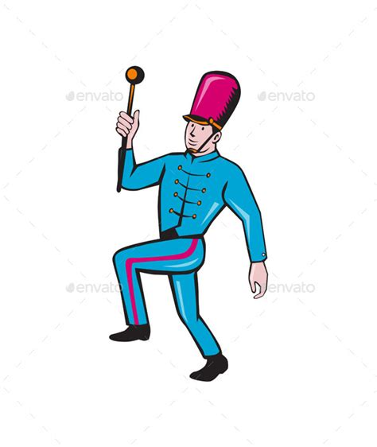

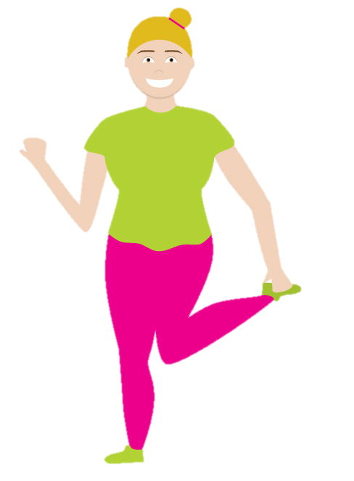
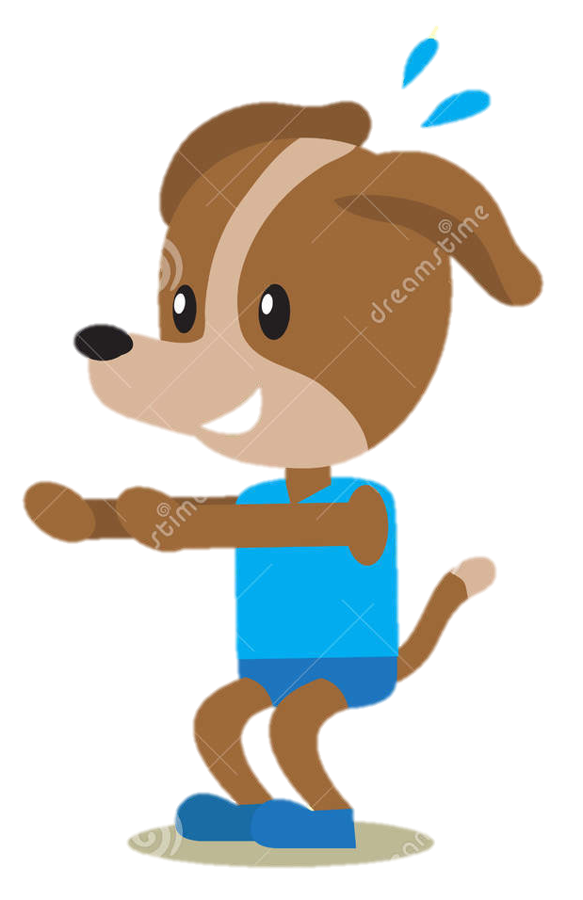

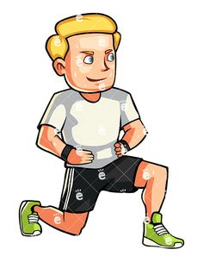
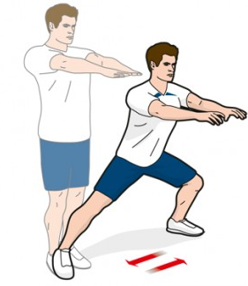
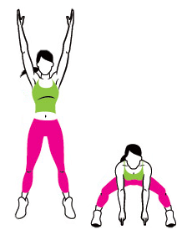
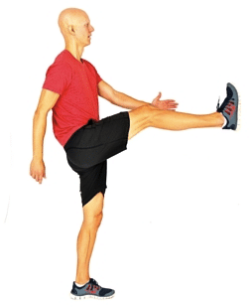
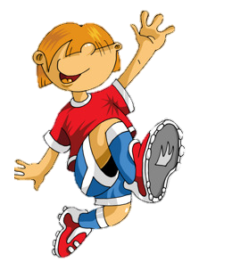


P
H
Y
S
Week 1
Week 2
Week 3
Week 4
Week 5
Week 6
Week 7
Week 8

Slide 4
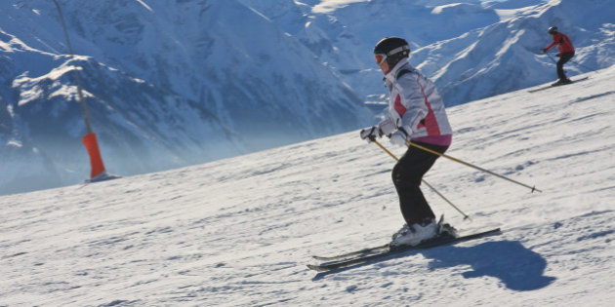

Squat hold/ski position
Nice work!
Have a look at this person skiing. You guys look just like her!
Was it hard holding that position for a long time?
Have a chat of why you think that is!
Place your two feet facing forward on the ground.
Hold both hands out in front of you.
Sit down with your back flat against the wall.
Try and hold this position for as long as you can!
DON’T FORGET TO BREATH!!
Finished? What muscles feel tired?

Slide 5
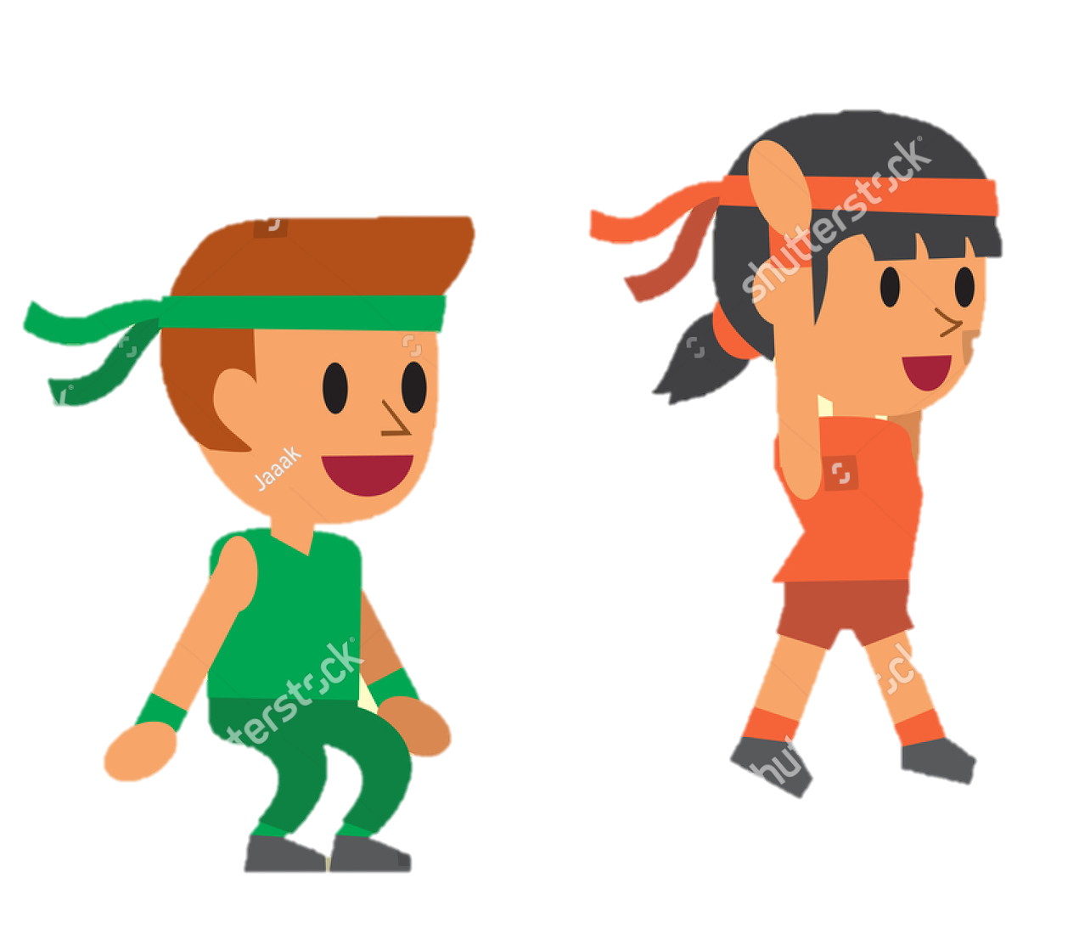
P
H
Y
S
Week 1
Week 2
Week 3
Week 4
Week 5
Week 6
Week 7
Week 8

Slide 6
Squat jumps with a clap
Put your two feet about shoulder width apart on the ground (Point your toes forward).
Bend your knees slowly and squat down.
Go down as far as you can without moving your feet!
Then jump up as high as you can!
Don’t forget to bend your knees to land safely!
TOP TIP:
Swing your arms up at the same time that you jump for extra height!

Slide 7

P
H
Y
S
Week 1
Week 2
Week 3
Week 4
Week 5
Week 6
Week 7
Week 8

Slide 8



Let’s get creative!!
Choose one of the activities you done before that made you jump or catch or even make up your own fun game for you and your friends!
Notes:
*Change this verbiage to the language your school uses.

Slide 9
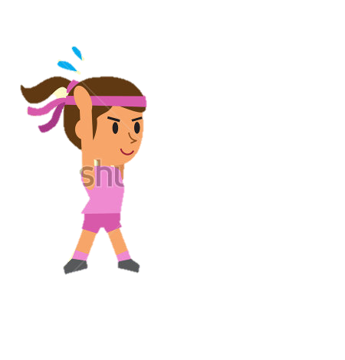
P
H
Y
S
Week 1
Week 2
Week 3
Week 4
Week 5
Week 6
Week 7
Week 8

Slide 10
Trampoline time!
Question Time!
How do you feel after doing exercise/playing games?
Does it make you feel good?
Is it fun?
Can you guess how much exercise you are supposed to do every day?
All of you can jump so well!
Now try and do it on one leg!
Was it an different?
Try the other leg this time!
Can you jump higher on one leg or two? Why?
Place your feet apart and stand nice and tall with your back straight.
Bend your knees a little and jump up into the air! Remember to land softly on both feet!
Keep jumping up and down until your teacher says stop! Try and be as quiet as you can when you are jumping and landing!
Can you remember what to do with your hands to help you go higher?
Nice work minions!
1 hour!
That’s not much right?!
But it’s so good for you!
What kind of exercise do you think you could do every day?

Slide 11
P
H
Y
S
I
Week 1
Week 2
Week 3
Week 4
Week 5
Week 6
Week 7
Week 8

Slide 12
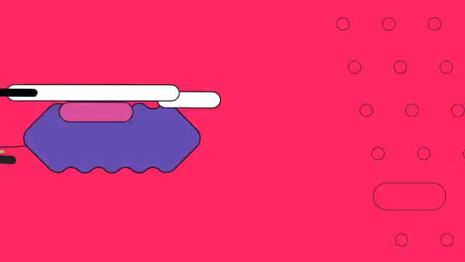

Slide 13



Nice Work!

