Slide 1
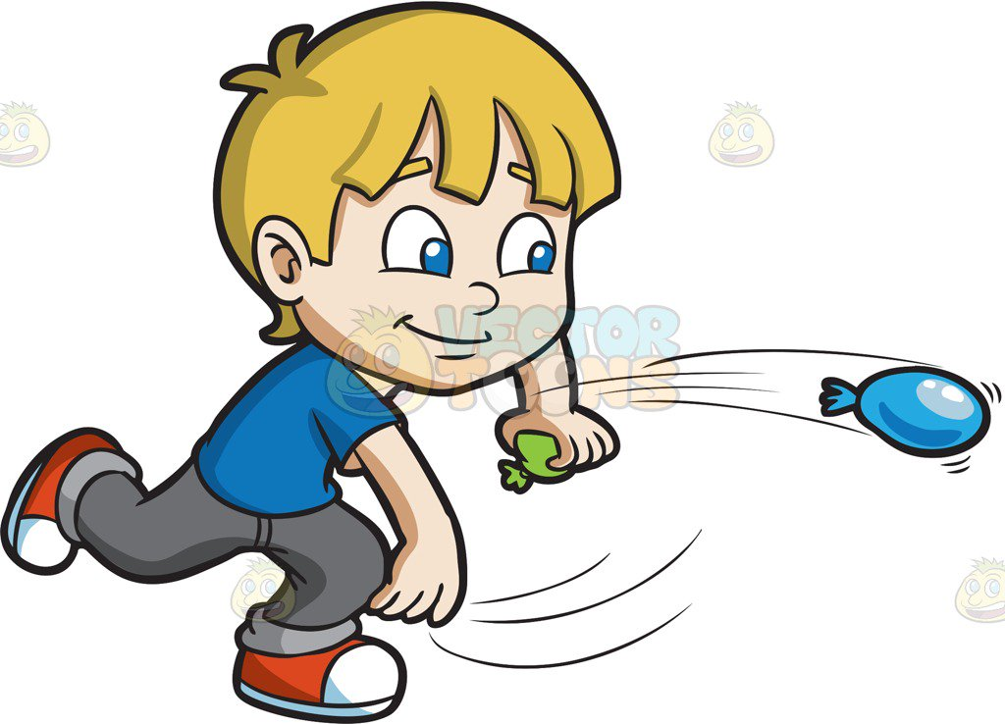
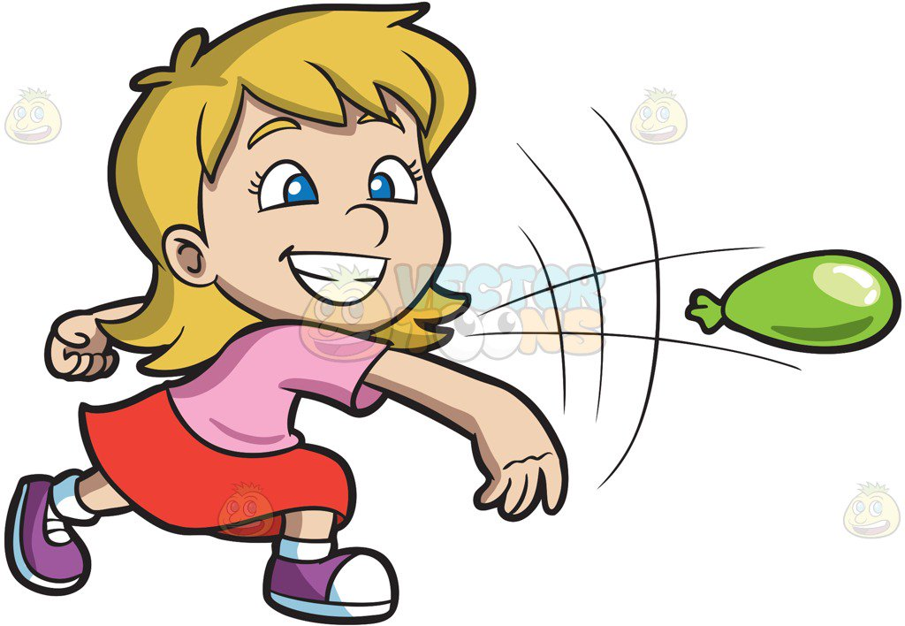
Week 4
Horizontal Jump & Throw
Notes:
These can be changed to reflect your school’s specific rules.

Slide 2
ready
Are you
For activity?

Slide 3
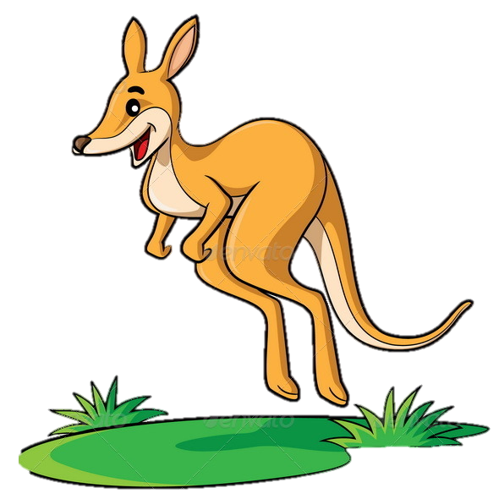
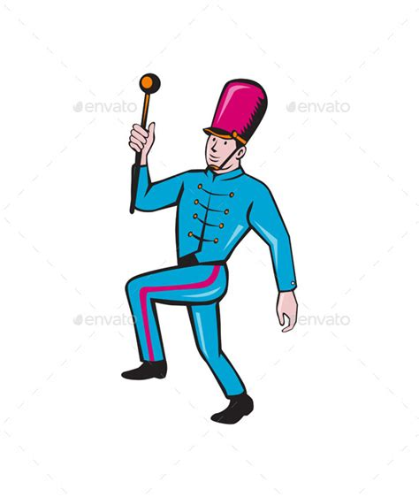
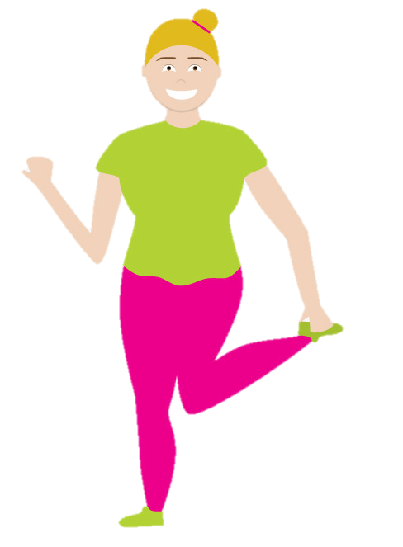
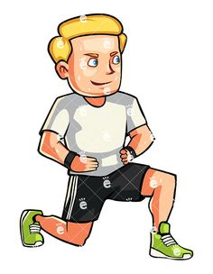
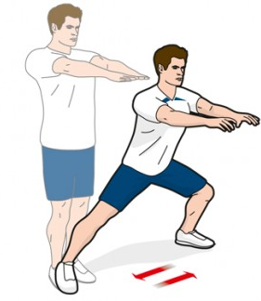
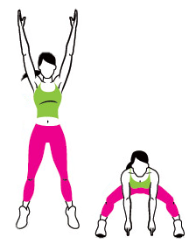
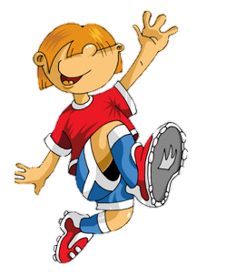
P
H
Y
Week 1
Week 2
Week 3
Week 4
Week 5
Week 6
Week 7
Week 8

Slide 4
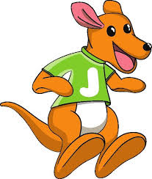
Fun Fact: Baby Kangaroos are called Joeys
Kangaroo jumps
Alright Joeys, it’s time for the Kangaroo long jump!
We are going to practice our kangaroo jumps.
Let’s try and jump as far as we can!
Choose a starting line and jump as far as you can.
Remember how far you went and try to jump even further the next time!
Don’t forget to bend your knees when you land so you don’t hurt yourself!
Did swinging your arms help?
Place your two feet around shoulder width apart.
Bend your knees down, lower your bum and jump forward.
Try doing the same going backwards.
Now try swinging your arms together as you jump.
Why do you think that?

Slide 5
P
H
Y
Week 1
Week 2
Week 3
Week 4
Week 5
Week 6
Week 7
Week 8

Slide 6
Doggy Squat
Challenge time!
Put something small on your head that won’t hurt you if it falls, like one of your pencil cases or a small copy!
(Remember to close it)
Try and squat down as low as you can and back up without letting it fall off,
No cheating so don’t use your hands, just keep your back straight and look forward!
Quick tip: Going nice and slow helps too!
Got that? See can you do 10!
How is this similar to your Kangaroo jumps?
Put your feet shoulder width apart.
Hold your hands out in front of your body.
Bend you knees and lower your bum down just like you’re sitting in an imaginary chair!
Remember: Keep your back straight and look forward.
Here’s a trick! If it’s a little difficult, put a chair behind you! Try to only touch it though and not sit on it!
If you get really good, try do it on one leg!
You’ll need a chair behind you for this!
(And careful you don’t fall over!)

Slide 7
P
H
Y
Week 1
Week 2
Week 3
Week 4
Week 5
Week 6
Week 7
Week 8

Slide 8
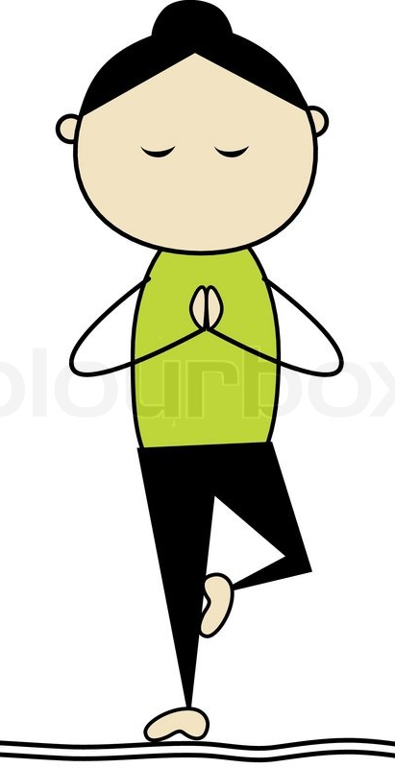
Ninja Warrior pose
To begin your warrior pose take a big step back with one foot.
Lower your body by bending your knee and hold that position.
Hold your arms out for balance, one in front, one behind.
Now pretend you are going to karate chop something in front of you! If your left leg is the one in front then swing your right arm up in a big circle and chop the air in front of you!
Put your other arm out to the side for balance if you like!
Try that on both sides. And remember; opposite arms and legs!
Before you become a warrior you have to be calm and focused.
This balance will help you become a true ninja!
Hold your hands together in front of your body.
Light one leg up and hold it against your knee.
Once you’re balanced, close your eyes and take 2 deep breaths.
Then do the same on the other side and you are ready to be a ninja warrior!
Notes:
*Change this verbiage to the language your school uses.

Slide 9
P
H
Y
Week 1
Week 2
Week 3
Week 4
Week 5
Week 6
Week 7
Week 8

Slide 10
Time to learn a new handshake
Face your partner but stand to the side of each other.
Step forward with your outside foot like a lunge.
Swing your inside hand up and high-5 in the middle.
Stand back up, turn around and do it on the opposite side.
Nice work minions!

Slide 11
P
H
Y
Week 1
Week 2
Week 3
Week 4
Week 5
Week 6
Week 7
Week 8

Slide 13
P
H
Y
S
Week 1
Week 2
Week 3
Week 4
Week 5
Week 6
Week 7
Week 8

Slide 14
Nice Work!

