Slide 1
Week 3
Skip & Stride
Notes:
These can be changed to reflect your school’s specific rules.

Slide 2
ready
Are you
For activity?

Slide 3
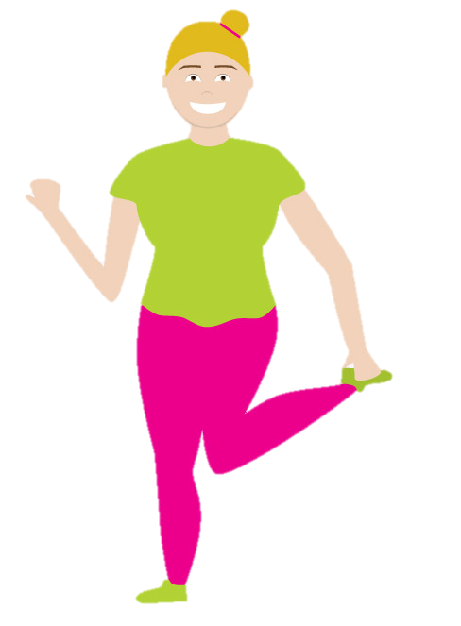
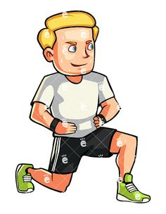
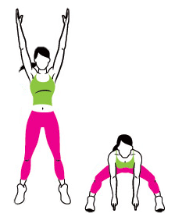
P
H
Week 1
Week 2
Week 3
Week 4
Week 5
Week 6
Week 7
Week 8

Slide 4
Knee to elbow
Try and skip keeping your whole foot on the floor.
Now try it up on your toes
What did you notice? What does that mean?
Start with your 2 feet on the ground.
Bring one knee up toward the sky.
Move your knee up and over a little to try and touch the opposite elbow.
Don’t touch it though or you get a sore elbow!
Got it? Try add a little hop with your standing leg when you bring your knee up.
Now try skip around the room bringing your knee nice and high and swing your arms!

Slide 5
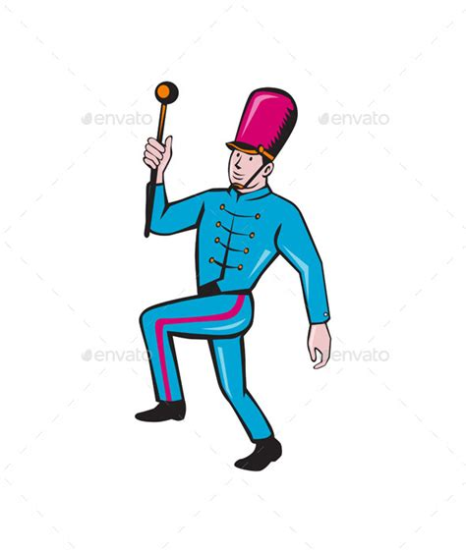
P
H
Week 1
Week 2
Week 3
Week 4
Week 5
Week 6
Week 7
Week 8

Slide 6
Marching on the spot
Let’s all pretend that we are soldiers or in a marching band!
Bring one knee up towards the sky.
At the same time bend the opposite arm and raise it too.
Then bring them down and raise the opposite two.
Try and march as quietly as possible.
Try and march as loudly as possible.
Which one should you do when you run on the spot?
Try both and see!

Slide 7
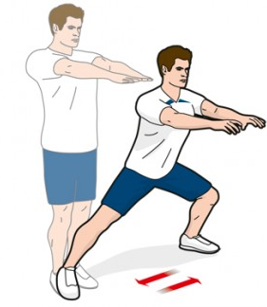
P
H
Week 1
Week 2
Week 3
Week 4
Week 5
Week 6
Week 7
Week 8

Slide 8
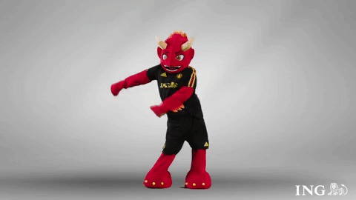
Side lunges
I hope you guys feel loose because we’re going to wiggly those hips and do the floss dance!
Teach your friend if they don’t know how!
Stand with your feet about as wide as your shoulders.
Hold your arms out in front of you.
Take a big step out to the side.
Lower your body by bending your knees.
Keep your back straight and head looking forward.
Move back up to the middle then do the same on the other side.
Notes:
*Change this verbiage to the language your school uses.

Slide 9
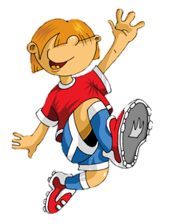
P
H
Week 1
Week 2
Week 3
Week 4
Week 5
Week 6
Week 7
Week 8

Slide 10
Jump skip
Have a think??.......
Try and skip without using your arms
Did you notice anything?
Is it harder or easier?
Can you go as high?
Do you think your arms help you jump?
Remember our marching activity?
Well this time we are going to try it with a jump in the middle.
Whilst you march try and get up as high as you can!
Bring your arms up and try and touch the roof.

Slide 11
P
H
Week 1
Week 2
Week 3
Week 4
Week 5
Week 6
Week 7
Week 8

Slide 13
P
H
Y
Week 1
Week 2
Week 3
Week 4
Week 5
Week 6
Week 7
Week 8

Slide 14
Nice Work!

