Slide 1
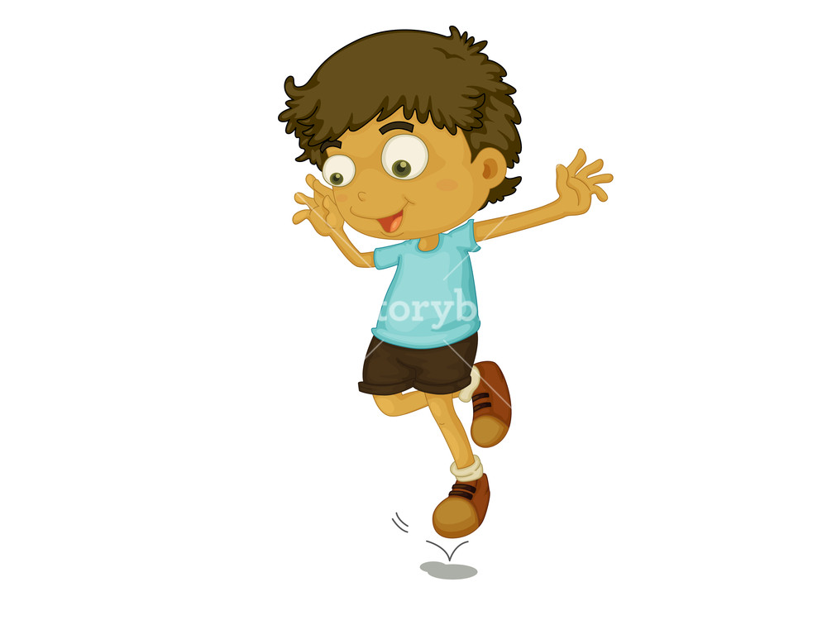
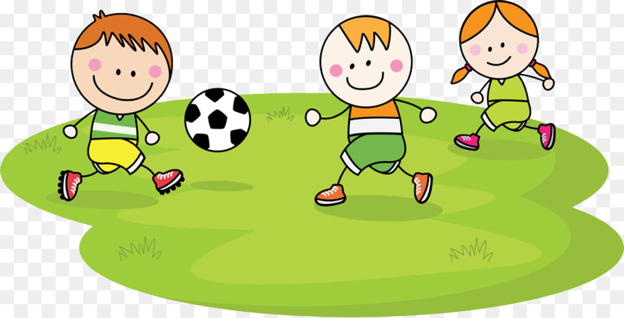
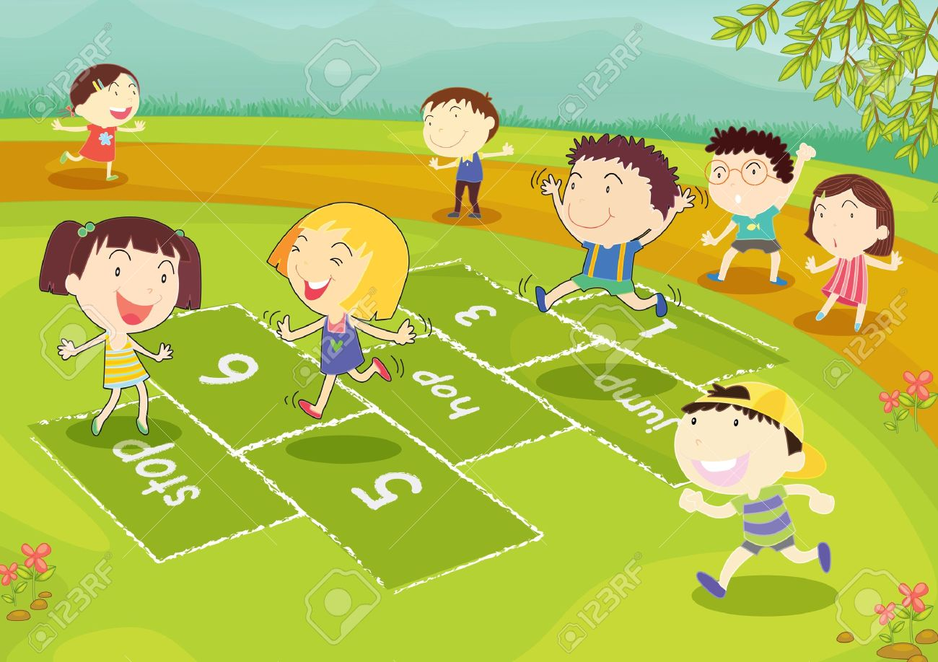
Week 2
Hop & Kick
Notes:
These can be changed to reflect your school’s specific rules.

Slide 2
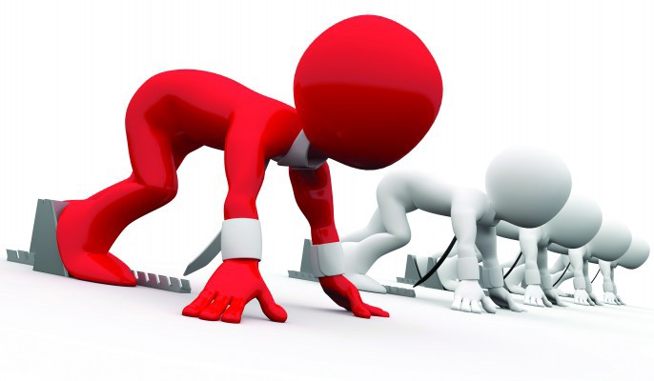
ready
Are you
For activity?

Slide 3
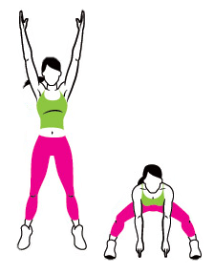
P
Week 1
Week 2
Week 3
Week 4
Week 5
Week 6
Week 7
Week 8

Slide 4
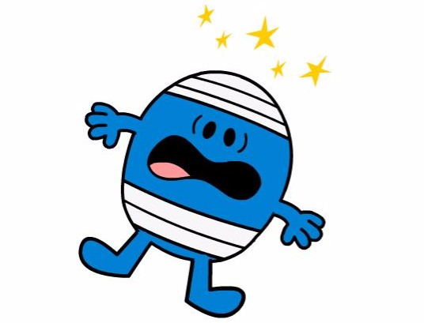
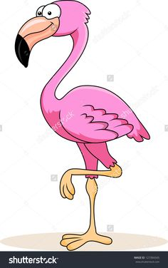
Flamingo BAlance
Did you know??
Flamingos sleep while standing on one leg!
But please don’t try it at home or you’ll probably fall over!
Can you do it as good as me?
Balance on one leg with your hands on your hips.
Try bend your leg that isn’t balancing you up so that it doesn’t go near the ground.
Lets see how long you can balance on each leg for!
If that’s too easy try closing your eyes or touching your noes whilst doing it!

Slide 5
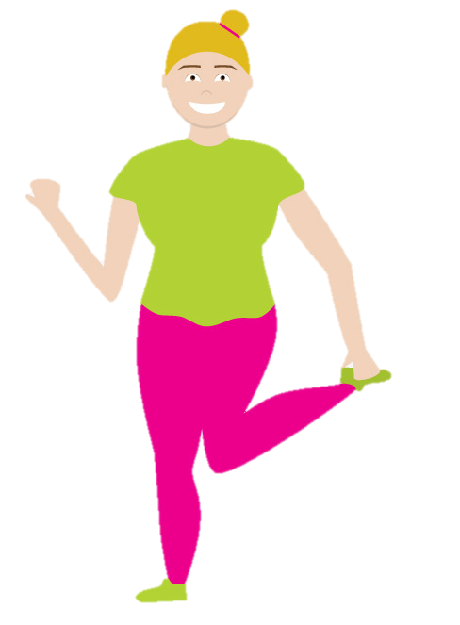
P
Week 1
Week 2
Week 3
Week 4
Week 5
Week 6
Week 7
Week 8

Slide 6
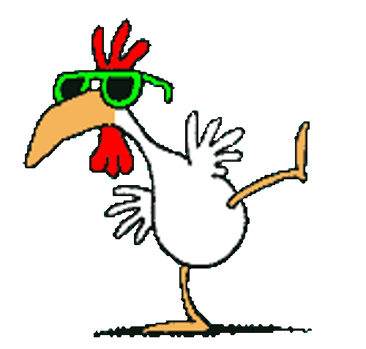
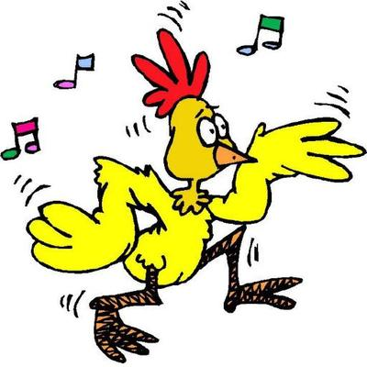
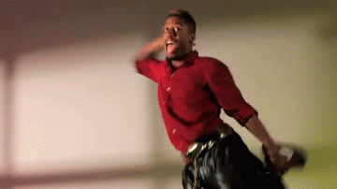
Ready for more?
Lets see can you get as funky as me!
Follow my groovy friend in the video!
The Funky chicken
For Starters
Bring one leg up behind your bum and hold it.
Hold your other hand out to balance.
Now try hopping on the spot whilst trying to keep your balance.
See can you do it on both legs!

Slide 7
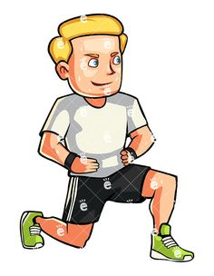
P
Week 1
Week 2
Week 3
Week 4
Week 5
Week 6
Week 7
Week 8

Slide 8
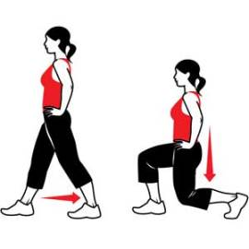
Lunge like you mean it
Question time
How do your legs feel now?
Do any parts of your leg feel different than others? Point to it!
Why do you think this is?
Stand with your feet about as wide as your shoulders.
Put your hands on your hips.
Step forward with one foot and bend your knees to lower yourself close to the ground.
But Remember: Don’t touch the ground and keep those hands on your hips!
Try and keep yourself in that position for 5 seconds without your knee touching the ground, then try it using the other foot.
Notes:
*Change this verbiage to the language your school uses.

Slide 9
P
Week 1
Week 2
Week 3
Week 4
Week 5
Week 6
Week 7
Week 8

Slide 10
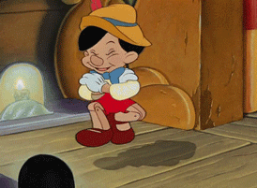
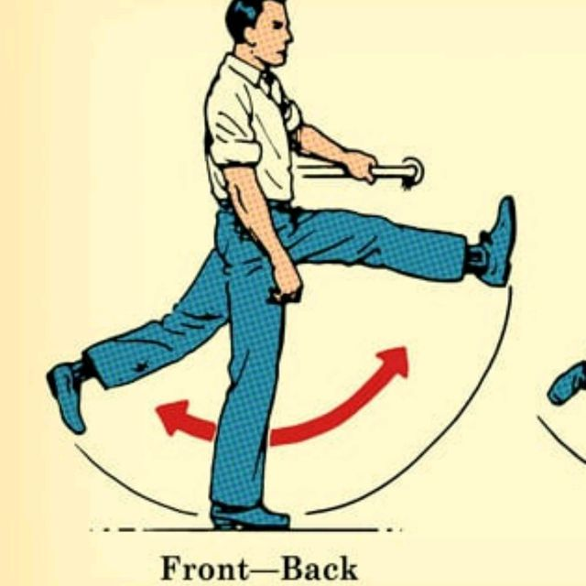
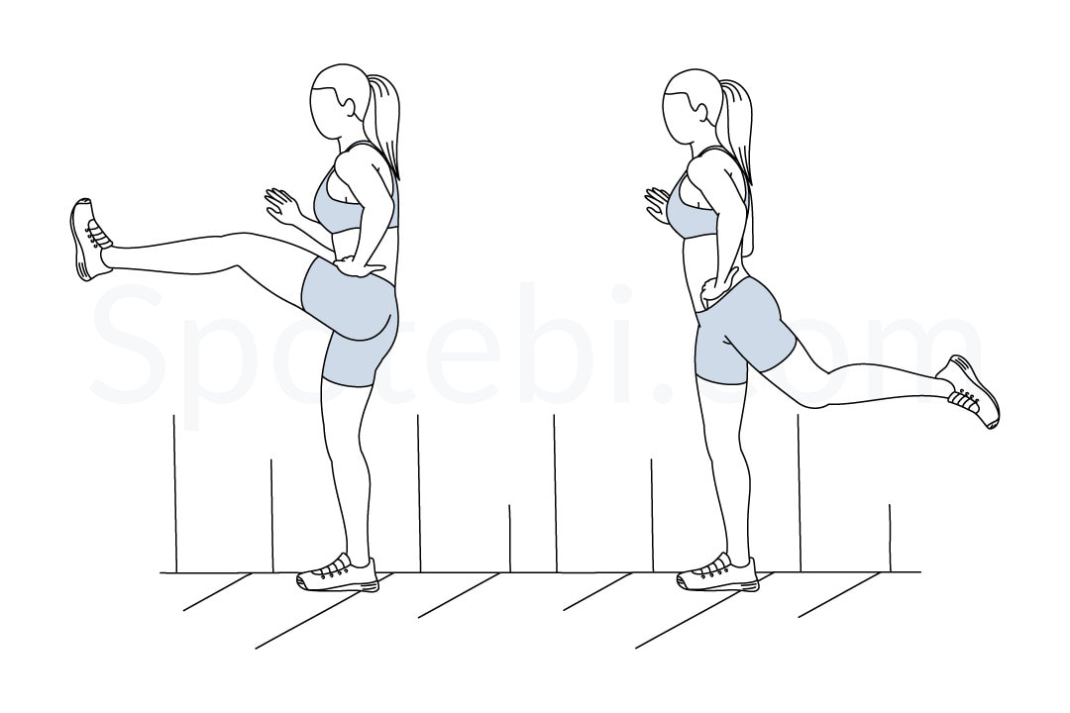
Good at that?
Then lets copy our friend Pinocchio's fun dance!
Make sure you have plenty of space and don’t kick anyone!
Leg swings
Start by standing up nice and tall.
Swing one of your legs up and try to touch your toe with the opposite hand.
Try and touch your toes with you hand when you kick.
Do this on both legs.
If you keep losing your balance hold onto the wall like the girl here!

Slide 11
P
Week 1
Week 2
Week 3
Week 4
Week 5
Week 6
Week 7
Week 8

Slide 13
P
H
Week 1
Week 2
Week 3
Week 4
Week 5
Week 6
Week 7
Week 8

Slide 14
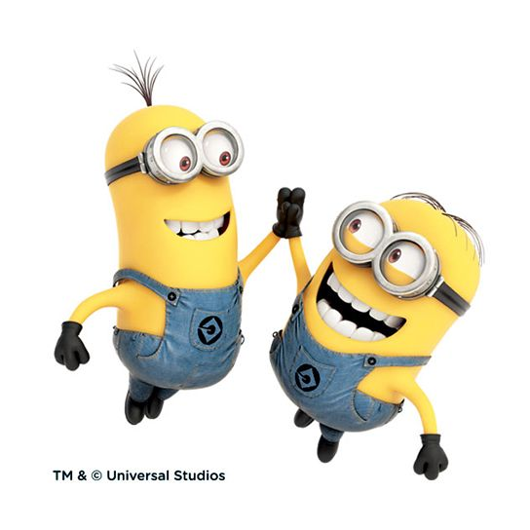
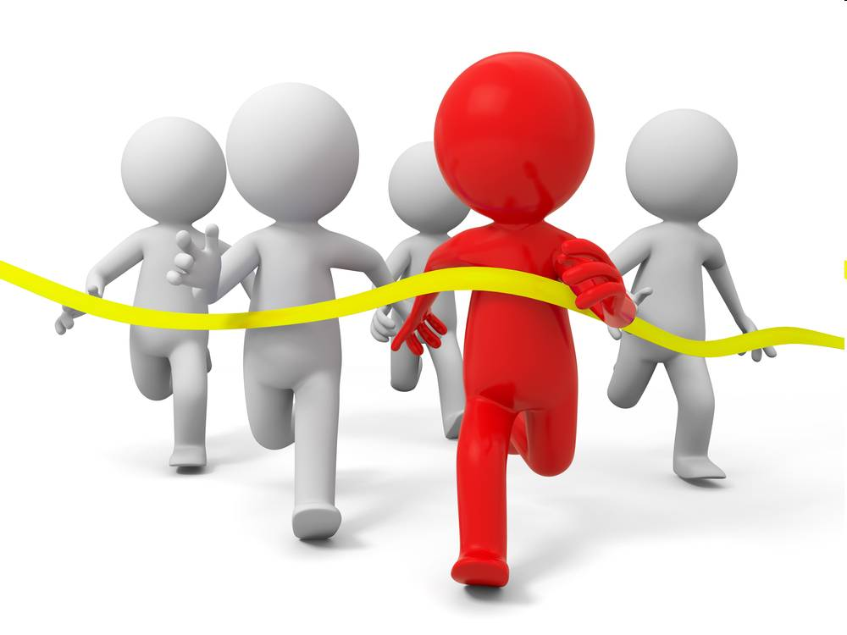
Nice Work!

