Slide 1
Week 1
Vertical Jump & Catch
Notes:
These can be changed to reflect your school’s specific rules.

Slide 2
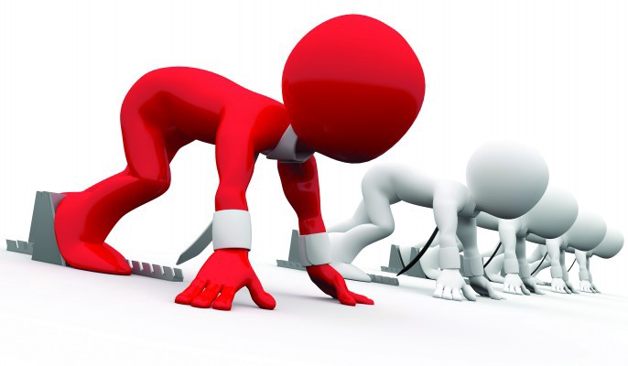
ready
Are you
For activity?

Slide 3
Week 1
Week 2
Week 3
Week 4
Week 5
Week 6
Week 7
Week 8

Slide 4
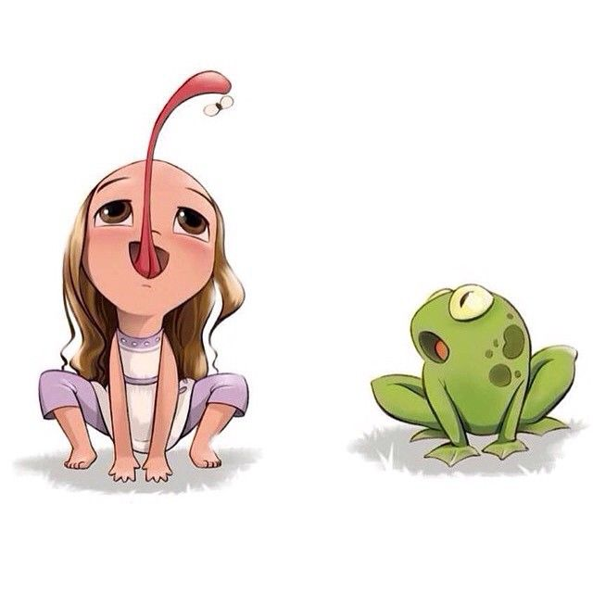
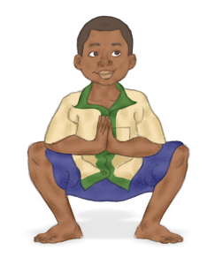
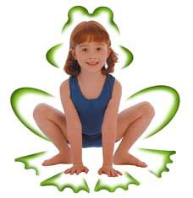
Hey look! You’re practically frogs!
How do you feel after that?
When you’re able to hunch down nice and low that means your muscles are nice and bendy. Does anyone know what that called?
It’s Frog hunches time!
Copy my Froggie friends here!
Start by standing up.
Stand with your legs a little wider than your shoulders and point your toes out.
Now hunch down like a frog by bending your knees and touching the floor with your hands.
Then stand back up.
Nice work! Lets try and do 10!
Got that? How about we try bouncing around the room? Make sure not to bump into anyone though!
Flexible!

Slide 5
Week 1
Week 2
Week 3
Week 4
Week 5
Week 6
Week 7
Week 8

Slide 6
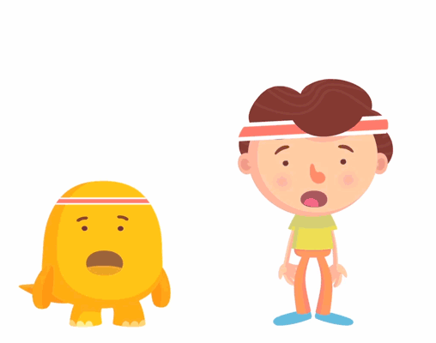
Put your hand on your chest….does anything feel different?
Why do you think this happens?
Has anything else happened?
Starfish Jumping Jacks
Stand with your feet together.
Jump and spread your feet apart, move your hand out and up over your head!
Jump back bringing your feet together and your hands down by your side.
Lets try and do it for 20 seconds! See how many you can do!
Now try jumping higher, then faster!
Try do it just like my friends!

Slide 7
Week 1
Week 2
Week 3
Week 4
Week 5
Week 6
Week 7
Week 8

Slide 8
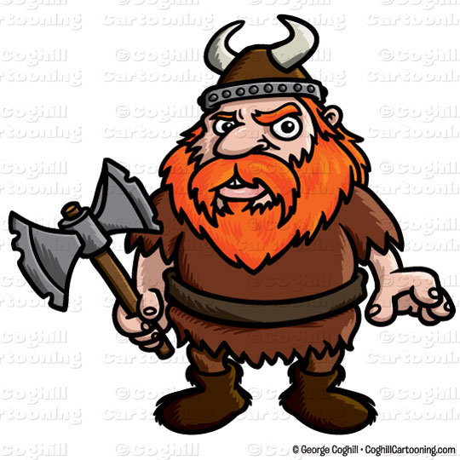
You look just like real Vikings!
Now you have to make up your own Viking handshake with the person beside you!
If you want to be a real Viking it has to include:
A clap
You have to be moving whilst doing it
A high-5
A Viking roar
It’s time….for the Thunder clap!
What games do you play where you bring your hands up above your head like that?
Would jumping at the same time make it harder or easier? Try it out and see!
Next time you’re doing PE try use your new Viking skills to catch a ball above you’re head!
Get ready to show me your inner Viking and copy my Icelandic friends.
Try to do it all together!
Notes:
*Change this verbiage to the language your school uses.

Slide 9
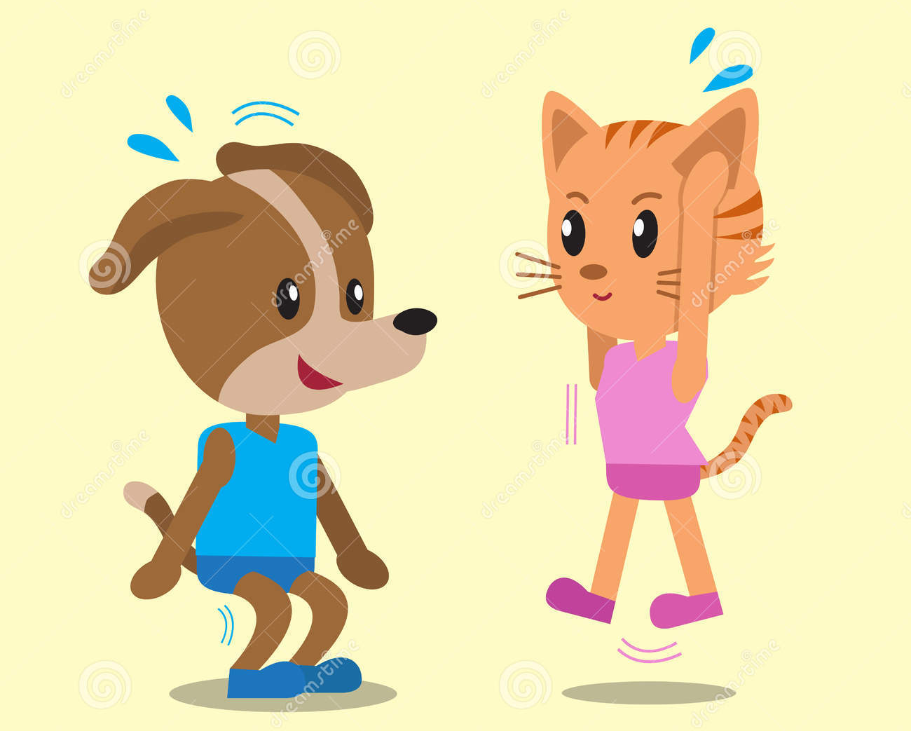
Week 1
Week 2
Week 3
Week 4
Week 5
Week 6
Week 7
Week 8

Slide 10
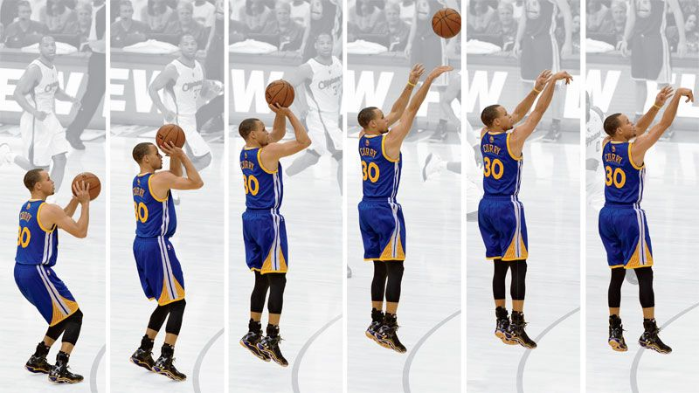
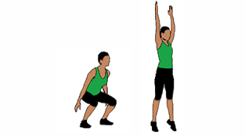
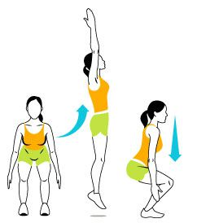
The imaginary catch
Question time!
What other sports do you do this kind of movement?
Can you think of a game where you go from being in the frog position to jumping and throwing at the same time?
Let’s try and do 20!
This movement is going to combine our frog hunch, star jumps and our Viking clap!
Start with your feet about shoulder width apart.
Bend your knees, put your bum back and remember: Keep your head up and looking forward, you can’t see the imaginary ball if you don’t!
Then jump up as high as you can and bring your hands up and clap them. Just like you’re catching something!
IMPORTANT TIP: Try not to jump through the roof! Your teacher won’t be happy!
Who said Basketball? Swish
Do you think how low he gets in his frog hunch would affect his jump?

Slide 11
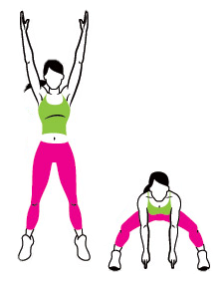
Week 1
Week 2
Week 3
Week 4
Week 5
Week 6
Week 7
Week 8

Slide 13
P
Week 1
Week 2
Week 3
Week 4
Week 5
Week 6
Week 7
Week 8

Slide 14
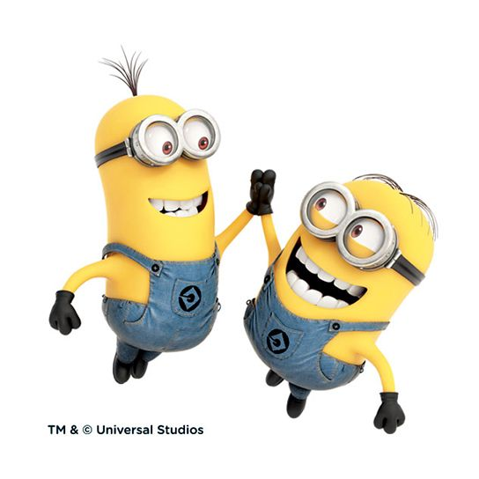
Nice Work!

