Slide 1
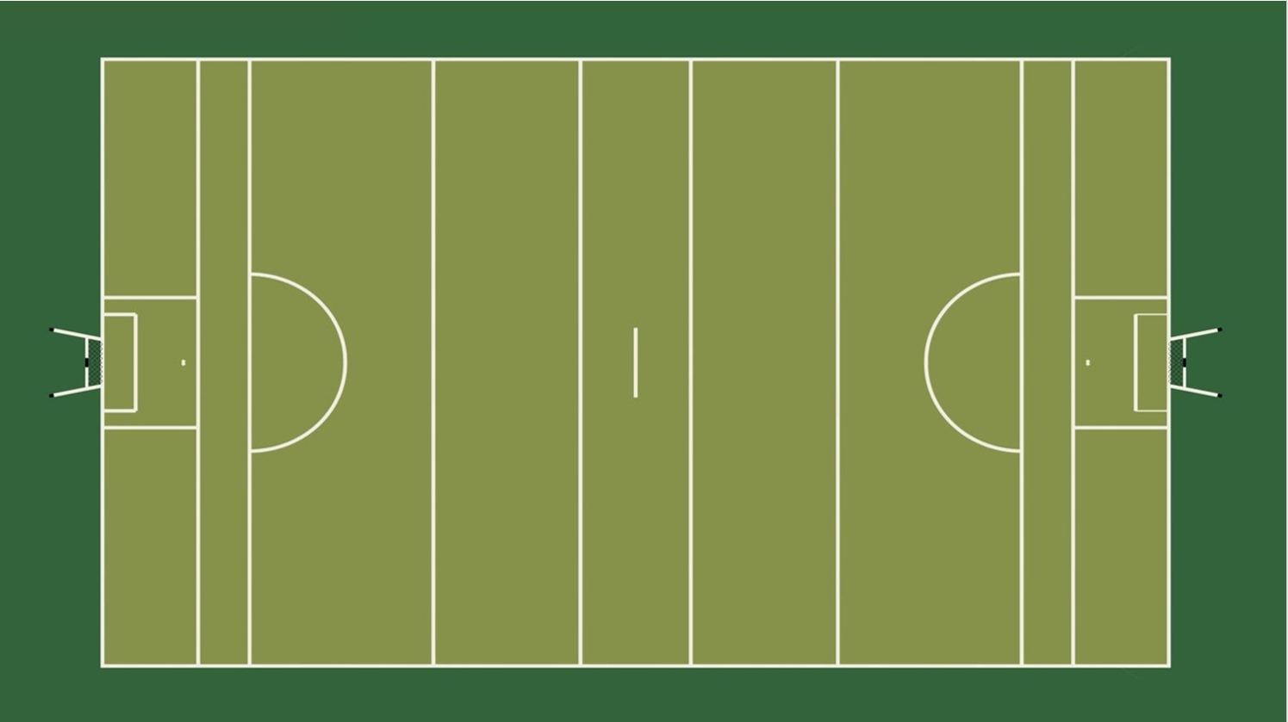

Match Officials Positioning
L
Positioning during play:
Referee in a position to observe a wide view of play.
Arrows represent the diagonal runs that should be made to get the side on view
Umpires move into a position to judge scores:
Far Umpire behind the goal
Near Umpire on end line
Linesman on side near play stays close to end line
Linesman opposite side moves away from play
U
U
R
U
U
L
Dugout A
4
Dugout B

Slide 2
Match Officials Positioning PUCKOUTS HURLING
L
Referee near midfield just off center. Can view and move
where needed
Umpires in position on each end line watching GK
Near Linesmen on the 45 line
Far Linesman behind the referee
R
U
U
U
U
L
Dugout A
4
Dugout B

Slide 3
Match Officials Positioning FREE HURLING
L
Referee near midfield just off center. Can view and move
where needed
Umpires in position on each end line watching GK
Near Linesmen on the 45 line
Far Linesman behind the referee
R
U
U
U
U
L
Dugout A
4
Dugout B

Slide 4
Match Officials Positioning
Positioning for a penalty:
Referee in a wide position between endline and 13m to view GK,
goal line and encroachment
Umpires move into a position to judge scores:
White Flag Umpire behind the goal
Green Flag Umpire on goal line
Linesman on 20m line and edge of the arc to stop encroachment
L
U
U
U
U
R
L
Dugout A
4
Dugout B

