Slide 1
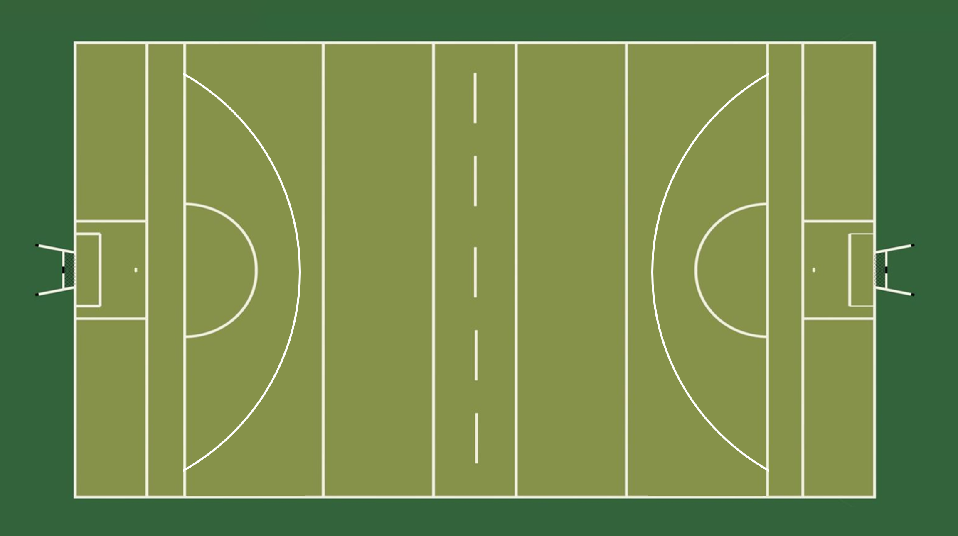

Match Officials Positioning
In Play:
Line Umpire alternate positions depending on ball location
Line Umpire nearest ball stays with it
Opposite Line Umpire on 65m/halfway to judge 4v3
Umpire aware of the space infront
L
8
U
U
R
U
U
9
L
Dugout A
4
Dugout B

Slide 2
Match Officials Positioning
In Play:
Ball switched so Line Umpires alternate positions
Line Umpire nearest ball stays with it
Opposite Line Umpire on 65m/halfway to judge 4v3
Umpire aware of the space infront
L
8
U
U
R
U
U
9
L
Dugout A
4
Dugout B

Slide 3
Match Officials Positioning
Kick Out:
Whatever Line Umpire was nearest 45m line stays there for KO
Opposite Line Umpire on 65m/halfway to judge 4v3 (in play)
Umpire aware of the space infront
L
8
R
U
U
U
U
9
L
Dugout A
4
Dugout B

Slide 4
Match Officials Positioning
Kick Out:
Whatever Line Umpire was nearest 45m line stays there for KO
Opposite Line Umpire on 65m/halfway to judge 4v3 (in play)
Umpire aware of the space infront
L
8
R
U
U
U
U
9
L
Dugout A
4
Dugout B

Slide 5
Match Officials Positioning
In Play:
Ball switched so Line Umpires alternate positions
Line Umpire nearest ball stays with it
Opposite Line Umpire on 65m/halfway to judge 4v3
L
8
R
U
U
U
U
9
L
Dugout A
4
Dugout B

Slide 6
Match Officials Positioning
In Play:
Line Umpire nearest ball stays with it
Opposite Line Umpire on 65m/halfway to judge 4v3
Umpire aware of the space infront
L
8
U
R
U
U
U
9
L
Dugout A
4
Dugout B

Slide 7
Match Officials Positioning
In Play:
Line Umpires alternating positions
LU nearest ball stays with it
Opposite Line Umpire on 65m/halfway to judge 4v3
Umpire aware of the space infront
L
8
U
U
R
U
U
9
L
Dugout A
4
Dugout B

