Slide 1

Goalmouth Repairs
Preventative maintenance is better than emergency repairs

Slide 2
Preventative Measures & Maintenance
Barriers
Remove nets & crossbars when closed
Provide portable goals for training and pregame warmups
Aeration
Topdressing
Overseeding
Nutrition
Irrigation

Slide 3
SIS Stitching
Synthetic fibre
160-190 mm depth
Extra anchoring for roots
Preferably some grass cover
Aeration prior to stitching
Reduce wear area
Natural looking
Stable and hard wearing
6 weeks for grass growth

Slide 4
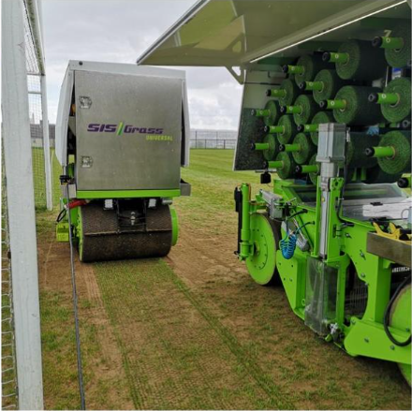
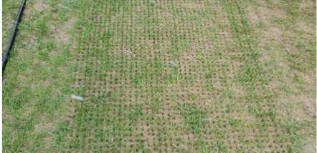
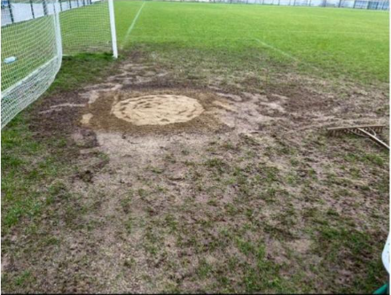
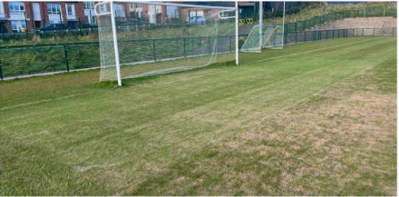

Slide 5
Maintenance & Cost
Carry out annual renovation
Light scarification
Overseed
Nutrition
Irrigation
Topdressing
100-120m2
€9500 - €12000 + VAT
Exact size of stitched area
Ground condition and preparation required
Timing of works
Access and location
Mark.b@sispitches.com

Slide 6
Croke Park system
Lay and play
45-50mm depth
1.25m x 7m length
4 rolls per goal
¾ ton per roll
Reduced wear area
Minimal disruption to games
1 week bedding in period preferred for best results

Slide 7
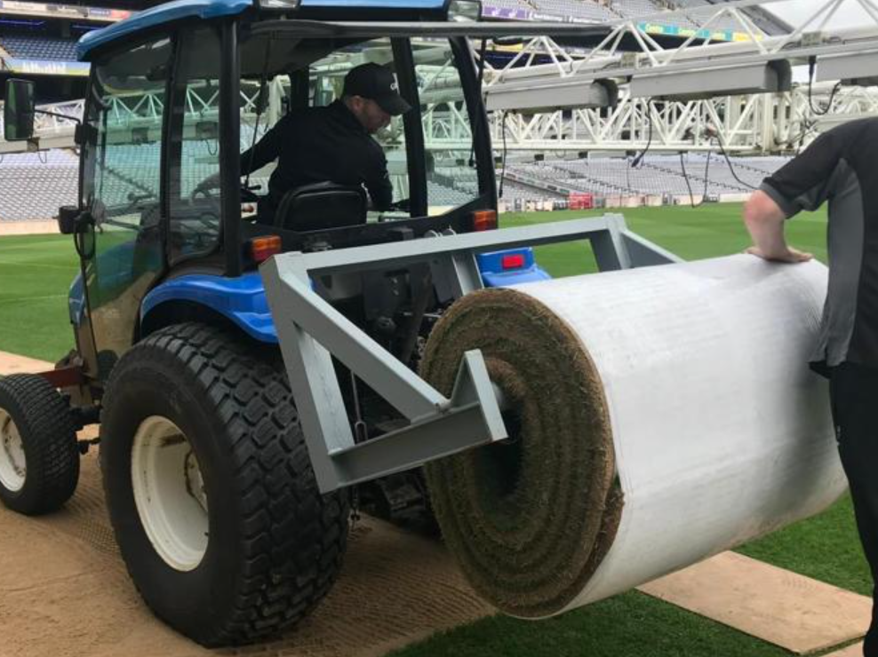
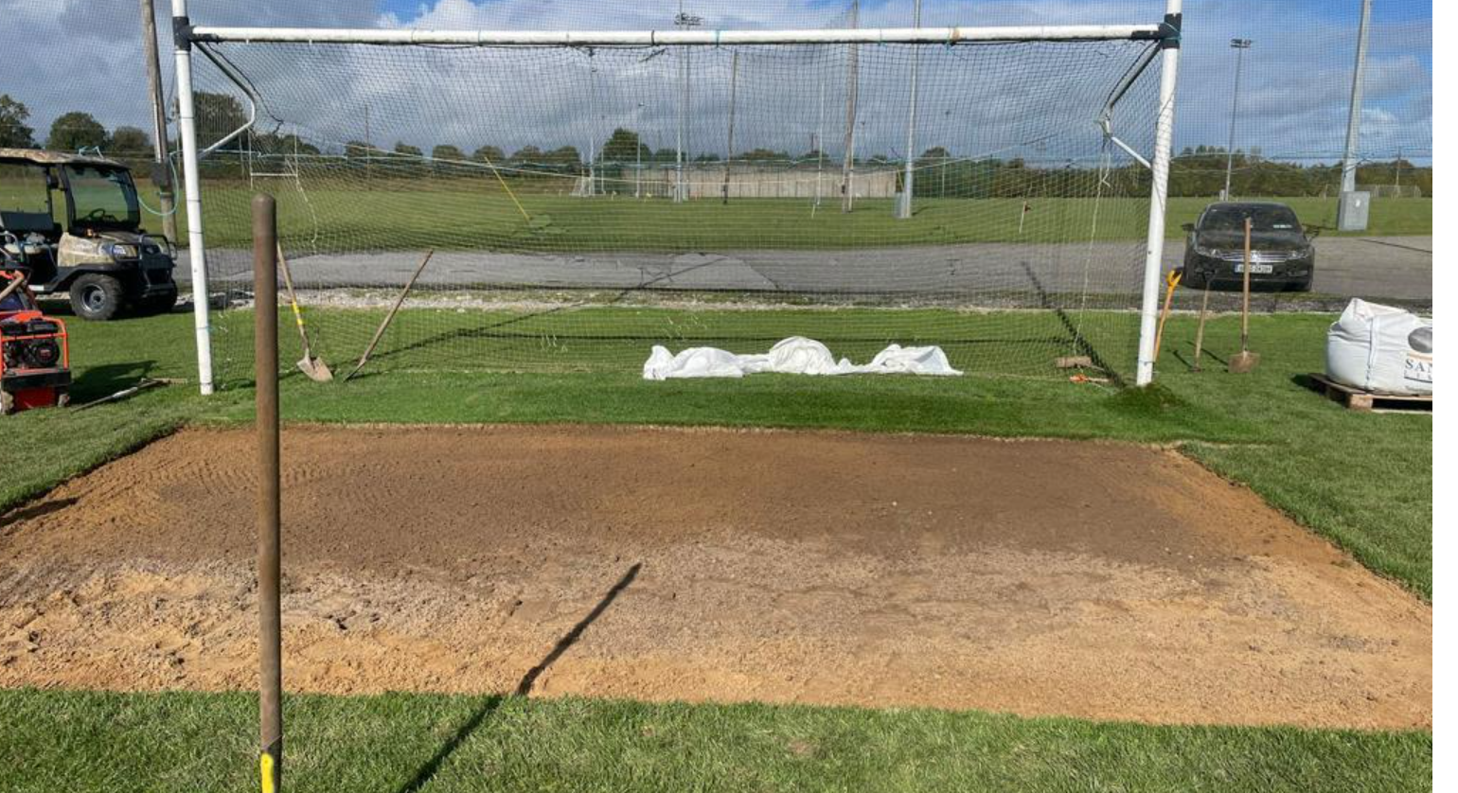
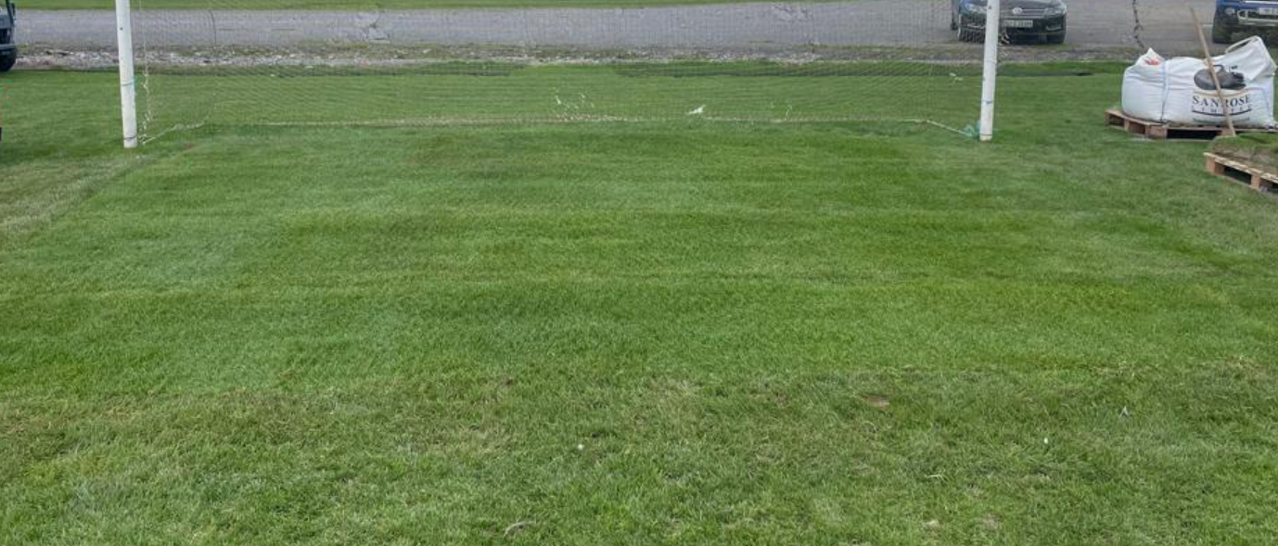
Install

Slide 8
Maintenance & Cost
Carry out annual renovations
Overseeding
Nutrition
Irrigation
Aeration
Topdressing
DO NOT SHOCKWAVE
35m2 per goal
€4550 +VAT
Transport - €650- €800
Installation - €2500 - €3500
swilson@crokepark.ie

Slide 9
Resodding
Rolls from sod farm
20-25mm
Can be done by club volunteers
Aeration prior to laying to improve root development
Immediate results
Can be done more often in smaller areas

Slide 10
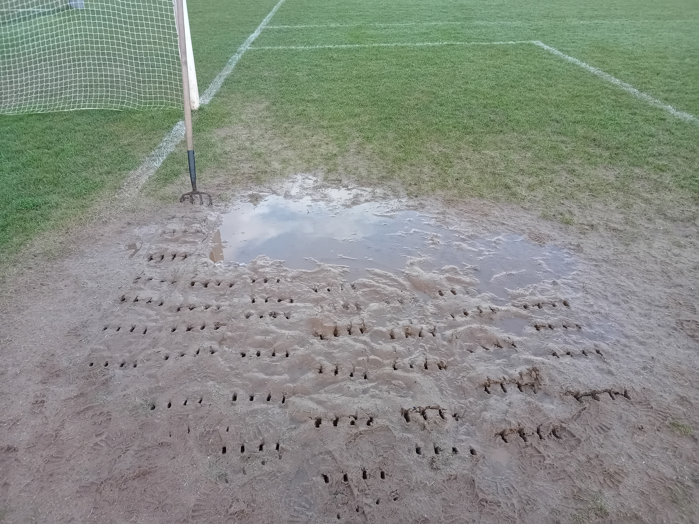
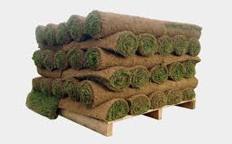
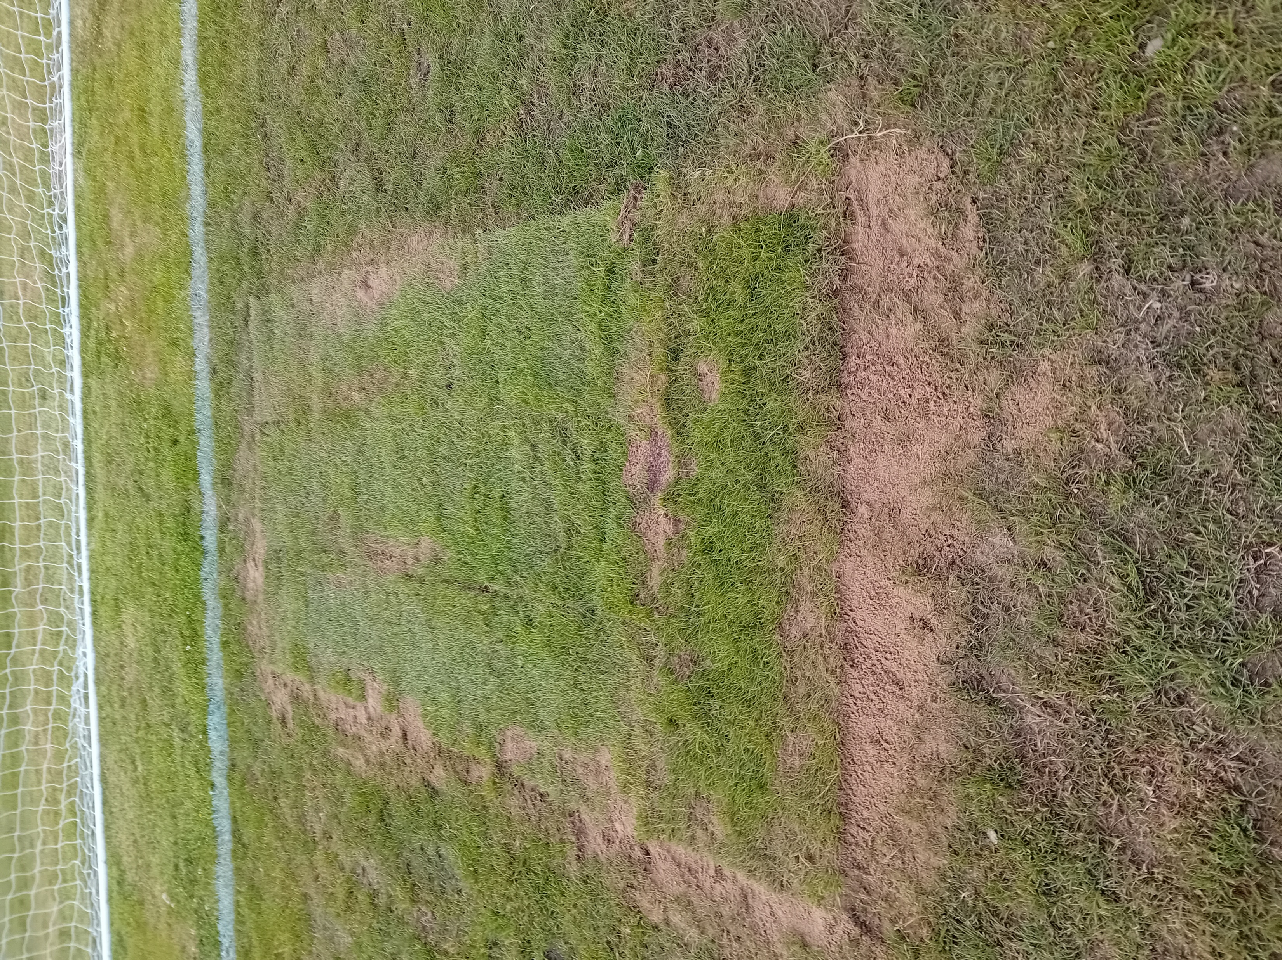

Slide 11
Maintenance & Cost
Carry out annual renovations
Overseeding
Aeration
Nutrition
Irrigation
Topdressing
60m2 for 2 goals
€300- €500 +VAT
Delivery
Optional installation
info@garryfloodlandscapes.ie
info@evergreenlawns.co.uk
info@martynslawns.com
info@harristurf.ie

Slide 12
Astro Turf
100% synthetic carpet
Hard wearing
Eliminates wear area
Quick return to play
100mm depth
Stone
Shockpad
Infill material

Slide 13
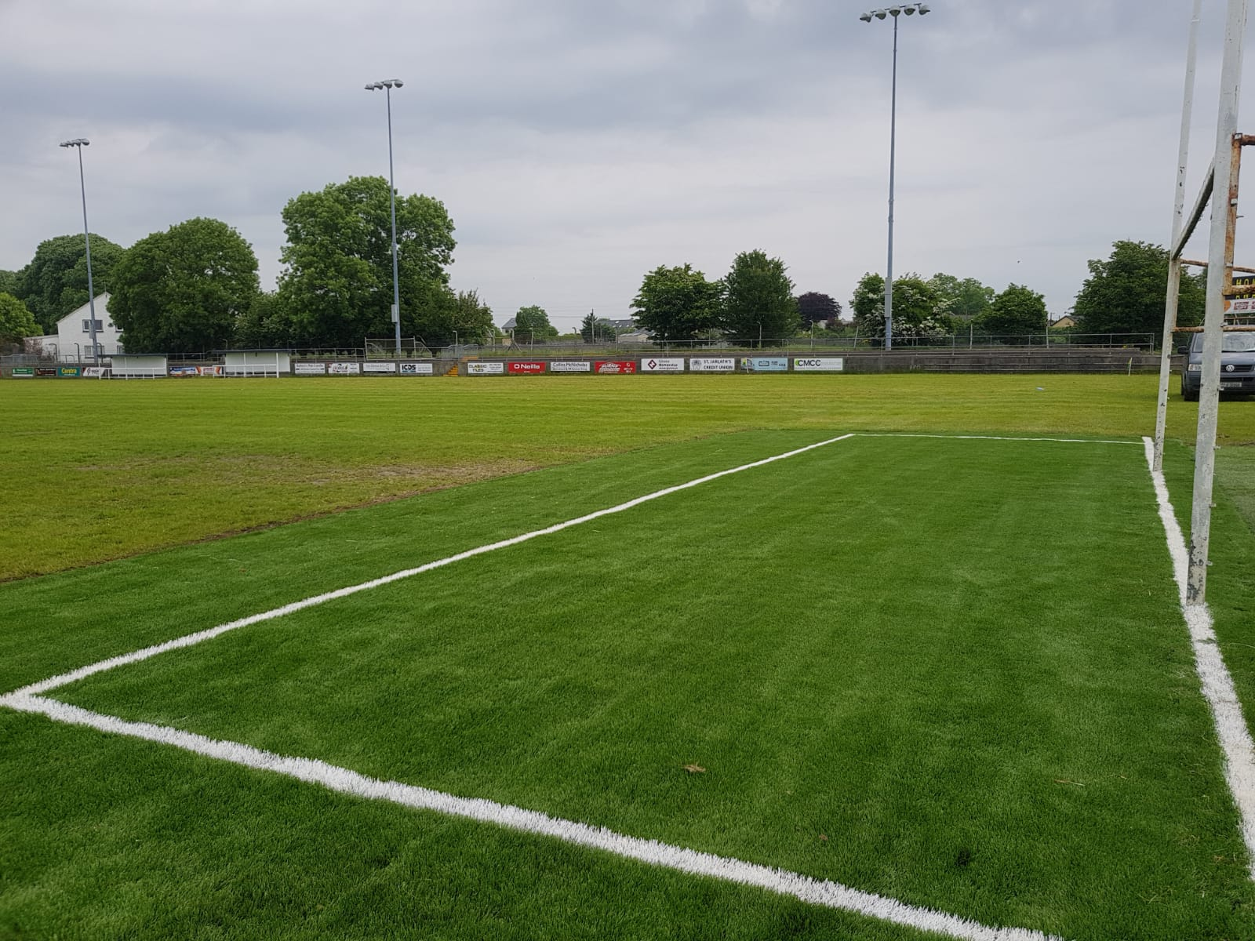
Installation

Slide 14
Maintenance & Cost
Weekly brushing/raking
Debris removal
Weed control
Infill top up
Checking seams
2nr 5.5mx15m carpets
Infill material
Shockpad
€7000 +VAT
Supply only
Ruairikelly@pstsport.com

Slide 15
Hybrid system
60% synthetic carpet
Reduces wear area
Extra anchoring for root system
50mm depth
Rootzone
Carpet
Porus ceramic infill
Seed
Germination sheet

Slide 16
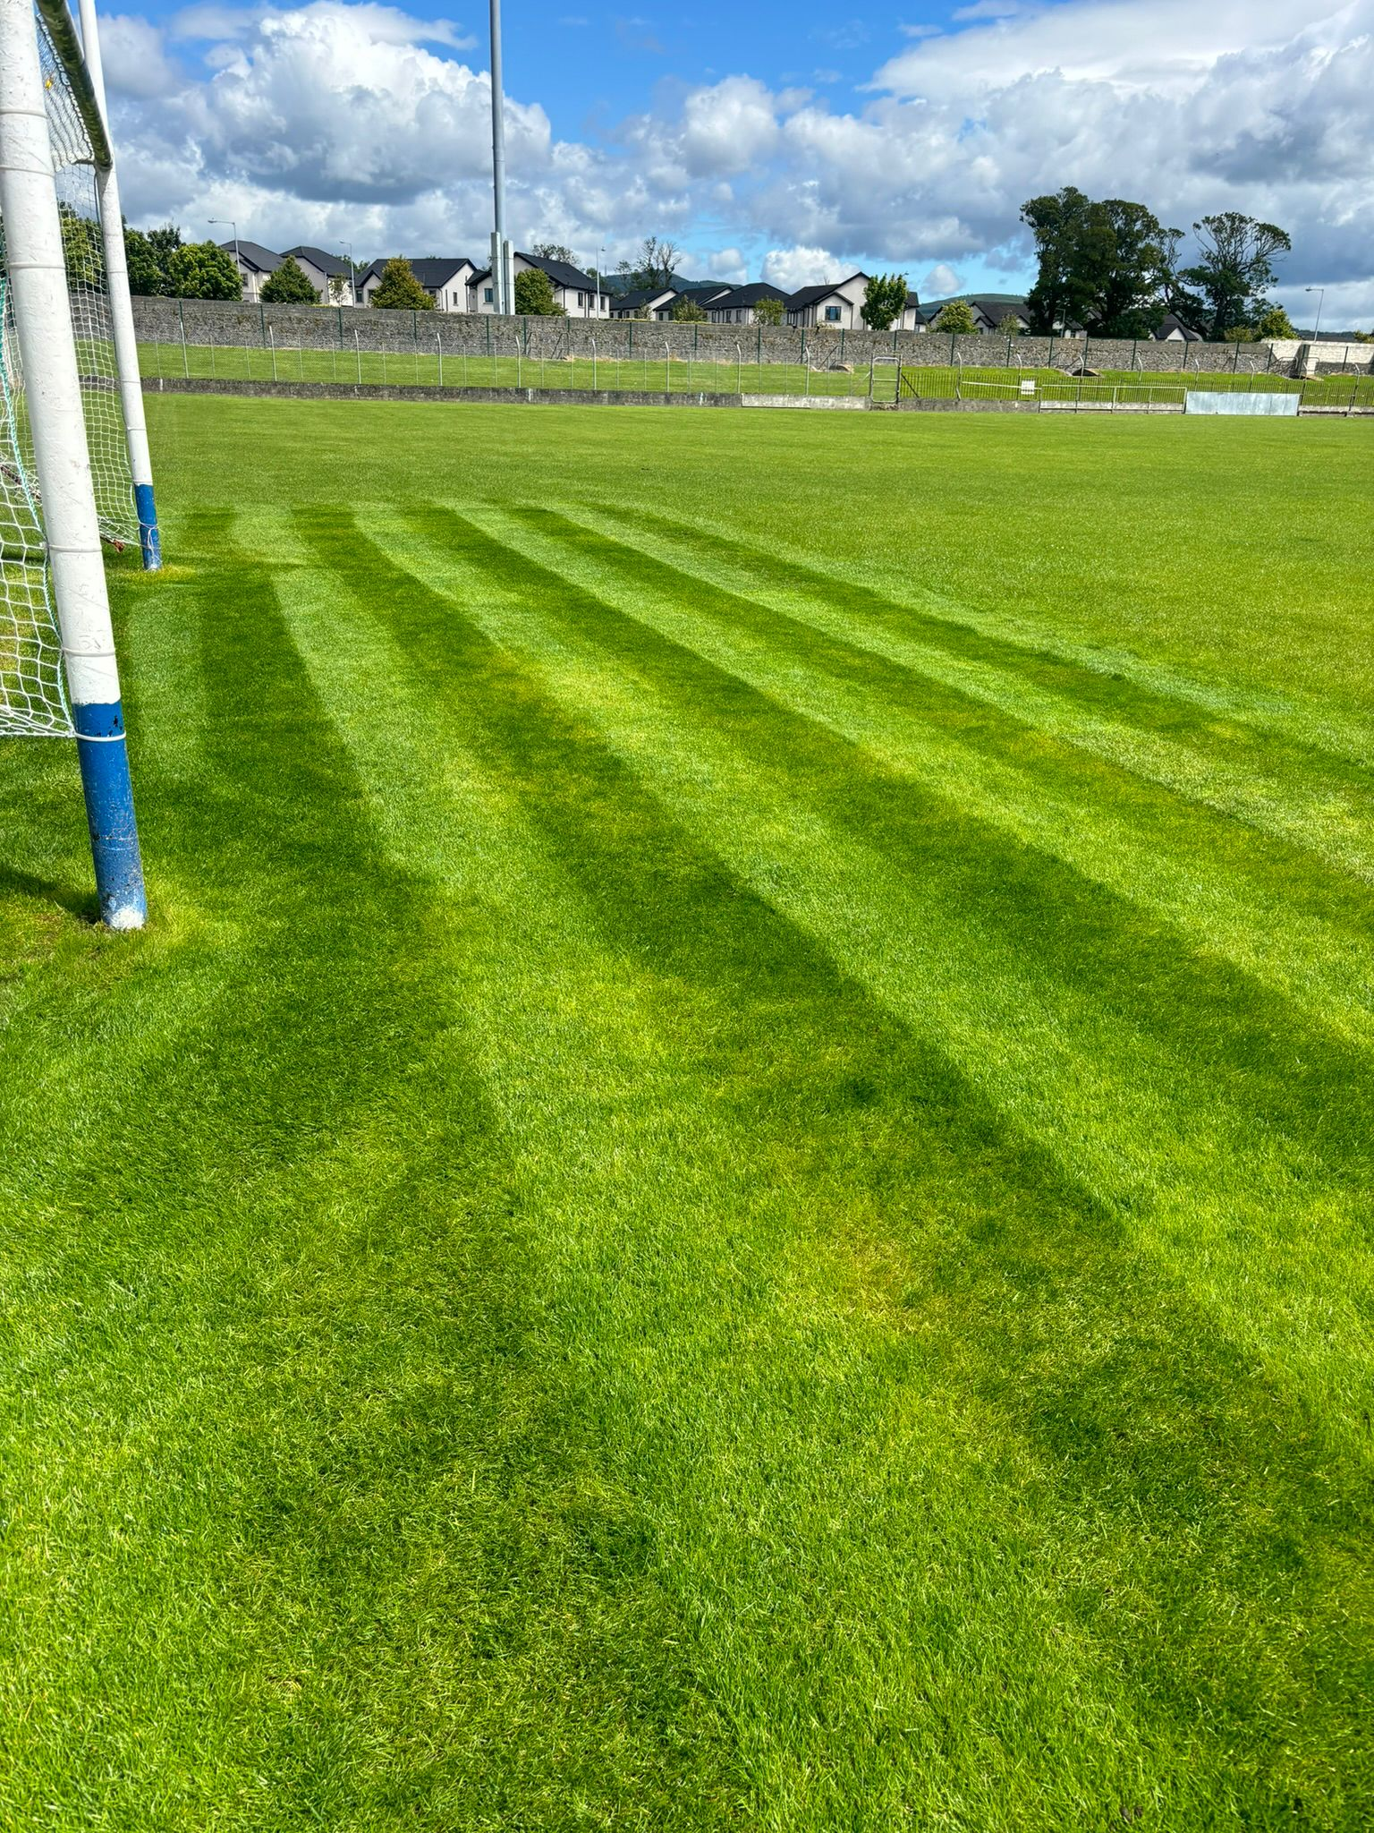
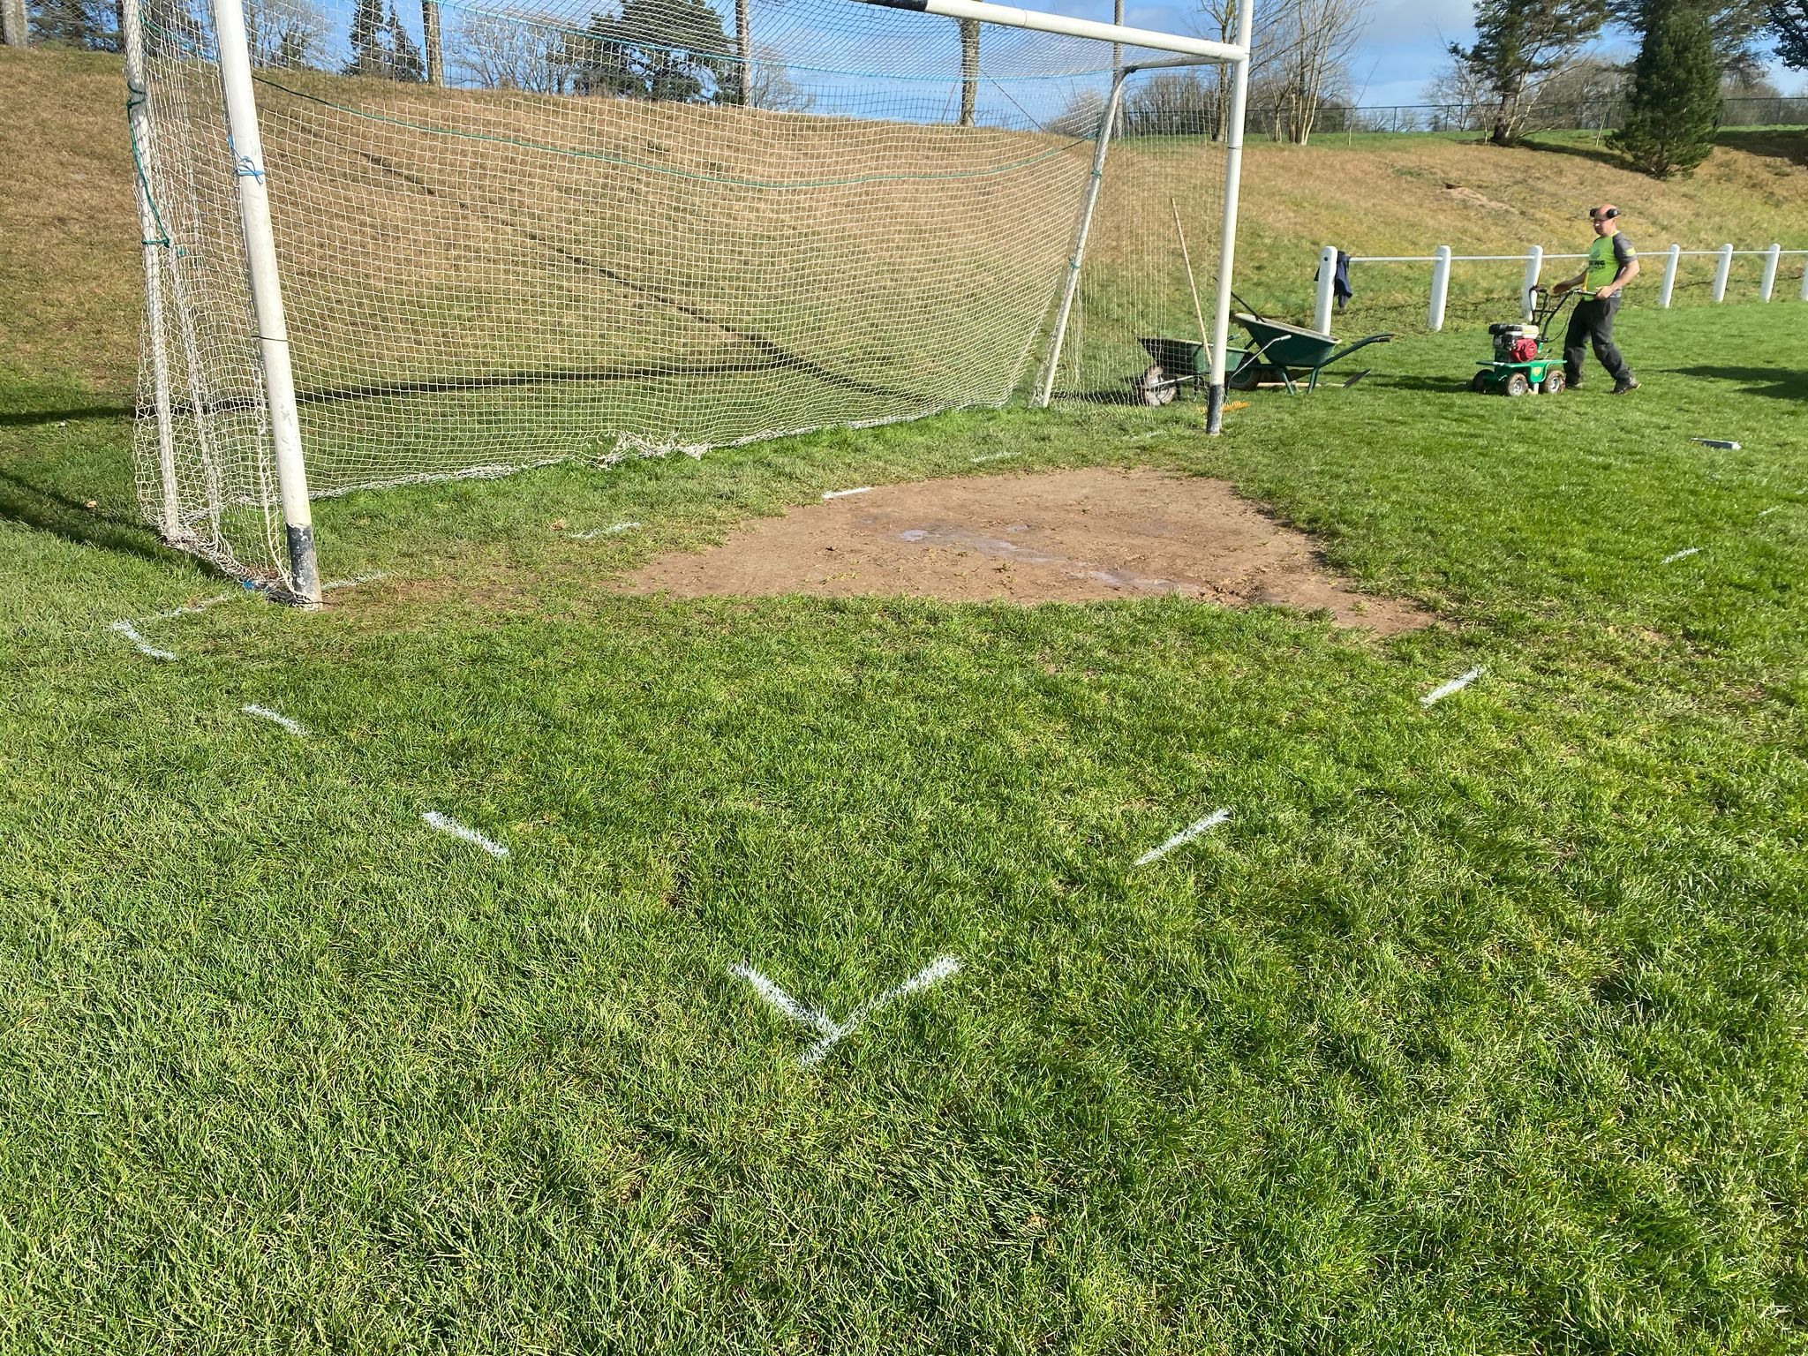
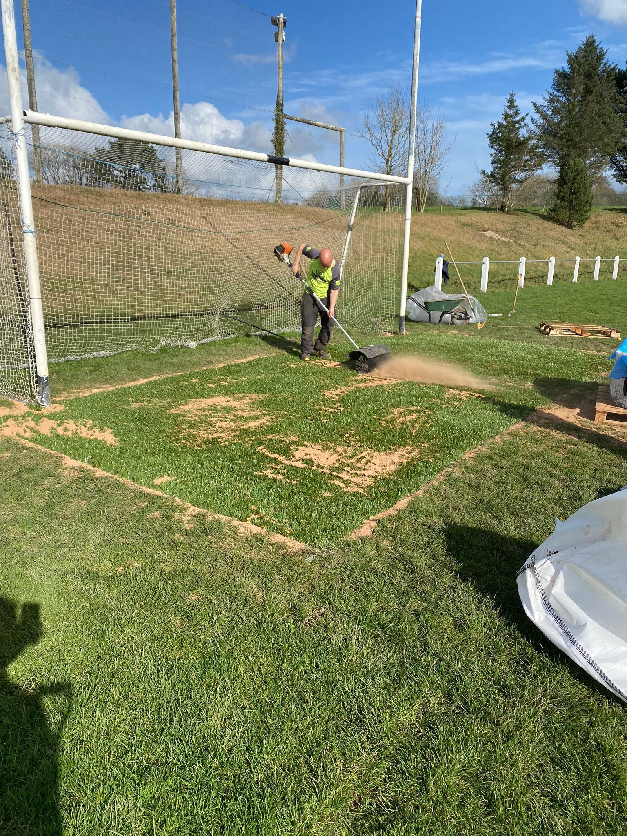
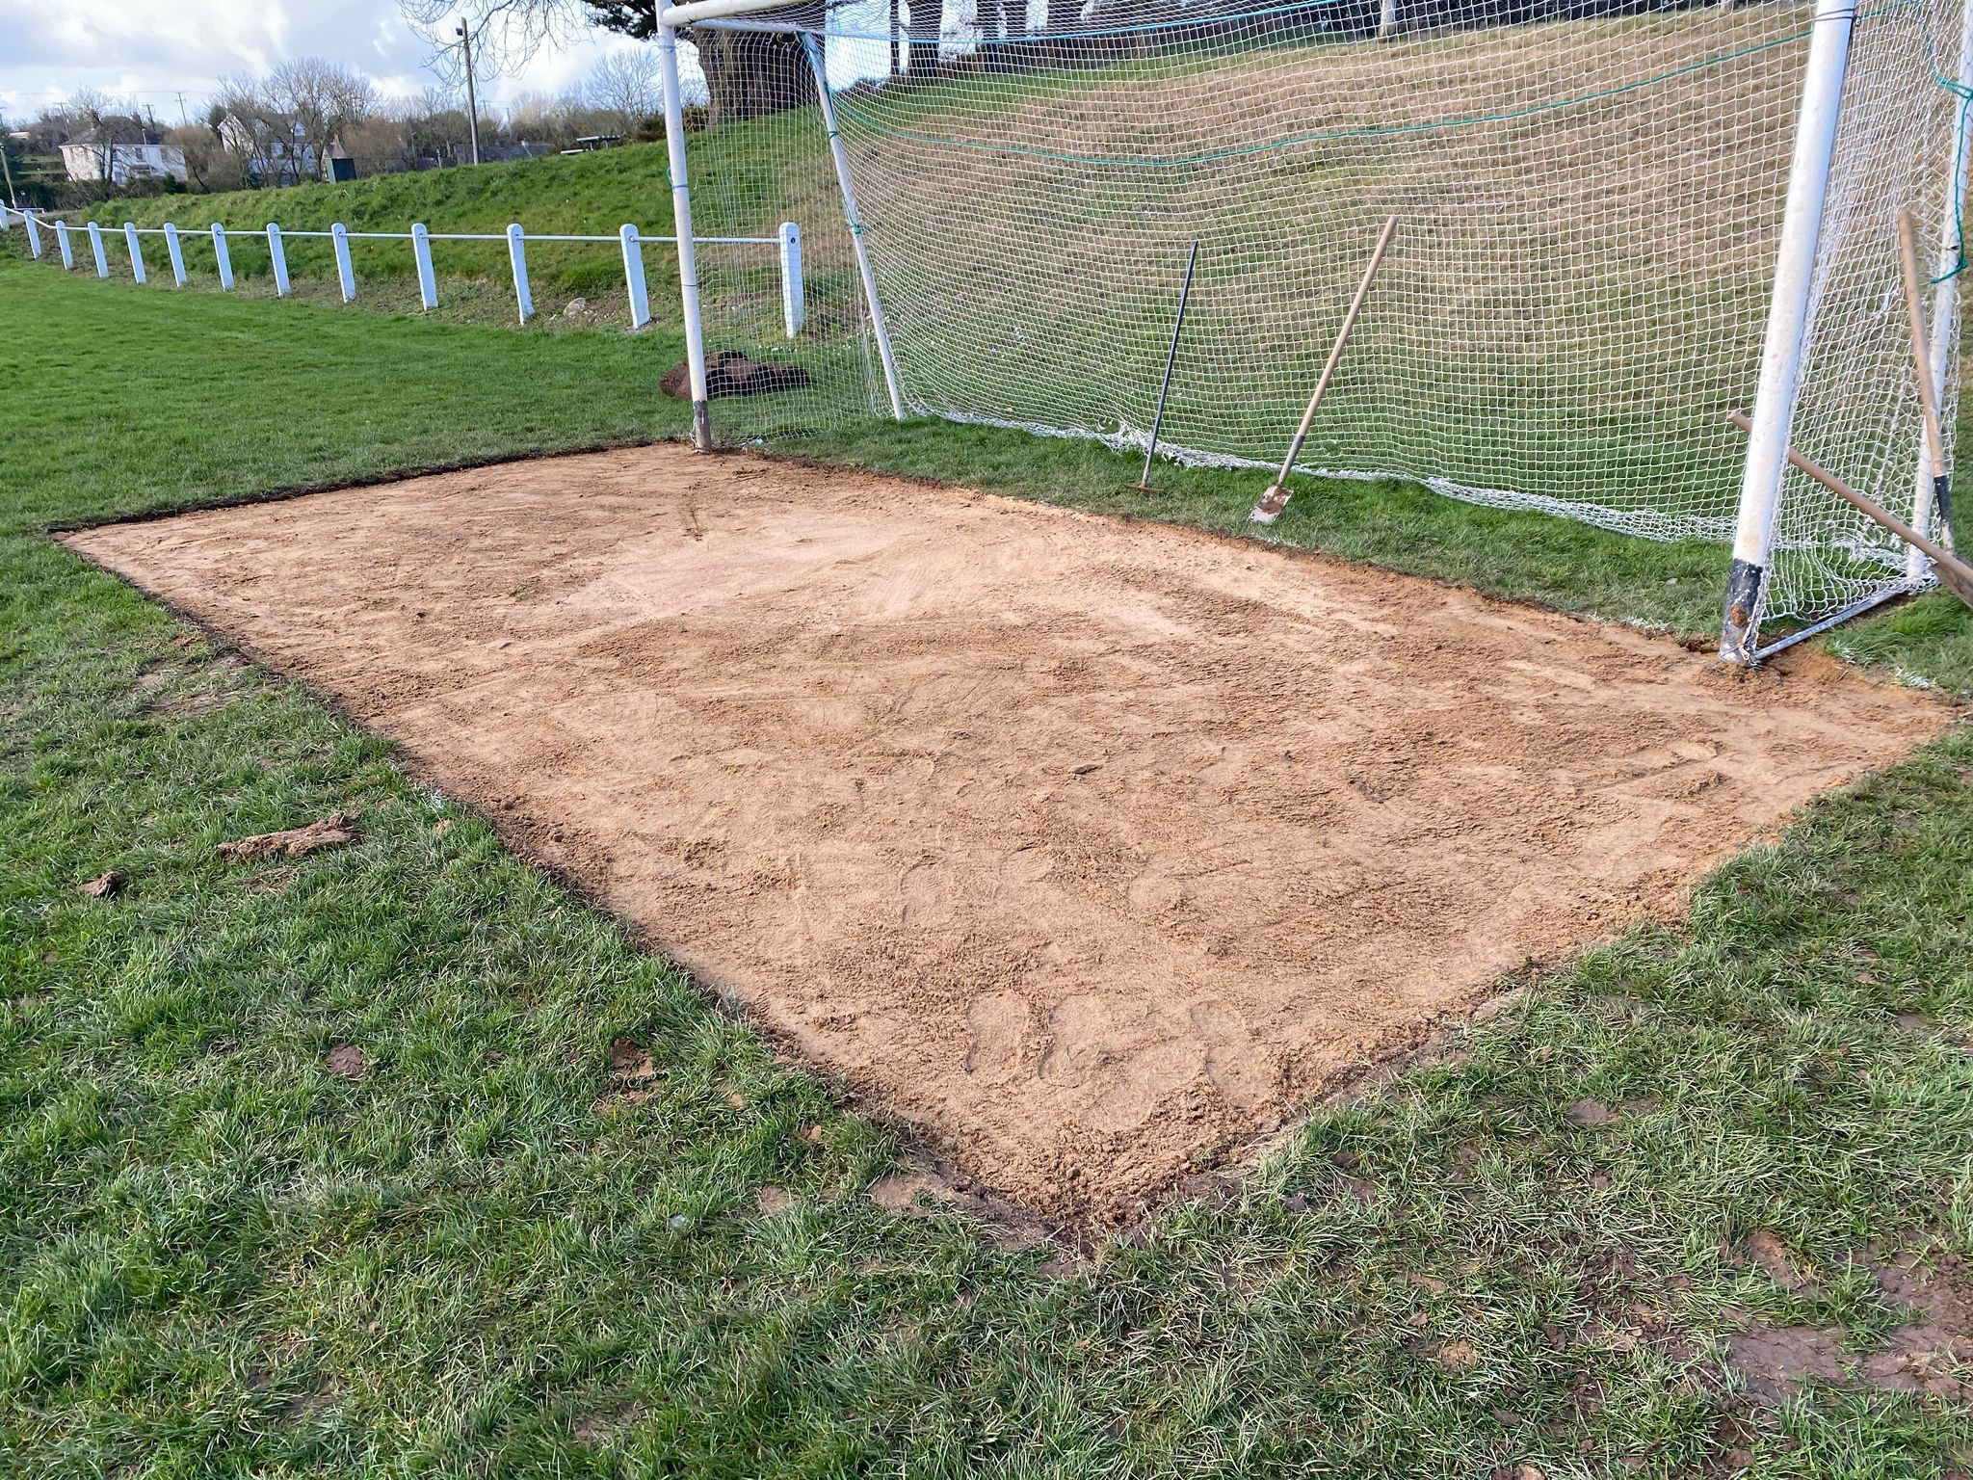

Slide 17
Maintenance & Cost
Carry out annual renovations
Overseeding
Nutrition
Aeration
Irrigation
Topdressing
DO NOT SHOCKWAVE
60m2
€5000 - €7000
Depending on access/scope of works
Carpet
Rootzone
Infill material
info@cropcare.ie

Slide 18
Thanks for your attention
All prices and contact details correct as of March 2026
nationalpitchworkgroup@gaa.ie
Any questions

