Slide 1
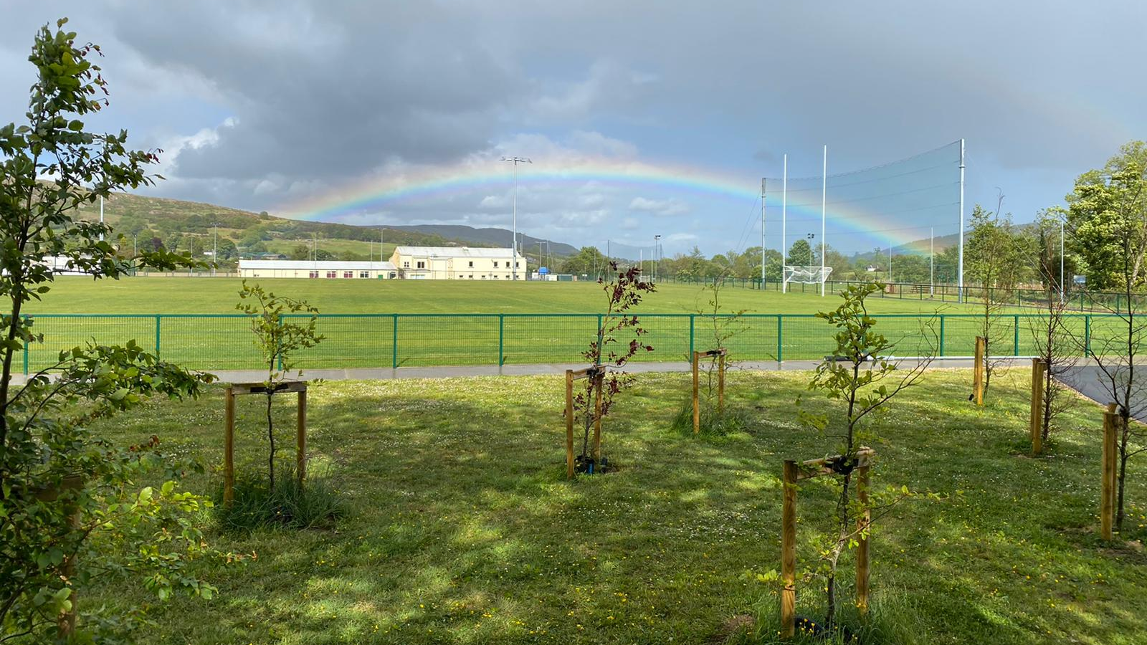
The Club Pitch Maintenance and Management Calander

Slide 2

Declan Magee
Volunteer Groundsman at Liatroim Fontenoys GAC Co Down
Member of the National Pitch Maintenance Workgroup Workgroup

Slide 3



Liatroim Fontenoys GAC
Founded in 1888
We promote all four codes with 34 teams across the four codes. Competing at Senior Level in Hurling, Football and Camogie & LGFA at Intermediate Level

Slide 4
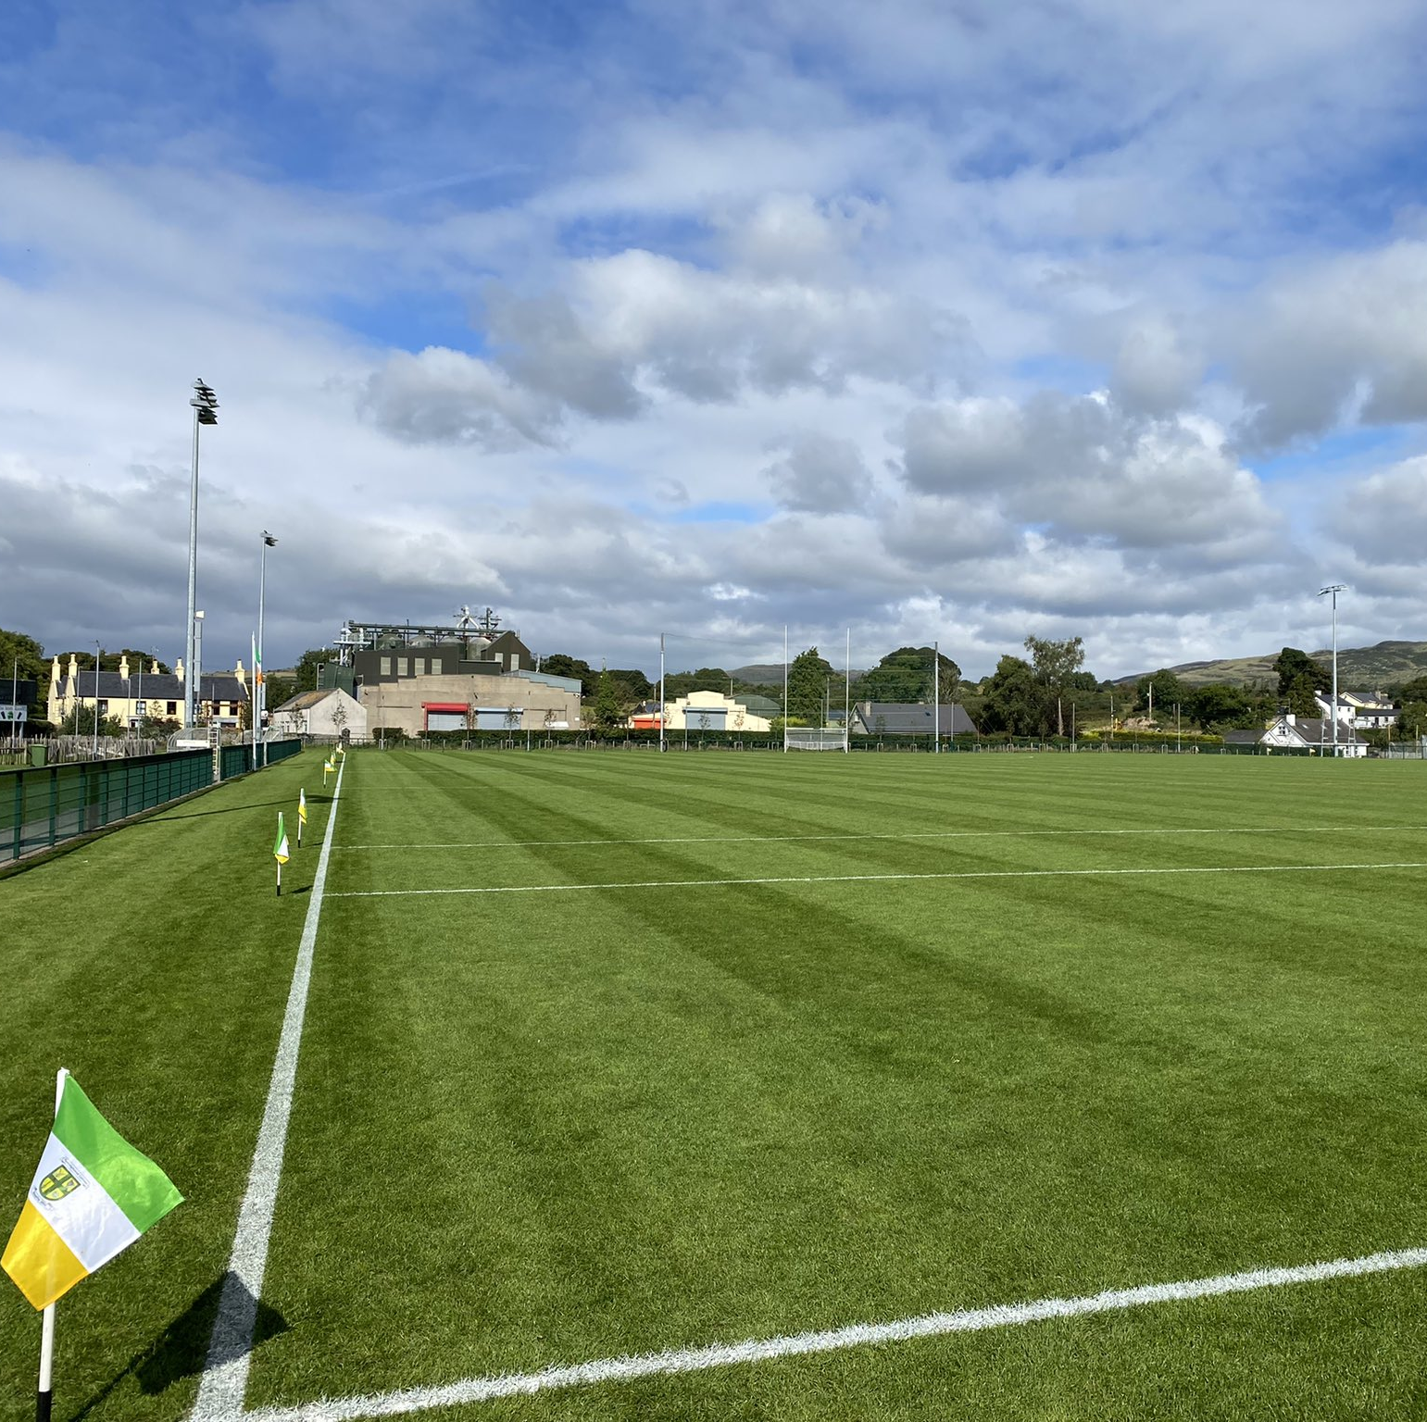
Playing Areas
Pitch 1 was constructed in 1968 by Club volunteers and opened in 1969 Soil Based Piped Drained Construction 130m x 85m
Pitch 2 was constructed in 1994 by John Brannigan and Sons. Soil Based Construction 90m x 50m
Pitch 3 was constructed in 2018 by McAvoy's and opened 2019 Sand Based Pipe Drained Construction 135m x 90m

Slide 5
What does the Club Pitch Maintenance Calander look like at Liatroim Fontenoys GAC?

Slide 6
Pitch Maintenance Influences
There are a few influences that determine – What, When, Why, and How we carry out Pitch Maintenance Tasks

Slide 7
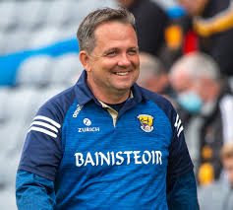

Pitch Maintenance Influences
Coaches and Players
These people are the reason that we do what we do

Slide 8

Pitch Maintenance Influences
Time
Fitting in maintenance tasks around fixtures, training and volunteer availability

Slide 9

Pitch Maintenance Influences
Finance
Budget for maintenance tasks and materials –Fertilizer, Fuel Contractor Work etc.

Slide 10

Pitch Maintenance Influences
Weather
The one thing we can’t control

Slide 11
Pitch Maintenance Details
So what maintenance is carried out?
It will depend on the type of pitch construction.
Sand based pitches require more maintenance and nutrition than a soil- based pitch
Each pitch has its own specific requirements.

Slide 12
Pitch
Usage
Details
34 Teams across 4 codes
Pitch 1 – 435 Hours
Pitch 2 – 271 Hours
Pitch 3 – 495 Hours

Slide 13
Pitch Usage Details – Weekly Schedule
Monday 19 August | Tuesday 20 August | Wednesday 21 August | Thursday 22 August | Friday 23 August | Saturday 24 August | Sunday 25 August
18:30 - U14 Football Championship Liatroim v Ballyholland (Throw-in 19:15) | 18:00-19:15 - Senior Hurling training 19:30-20:30 - U12 & U14 Hurling training 19:30-20:30 - Senior LGFA training | 19:00 - U16 Football Challenge Match Liatroim v Rostrevor (Throw-in 19:30) | 18:30-19:30 - U10 Camogie training 18:30-19:30 - U12 & U14 Camogie training 18:30-19:30 - U12 Football training 19:30-20:30 - Senior LGFA training | 18:30-19:45 - Senior Camogie training | 09:00-10:00 - U8 Camogie training 10:00-11:00 - U8 LGFA training 17:00-18:00 - U14 Football training 18:00-19:00 - U16 Football training | 10:00-11:00 - U12 LGFA training 12:00 - U14 LGFA League Liatroim v Bryansford (Throw-in 12:30)
18:30-19:15 - Senior Camogie training 19:30-20:45 - Senior Football training | 18:30-19:45 - U10.5 Matches Liatroim v An Riocht 19:45 - U14 LGFA training |  | 18:30-20:00 - U10 Hurling & Football training | 18:30-19:30 - U14 Hurling training |  | 10:30 - U12 Boys Football Match Liatroim v Loughinisland (Throw-in 11:00)
18:30 - U16 Camogie Championship Liatroim v Clonduff (Throw-in 19:30) | 18:30 - Minor Football Championship Liatroim v Glenn (Throw-in 19:15) | 18:30-19:30 - U16 LGFA training 19:30-21:00 - Senior Football training | 18:30-19:45 - Senior Hurling training 19:45-21:00 - Minor Football training | 19:00-20:30 - Senior Football training | 18:00 - Down Senior Football C'ship Loughinisland v Kilcoo (Throw-in 19:00) | 10:00-11:30 - Fundamentals
 | 18:30-19:30 - U14 LGFA training
18:30-19:30 - U8 LGFA training 20:00-21:00 - Caman an Chat Camogie | 18:30-20:00 – U8 Hurling & Football training |  | 18:30-20:00 – U8 Hurling & Football training |  |  | 10:00-11:00 - GAA All Stars
Pitch
1
2
3
4
Ball
Wall

Slide 14
Pitch 1,2 & 3
Pitch Maintenance
Program - Mowing
Mowing Frequency
January to March – As and when required
April – Every 3 to 4 days
May – Every 2 days
June – Every 2 days
July – Every 2 days
August – Every 2 days
September – Every 3 to 4 days
October – Every 5 to 7 days
November to December – As and when required
Height of Cut (HOC)
November to March – 40mm
April to October - 35mm

Slide 15
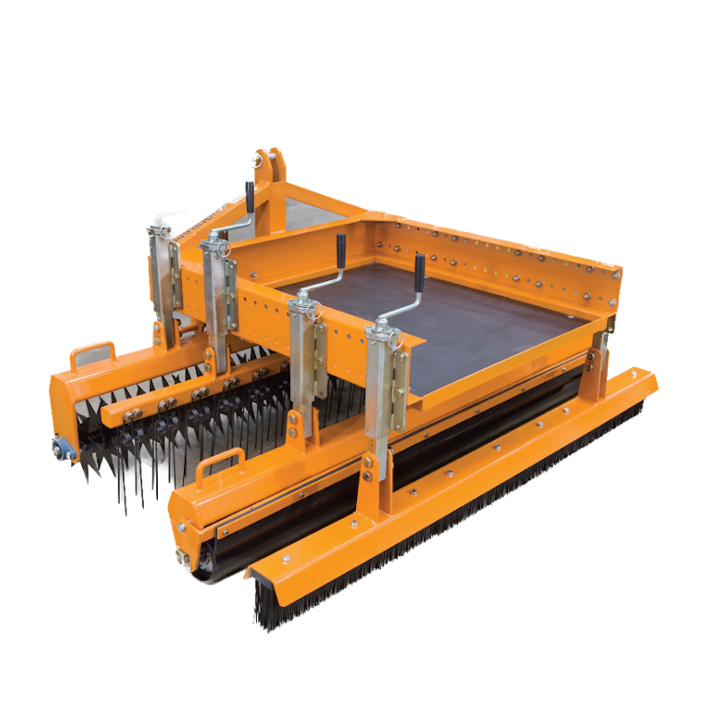
Pitch 1,2,3 & 4
Pitch Maintenance
Program - Shallow Aeration/Grooming
- Quadraplay
January to April – Weekly*
October to December – Weekly*
* When ground conditions allow
Additional operations are carried out post training/match when required

Slide 16
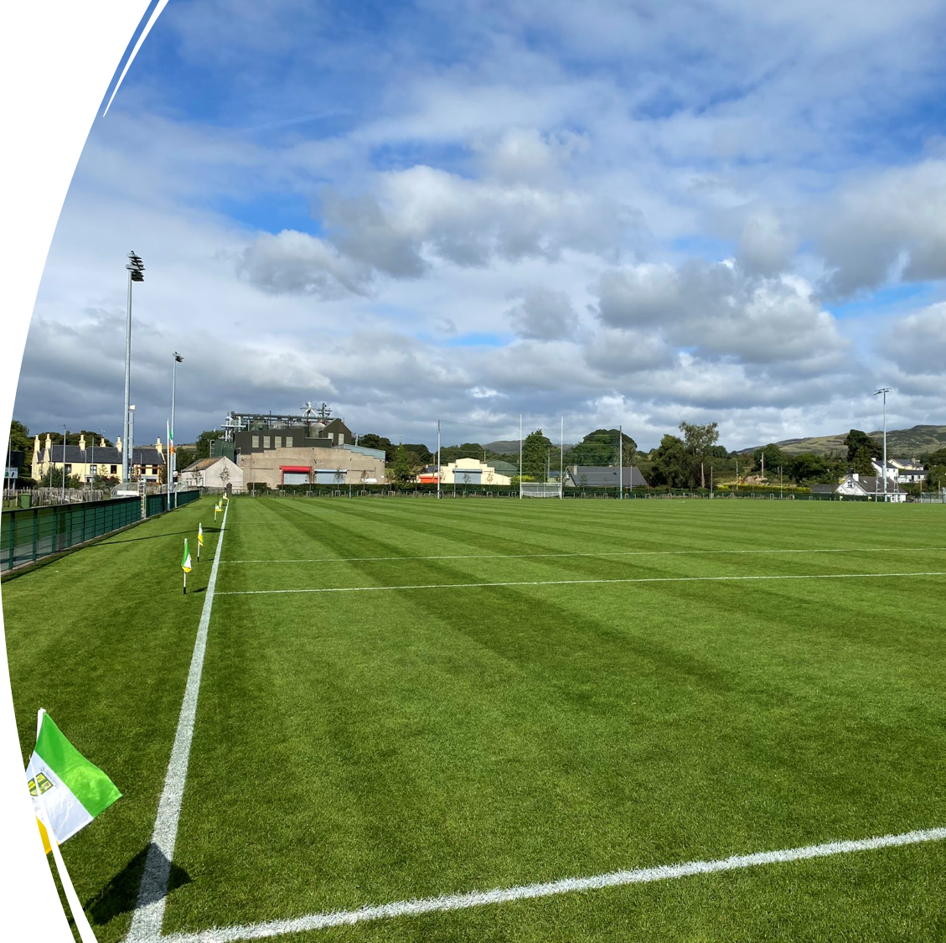
Fertilizer and Chemical Applications

Slide 17


Fertilizer and Chemical Applications
10-10-20
4 Weeks
22-5-6 + 3MgO + 2CaO
Controlled Release Fertilizer (CRF)
4-5 months

Slide 18
Fertilizer and Chemical Applications
Granular
March - Spring Starter 20-5-10 + 2MgO Controlled Release Fertilizer (CRF) 2-3 months longevity.
May – Spring Summer 22-5-6 + 3MgO + 2CaO Controlled Release Fertilizer (CRF) 2-3 months longevity.
August – Spring Summer 22-5-6 + 3MgO + 2CaO Controlled Release Fertilizer (CRF) 2-3 months longevity.
October – Autumn Winter 15-5-22 + 2MgO Controlled Release Fertilizer (CRF) 4-5 months longevity.
Calibrate spreading equipment regularly

Slide 19
Fertilizer and Chemical Applications
Recommended application rates vary from 20 mg/m² to 35 mg/m².
How many bags does this equate to?
Pitch enclosure measuring 100 metres x 140 metres = 14,000m²
For a 20 mg/m² application
14,000 x 0.02kg = 280 kg using 20kg bags = 14 bags
For a 30 mg/m² application
14,000 x 0.03kg = 420 kg using 20kg bags = 21 bags
What amount do we apply?

Slide 20
Fertilizer and Chemical Applications
Selective Herbicide – Two Treatment Programme
1st Treatment (Praxys): Apply in April or May for initial control of broad-leaved weeds and daisy.
2nd Treatment (Trophy XL): Apply in June, July, or August for continued suppression and to address weeds like plantain and emerging infestations.
March – September –Wetting Agent – Conservator Every 5 weeks to retain moisture in the rootzone to prevent the plant from reaching the Permanent Wilting Point Pitch 3 only (Sand Based)
March – September – Liquid Fertilizer Every 4 weeks 15-0-0 + 11CaO + 2MgO + 0.75Fe + 0.05B + Seaweed + Sugars
Pitch 3 only
October-February – Soluble Iron - Foliar Application
Keep Records of Pesticide and Fertilizer Applications
Apply at Manufacturer’s recommended rates

Slide 21
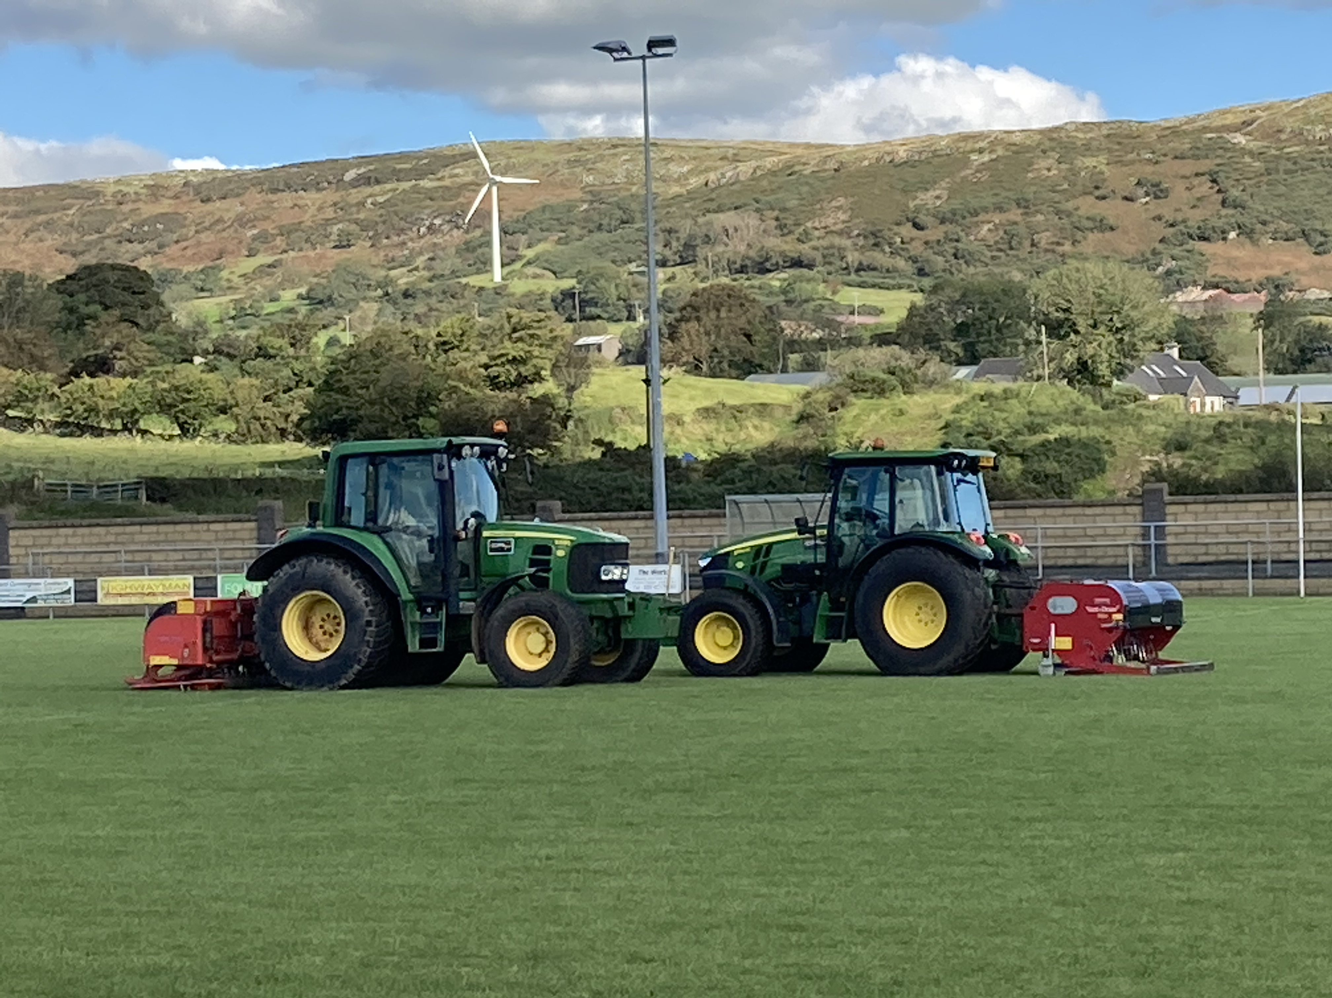
Major Pitch Maintenance Operations
March/April – Verti Drain/Shockwave
Overseed 12 bags/pitch
Sand Top-dress 50 tons/pitch
August/September
Scarify, (Verti Cut)
Verti Drain, Overseed 12 bags/pitch and Sand Top-dress 60 tons/pitch
November – Verti Drain/Shockwave Goal Mouth Repair

Slide 22

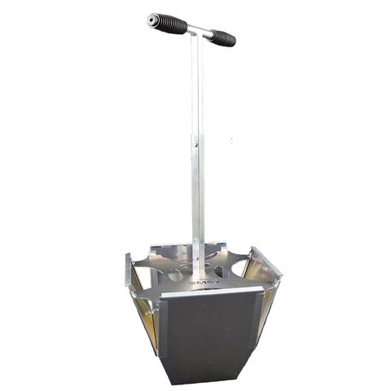
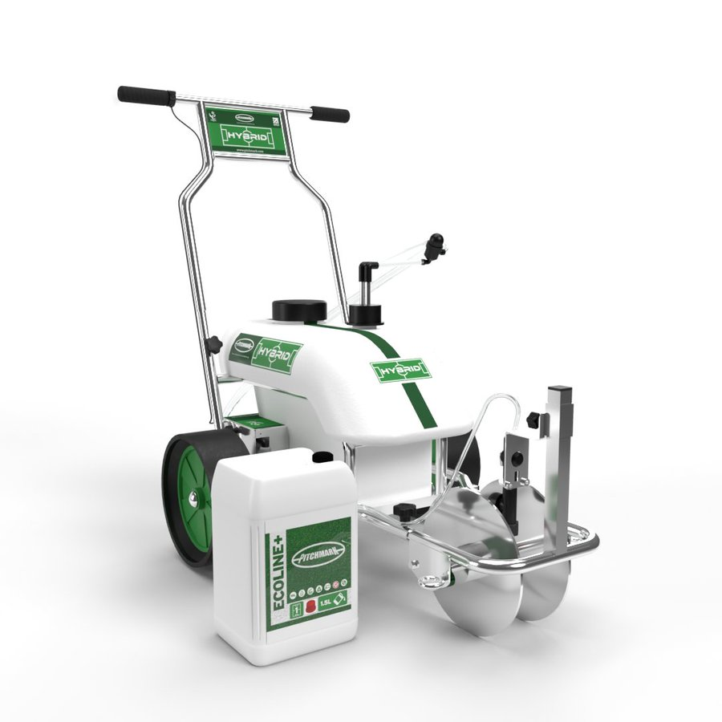
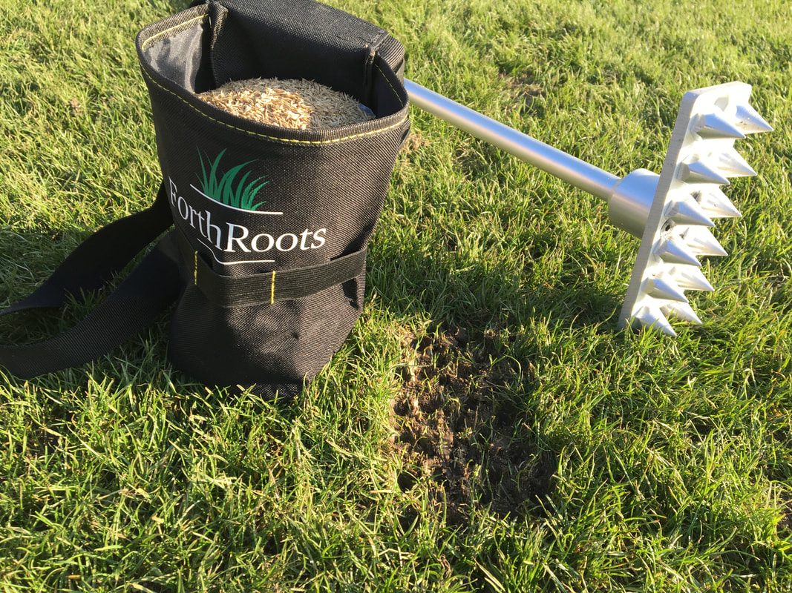
Minor Pitch Maintenance Operations (year-round)
Line Marking
Divot Repair – Post training/match
Triming around goal posts and pitch perimeter
Spot Overseeding – Rye Seeder
Turf Patching – Turf Doctor
Edging – Pitch Perimeter

Slide 23
Benefits of Pitch Maintenance
The better the surface the better the game
Reduced injury risk to players
Hosting of Inter County and Club Championship fixtures – Generates revenue for the Club

Slide 24
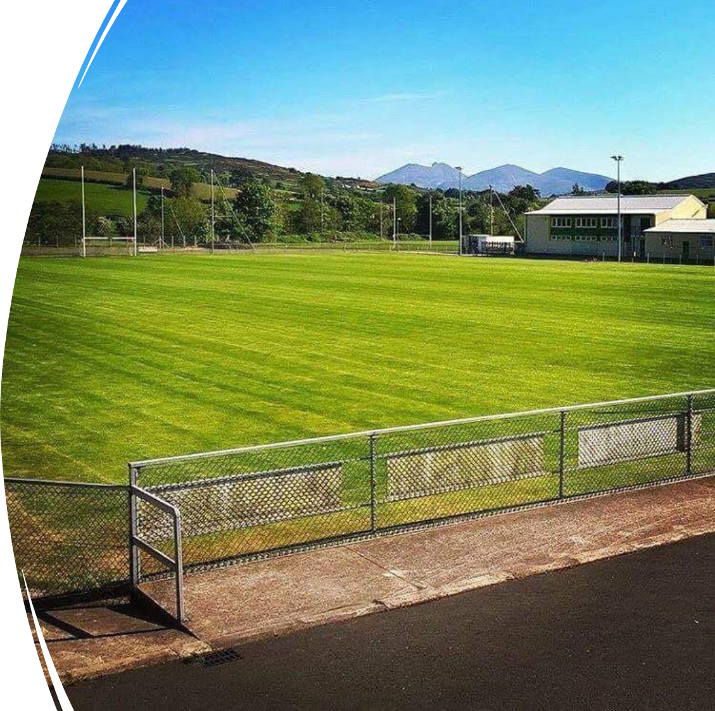
Pitch Maintenance
Costs
Verti- Drain/Shockwave £500/pitch
Top Dress with sand £30/ton spread
Overseed 12 bags/pitch £1750
Scarify/Veri Cut £500/pitch
Fertilizer Application £700/pitch
We budget for around £750/team/year as our top line cost, but weather and usage hours may determine a possible lesser or larger spend
Our volunteer grounds staff would regularly put in 30-40 hours a week on maintenance tasks at the peak of the season

Slide 25
Thanking You For Your Time and Participation
Questions?

