Slide 1

Club Coaches Induction Session
Gaelic Games Club Coaching Community of Practice…a peer facilitated approach
WELCOME
Notes:
First line - Wouldn’t it be great if sports clubs took ownership of the development of its coaches by development I mean coaches looking to continually improve ! What might that mean?

Slide 2
Introductions
WHO AM I?
Name, code, age group you coach etc.

Slide 3
My Role as a Coach Developer?
My role as a coach developer is to…
  Provide an overview of the CCCoP Programme
  Assist with identifying the CCCoP groups and coach leaders Upskill and support the coach leaders
  Support to Coach leaders throughout the programme i.e., email, phone or via WhatsApp

Slide 4
Setting the scene
Why are we here?

Slide 5


Slide 6
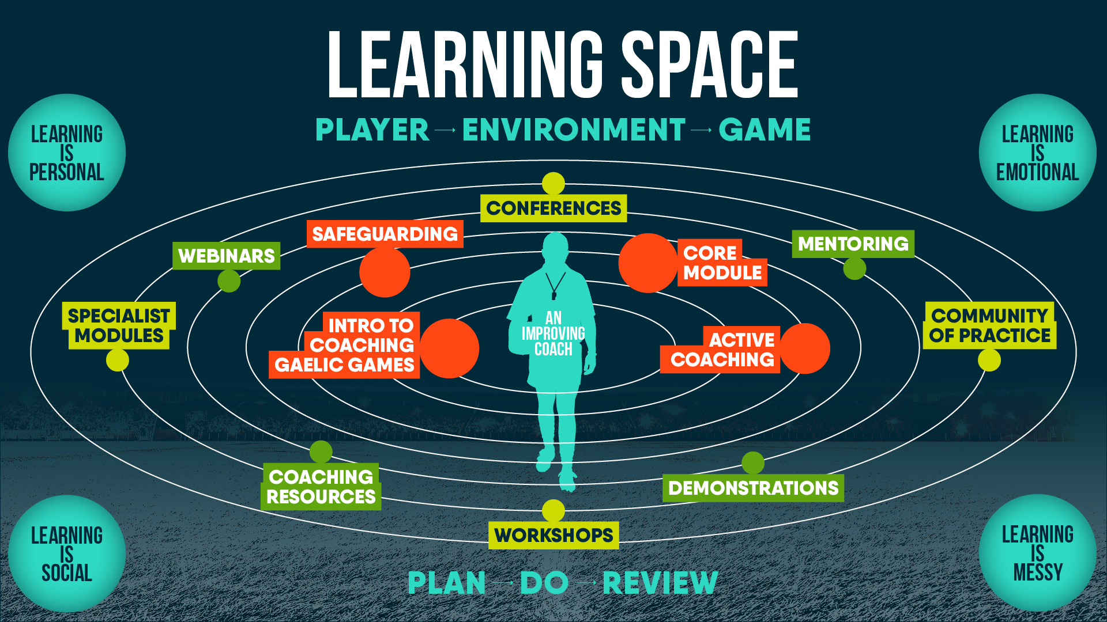

Slide 7
What is a Community of Practice?
Describe to me, what is your understanding of a Club Coaching Community of Practice!

Slide 8
What is a Community of Practice?
  “Groups of people who share a concern, a set of problems, or a passion about a topic, and who deepen their knowledge and expertise in this area by interacting on an ongoing basis”
  (Wenger, McDermott and Snyder, 2002, p. 4)
  In coaching terms, a coaches’ community of practice (CCoP) is a way to support coach learning through collaboration
  (Culver and Trudel, 2006)
Notes:
What is a Community of Practice?
It is where individuals or coaches, learn by being involved in a structured social framework of co-participation. Coaches work closely together with a ‘sense of a mission’ – there is something people want to accomplish or do together that arises their shared understanding. In essence, regular interaction assists coaches to find solutions to everyday coaching issues that in turn deepen their knowledge and potentially changing their practice.
‘It is club coaches having better coaching conversations’

Slide 9
Benefits of a Community of Practice
  Group of people, with a common interest meeting on a regular basis
  Promotes good coaching conversations within club coaches
  Develops Coach Self-Reflection
  Focus specifically on ‘active coaching’ i.e., good coaching practice, challenges etc.
  Cross pollination of ideas, trying to learn different things and learning from what works and what doesn’t.
  Improves social dynamic of the group where coaches get to know each other more.
Notes:
What is a Community of Practice?
It is where individuals or coaches, learn by being involved in a structured social framework of co-participation. Coaches work closely together with a ‘sense of a mission’ – there is something people want to accomplish or do together that arises their shared understanding. In essence, regular interaction assists coaches to find solutions to everyday coaching issues that in turn deepen their knowledge and potentially changing their practice.
‘It is club coaches having better coaching conversations’

Slide 10
In essence…
It is where coaches…
Take more ownership of their own learning and are involved in a structured social framework of co-participation
Work closely together with a ‘sense of a mission’- There is something people want to accomplish or do together that arise their shared understanding.
Have regular interaction and better conversations to assist coaches to find solutions to everyday coaching issues relevant to their needs and context that in turn deepen their knowledge and potentially changing their practice.

Slide 11
How to set up a Coaches CoP
  Level of Readiness – Club (Application Process)
  Coaches across all codes who are interested in trying something new
  Suitable Coach Leaders (a peer coach)
  Multiple Coach Leaders in a club setting (Internal Support)
  Provision of Training for the Coach Leader
  External Ongoing Support

Slide 12
Coach Expectations
Attend coaches' induction meeting with Coach Developer (Tonight)
Attend maximum three club coach gatherings over a three-month period with your peer coaches. These meetings will be sixty-ninety minutes in duration.

Slide 13
Coach Leader Expectations
Attend coaches' induction meeting with Coach Developer (Tonight)
Undertake an orientation (Training) with the coach developer
Lead maximum three club coach gatherings over a three-month period with peer coaches.
Support your peer coach leader
Ongoing support from the Coach Developer

Slide 14
Setting up the CCCoP Groups
TASK 1
In groups (4 or 5), discuss how you like the CCCoP groups in the club to be set up.
Potential options are:
Coaches within same or similar age band (Academy, U12-16, U18+) and same code
Coaches within similar age band (Academy, U12-16, U18+) but mix codes.
Mix coaches – new and experienced of same code.
Mix coaches – new and experienced of mix code.
VOTE!

Slide 15
Setting up the CCCoP Groups
TASK 2
Based on set up agreed, now divide into group of 4/5 coaches

Slide 16
Setting up the CCCoP Groups
TASK 3
Identify Coach Leaders
Key characteristics of a coach leader would be:
Creditable within group
Understands CoP Concept
Ability to facilitate conversation.
Good listener
Organised
Role of a coach leader would be:
Arrange the CCCoP sessions i.e., meeting place, time etc.
Link in peer coaches to identify coaching topics
Set the agenda for the meeting
Facilitate discussion
Complete short self-reflections post each CCoP session

Slide 17
Setting up the CCCoP Groups
TASK 3
Peer coaches each group identify two coach leaders for their group.
Having two coach leaders ensures CoP continues if one unable to make a session and act as a support for each other.

Slide 18
Setting up the CCCoP Groups
TASK 4
Agree a communication plan
Coach leaders with coaches agree dates for coaches CCoP – Max. 3 during Months of July, August, and September
Identify the specific coach leader for each CCCoP session.
Coach leaders set up communication tool for their respective CoP i.e., WhatsApp group.

Slide 19
Structure of a CCCoP
CCCoP structure will look like
Catalyst – something relevant, topical, video, article etc.
Coaches set the agenda
  Challenge or Opportunity in current coaching
  Order of discussion to be agreed pre-CoP
  Topics to be sent to Coach leader in advance!
  Explore Ideas on topics discussed
  Find solutions on topics discussed
Agree actions from topics discussed
The CCCoP sessions are min 60 minutes and max. 90 minutes in duration. Not all the coaches’ issues may be discussed on the night.

Slide 20
CCCoP Rules & Guidelines
Community of practice is aligned with club coaching code of behaviour
Ensure all conversations are coaching related
When becoming members of the Club, all coaches who work with young people are required to sign and abide to the Club Coaching Code of Behaviour.
As a result, all conversations conducted during the coaches ‘community of practice will be specifically coaching related and in line with Gaelic Games Code of Behaviour. No conversations about individual players will be permitted.

Slide 21
Next Steps
Conduct club coach leader orientation by 12th July
Club conduct three CCoP Sessions between August and September (1 CCCoP per month)
Assist with review of the Pilot in Sept/Oct

Slide 22

Useful Resource
Notes:
Basic Training
How to structure a CoP
Set the agenda
Conversation Framework
What is the issue
Discuss potential solutions
Agree action points

Slide 23


