Slide 1

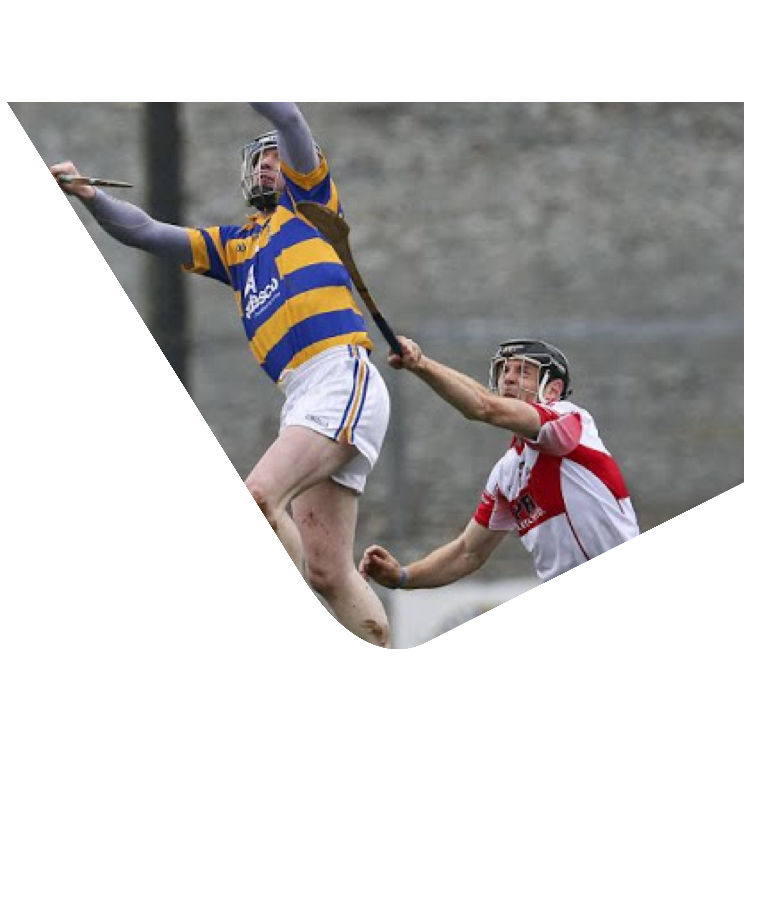
Technical Proficiency
GAA Award 1 Course

Slide 2
GAA Award 1 –
Technical Proficiency Outcomes
By the end of this Module participants will be able to:
  Be able to define Technical Proficiency
  Be able to identify different types of activities which can be used to develop Technical Proficiency
  Demonstrate effective ‘How to Coach Skills’ through the organisation of appropriate activities to develop Technical Proficiency
  Be able to identify key variables that can be altered to increase or decrease the difficulty of the activity

Slide 3

Lifting
Lee Chin Wex V Dub 35.07 - 35.24 Jab Lift
Dub No ^ V Wex
51.39 - 51.45
Lift U/Pressure
Catch
Paul Murphy Paddy Deegan
KK V WX 16.37 - 16.32
TJ Reid
KK V GY
3.31.15 - 3.36
Technical
Skills

Slide 4
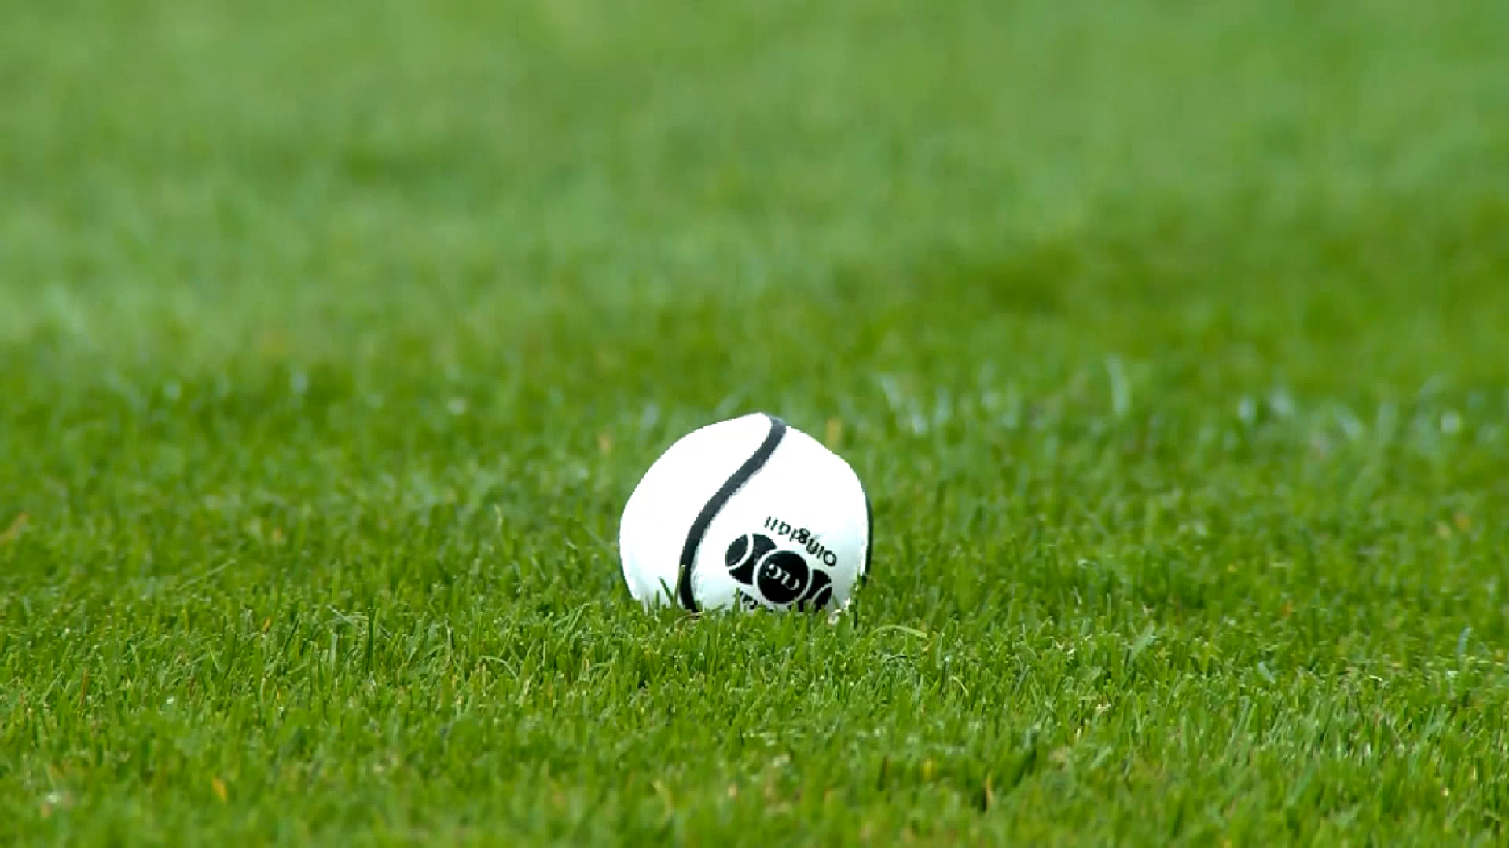
Technical
Skills

Slide 5

The TPP Model – Technical Proficiency
What do we mean by Technical Proficiency?
Be able to perform the techniques of the game
Accurately
Consistently
At Match Tempo which the game is being played
(U15-Senior games will vary in tempo and as a potential Award 1 coach you must be aware of this)

Slide 6
The Wheel of Technical Proficiency:

Slide 8
= Introduce
Use age appropriate language
= Demonstrate
Ensure all players can see
= Explain
Be brief, simple and direct
= Action
Encourage focus on head, hands and feet
= Looking
P.A.R.feedback
The
IDEAL
Principle

Slide 9
How can you modify the activities to challenge the players at their level?

Slide 10
= Space More space or less?
= Time Limit the time or give more time
= Equipment Different type of ball?
= Personnel More players, or less
= Rules/conditions of the activity.
An Easy Way of
Remembering this?
Perform the technique
Perform the technique moving​
Perform the technique under pressure​
Perform the technique in the game

Slide 11
GAA Award 1 –
Technical Proficiency Outcomes
Review
By the end of this Module participants will:
  Be able to define Technical Proficiency
  Be able to identify different types of activities which can be used to develop Technical Proficiency
  Be able to identify key variables that can be altered to increase or decrease the difficulty of the activity
  Demonstrate effective ‘How to Coach Skills’ through the organisation of appropriate activities to develop Technical Proficiency

Slide 12
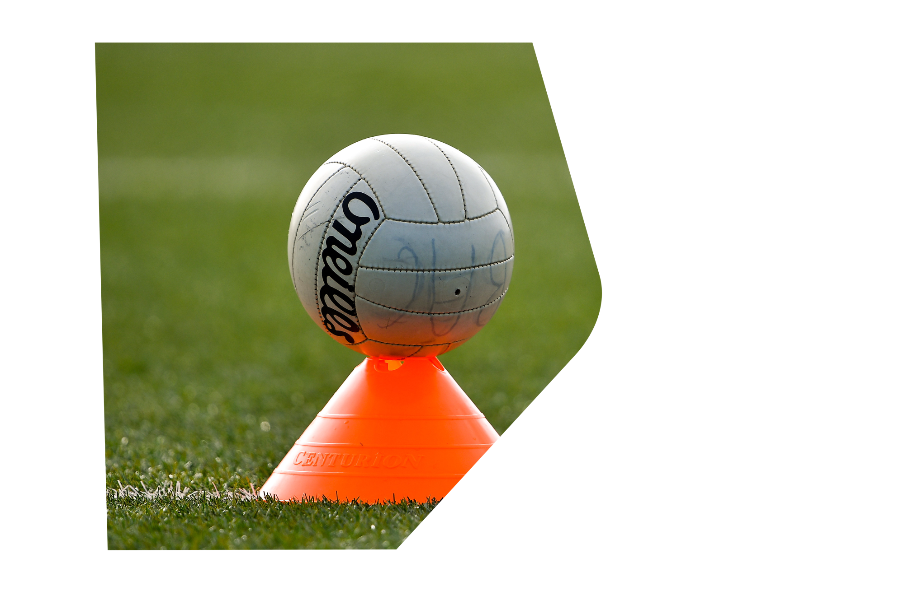
Now is your opportunity to show how well you can coach !
  Use the skill allocated. Chat about the coaching points (how to do the skill).
  Follow the IDEAL model and coach the skill to the group.
  In your group set up an appropriate activity to allow participants to practice – coach the skill as they practice.
  Using STEPR as your guide progress the skill using games and/or drills
THANK YOU

