Slide 1
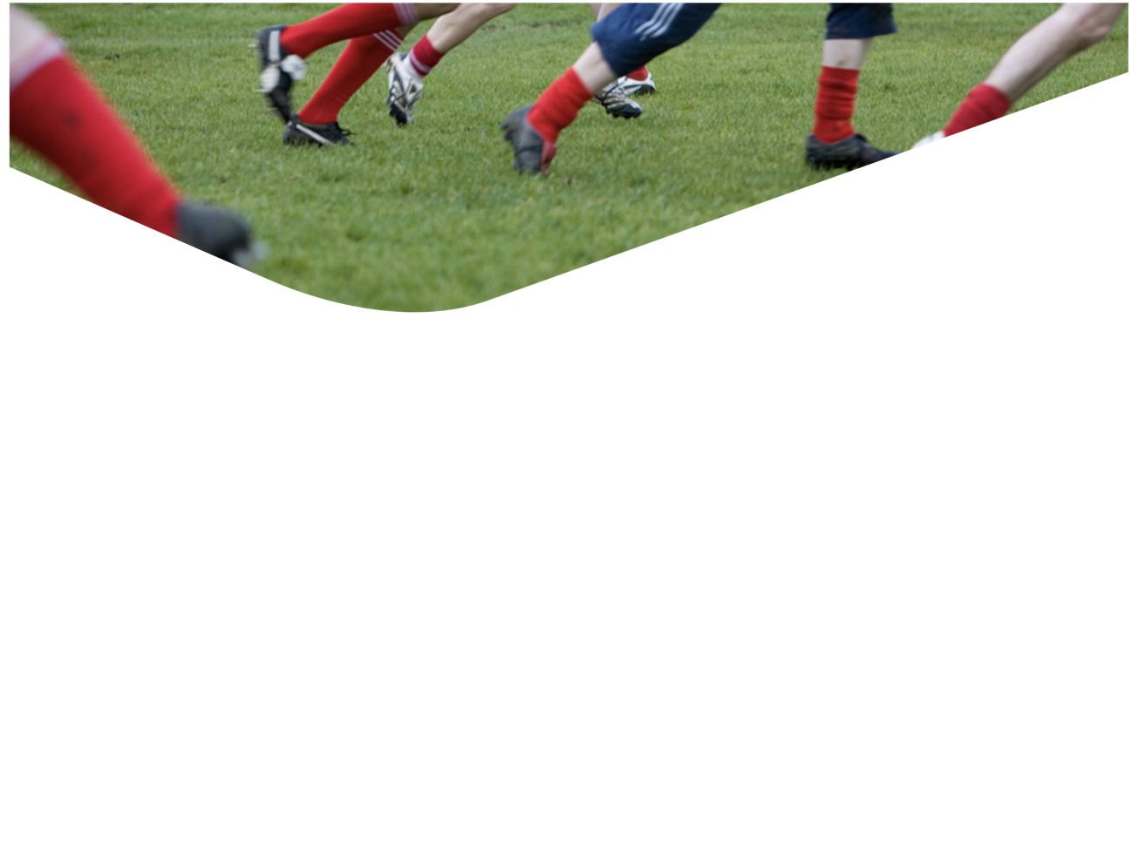
Tactical Prowess
Decision Making
Award 1 Youth/Adult

Slide 2
Outcomes of this session
Define Tactical Prowess/Decision Making.
Understand the role decision making plays in
Tactical Prowess and Team Play
Explain the learning cycle
Identify decisions a player makes on and off the ball
Understand the Games Based Coaching model
Identify the types of activities that develop decision making
Organise activities that develop decision making
Notes:
Tutor Notes:
Tutor to outline the outcomes to be achieved in this module.
Note that this session is mostly practical, with some theoretical aspects initially. The majority of the theory to this session should be completed through the practical session.

Slide 3
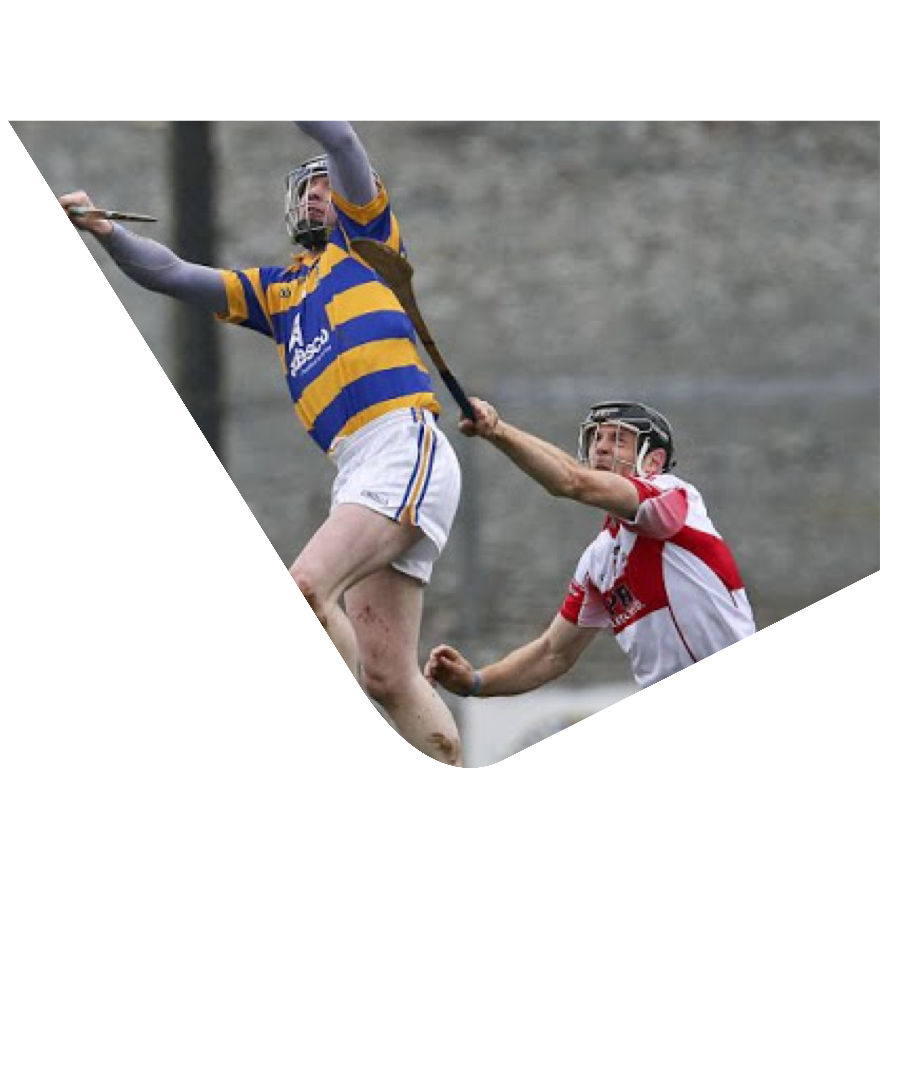
Definition of
Tactical Prowess/
Decision Making
“The ability of the individual to weigh up match situations and decide on what options to take and when to take it”
(knowing what to do
and when to do it)
Notes:
Tutor Note:
Tactical Prowess –
Tutor to ask what we mean by Tactical Prowess? Group Discussion and note on Flipchart
In short – Decisions on and off the ball, in Attack and Defence
Use Definition – ‘The Ability to Weigh Up Match Situations and Decide on What Option to Take and When to Take It’
Tactical Prowess is based on the players ability to take in all of the information from around him and choose the correct option to take. It is individual decision making, not the same as team tactics, or a teams style of play.

Slide 4
Decision Making
It is a skill that needs to be developed
Every activity has an element of decision making
The challenge for coaches is to develop the skill of decision making through appropriate activities (SSG, conditioned games, practice plays, etc.)
If a coach must tell the player what decision to make, is the skill of decision making being developed?
The key tool to develop decision making is questioning the player – Guided Discovery
Notes:
Tutor Notes:
Use points to generate discussion
Clarify what ‘Guided Discovery’ is if necessary

Slide 5
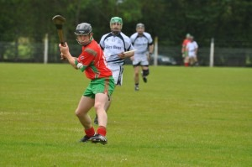
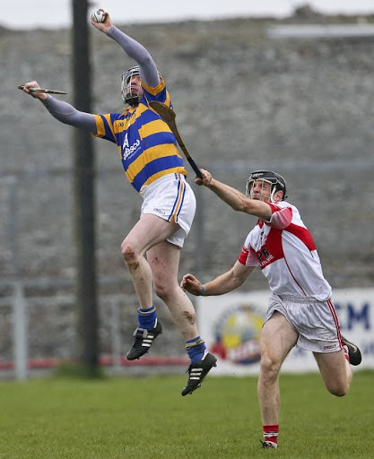
Tactical Prowess/Decision Making | Team Play
Individual Decisions It is an individual Skill that needs to be developed Let the player make the decisions Give the player opportunities to practice using different activities | Team Decisions Players need to practice working together The coach/team direct the decisions Give players the opportunity to practice using different activities

Slide 6
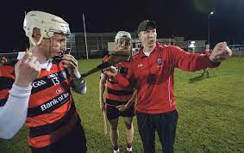
Effective Questioning
How can you use questioning to develop
tactical prowess/decision making?
Where was the defender/support?
What did you see when you got on the ball?
Where was the space?
Could you have done something else, other than…?
Where could X have moved to, to give you a better option? Why?
What is the danger of trying to pass to X?
What will you do next time?
Notes:
Tutor Notes:
Types of questions can be grouped as follows:
GROW Model??
Recall, Convergent, Divergent??

Slide 7
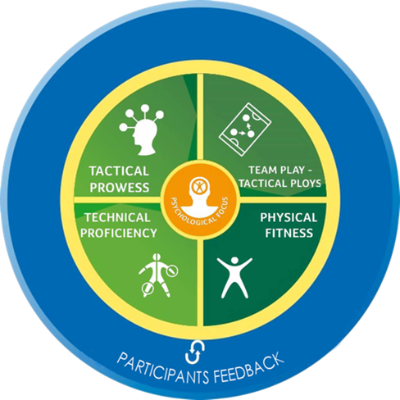
Decision Making Continuum
SSG
Conditioned Games
Practice Plays
Notes:
Ian: Highlight the 'Decision Making/Tactical Prowess" Step
Tutor Notes:
Ask for examples of activities that could be used to address the first 3 steps

Slide 8
Learning Cycle
(Adapted Kolb)
Notes:
Tutor Notes:
Discuss importance of learning cycle in coaching Decision Making
-‘telling’ robs the player of learning opportunities
Effective questioning helps guide player through steps 2-4

Slide 9
A Player has to make thousands of decisions in a game
It is equally important to know when as to know how
Notes:
Ian: Note; the terminology in the circle refers to hurling. Depending on the award, it should be hurling and football
Tutor Note:
Use this slide to sum up the decisions a player has to make.
Explain that when the participants deliver their coaching session the activity the choose must allow players the opportunity to make these decisions.

Slide 10
TASK
https://www.youtube.com/watch?v=fXYKHKfC8wk
Notes:
Play video clips. Groups observe.
Half the groups note the decisions made off the ball
The other half note the decisions made on the ball.
Discuss- Categorise them under the headings Who? When? What? Or where?
https://www.youtube.com/watch?v=FzxRE7V8yr0&feature=youtu.be
NIALL SCULY Decision making under pressure
https://www.youtube.com/watch?v=p_UTvHPW8CA&feature=youtu.be
LEE KEEGAN shot selection

Slide 11

Role of the player developed by the coach
“Scanning” needs to be taught at an early age
“ First Thought” decision making should be encouraged
The player in possession should make the decision
Players off the ball can advise the player – good communication important
Notes:
Tutor Notes:
Link back to previous video clip

Slide 12
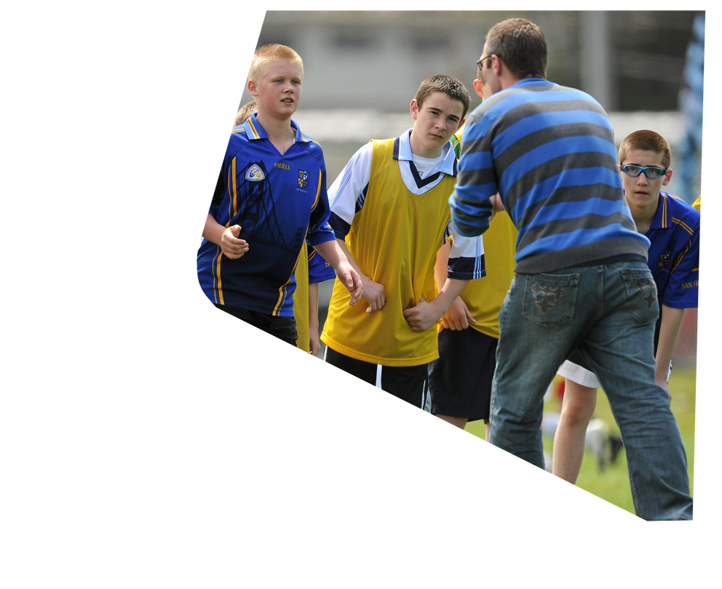
Our Role as Coaches?
To set up situations that are likely to occur in a match
To guide players in identifying the options that are available
To guide players in their learning process (best done through questioning and guided discovery)
To set up situations where the player can practice their responses to a given playing problem until they have perfected it
Because a match is fluid and ever changing, Decision Making is best developed through coaching in the game situation
Notes:
Tutor Notes:
Reinforce the 1st point: Reality based learning

Slide 13
GAMES BASED
COACHING
MODEL
Notes:
Tutor Notes:
What is the Coach’s role in the model?
Play the Game: Observe and Analyse
Freeze the Game: Reaffirm and/or Generate Feedback
Fix the Skill: Explain and Demonstrate
Fuel the will: Set Targets and Encourage (Motivate the player to apply their learning in the game)
Modify-What the coach does, STEPR
Change – Behavioural change of the player – links to 'Fuel the will‘
Reinforce that in this module ‘Fix the Skill’ refers to the skill of decision making not a technical skill

Slide 14
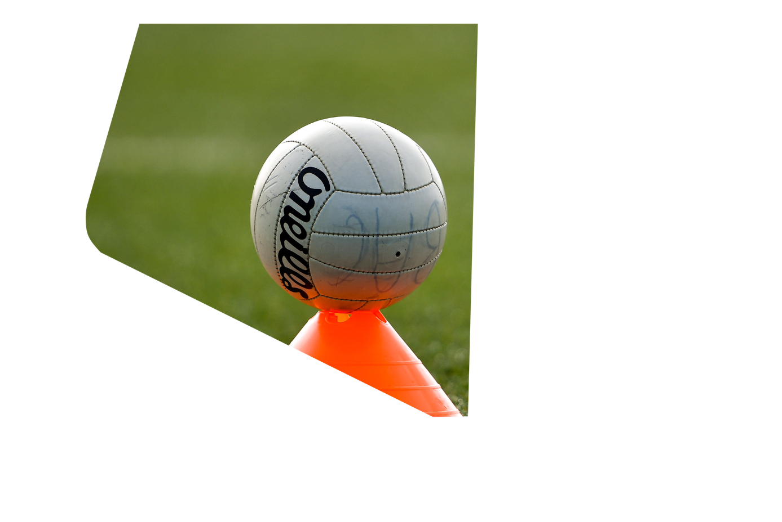
Lets go practice
Take a 15 minute session with the group
Using the skill card allocated and referring to your prompt card, familiarise yourself with the coaching points (the how to do the skill).
Follow the IDEAL model and coach the skill to the group.
Set up an appropriate activity to allow participants to use this skill activity to develop Tactical Prowess – coach the skill as they practice.
Use STEPR model to progress
Notes:
Tutor Notes:
Tutor to demonstrate best practice on two activities, half the group to act as players, half to observe the activities and give feedback
- Activity with very little decision making, e.g. truck and trailer
- Activity with lots of decision making, e.g. 6 v 6 attacking team can score in two goals
Recap on IDEAL and STEPR models
Following the discussion, coaches have the opportunity to plan their 15 minute session
Tutors set group of coaches a coaching task (Groups of 3, as per Technical Proficiency, new lead coach)
See task cards
Possible examples:
Devise an activity geared to preventing over carrying of the ball.
Devise an activity geared to delivery of low ball to forwards. 5 different scenarios

Slide 15
Outcomes for the Session
Define Tactical Prowess/Decision Making.
Understand the role decision making plays in Tactical Prowess and Team Play
Explain the learning cycle
Identify decisions a player makes on and off the ball
Understand the Games Based Coaching model
Identify the types of activities that develop decision making
Organise activities that develop decision making
Notes:
Tutor Notes:
Check for Learning – What have you learned and how will you apply it?

