Slide 1

Psychological Focus, Lifestyle & Conclusion
GAA Award 1 course

Slide 2
GAA Award 1 – Psychological Focus Outcomes
By the end of this Module participants will be able to:
  Define Psychological Focus for Gaelic games
  Identify issues surrounding the participation of youths/adults in Gaelic Games
  Describe the 5 C’s of Psychological Focus
  Identify methods of ensuring that sessions and games are enjoyable and challenging
  Set goals for Players and Coaches

Slide 3
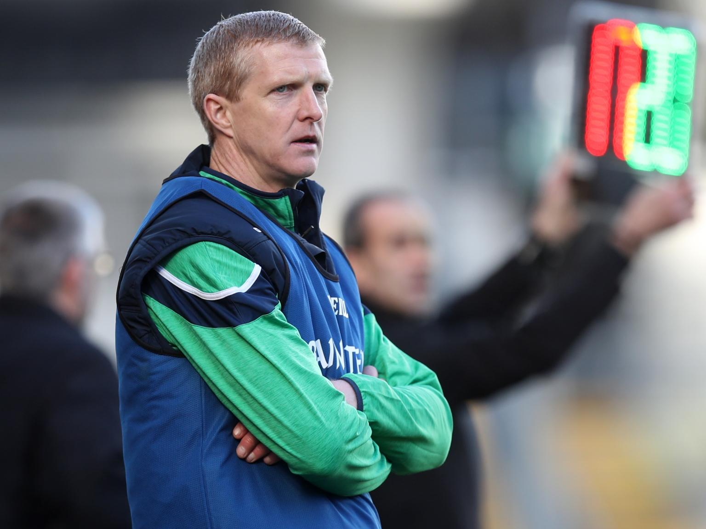
The Total Player Performance Model – Psychological Focus
The ability to maintain focus on the here and now, regardless of the internal and external distractions. It requires competence, confidence and cohesion..
What do we mean by Psychological Focus?

Slide 4

The Typical
Youth Player
Identify issues that affect a Youth players ability to play

Slide 5
Typical Youth….key words highlighted by coaches….
Drink
Volunteer in the local community
Health
Drugs
School/College
Relationships:
Family
Friends/Peers
Coaches
Commitment to different sports
Work-Part time job
Pressure/ Stress
Financial worries
What can a coach do to help?

Slide 6
The Typical Adult Player
Identify issues that affect an Adult players ability to play

Slide 7
Adult typical….key words highlighted by coaches….
Becoming Unemployed
Overweight
Finance Problems
Drink
Work
Administration in Club
Drugs
Health
Pressure/Stress
Children
Plays other sports
Coaching
Relationships
Married
Volunteer
What can a coach do to help?

Slide 8
What are the 5C’s of Psychological Focus?

Slide 9
The 5C’s of Psychological Focus
Confidence
Competent
Committed
Concentration
Control

Slide 10
How do we ensure the 5C’s are developed in our training sessions?

Slide 11
Variation is key
Varying exercise and training routines, Vary training sequence, Vary location, Utilise different mentors/players for coaching inputs, etc.
Maintains motivation, Stimulates interest and
ensures that the player does not go stale, Become bored or adapt to a routine in an overly negative manner

Slide 12
Challenging?
Understand Individual Needs within the Team
Set appropriate Activities and Contexts to promote enjoyment and challenge
Set SMARTER Goals

Slide 13
Goal setting?
Focus on Goal Setting
Types of Goals
pecific
- Outcome-winning the game
easurable
greed
- Performance-playing well
ealistic
Time Managed
xciting
ecordable

Slide 14
Goal setting?
Goals can be?
Short Term
Medium Term
Long Term

Slide 15
Short Term
Goals Lead
To Long Term
Success

Slide 16
Managing Conflict
When does conflict arise?
Differences between the coach and the player
Commitment
Discipline
Team Selection
What they want to achieve?
How can conflict be resolved?

Slide 17
GAA Award 1 – Psychological Focus Outcomes
By the end of this Module participants will be able to:
  Define Psychological Focus for Gaelic games
  Identify issues surrounding the participation of youths/adults in Gaelic Games
  Describe the 5 C’s of Psychological Focus
  Identify methods of ensuring that sessions and games are enjoyable and challenging
  Set goals for Players and Coaches

Slide 18
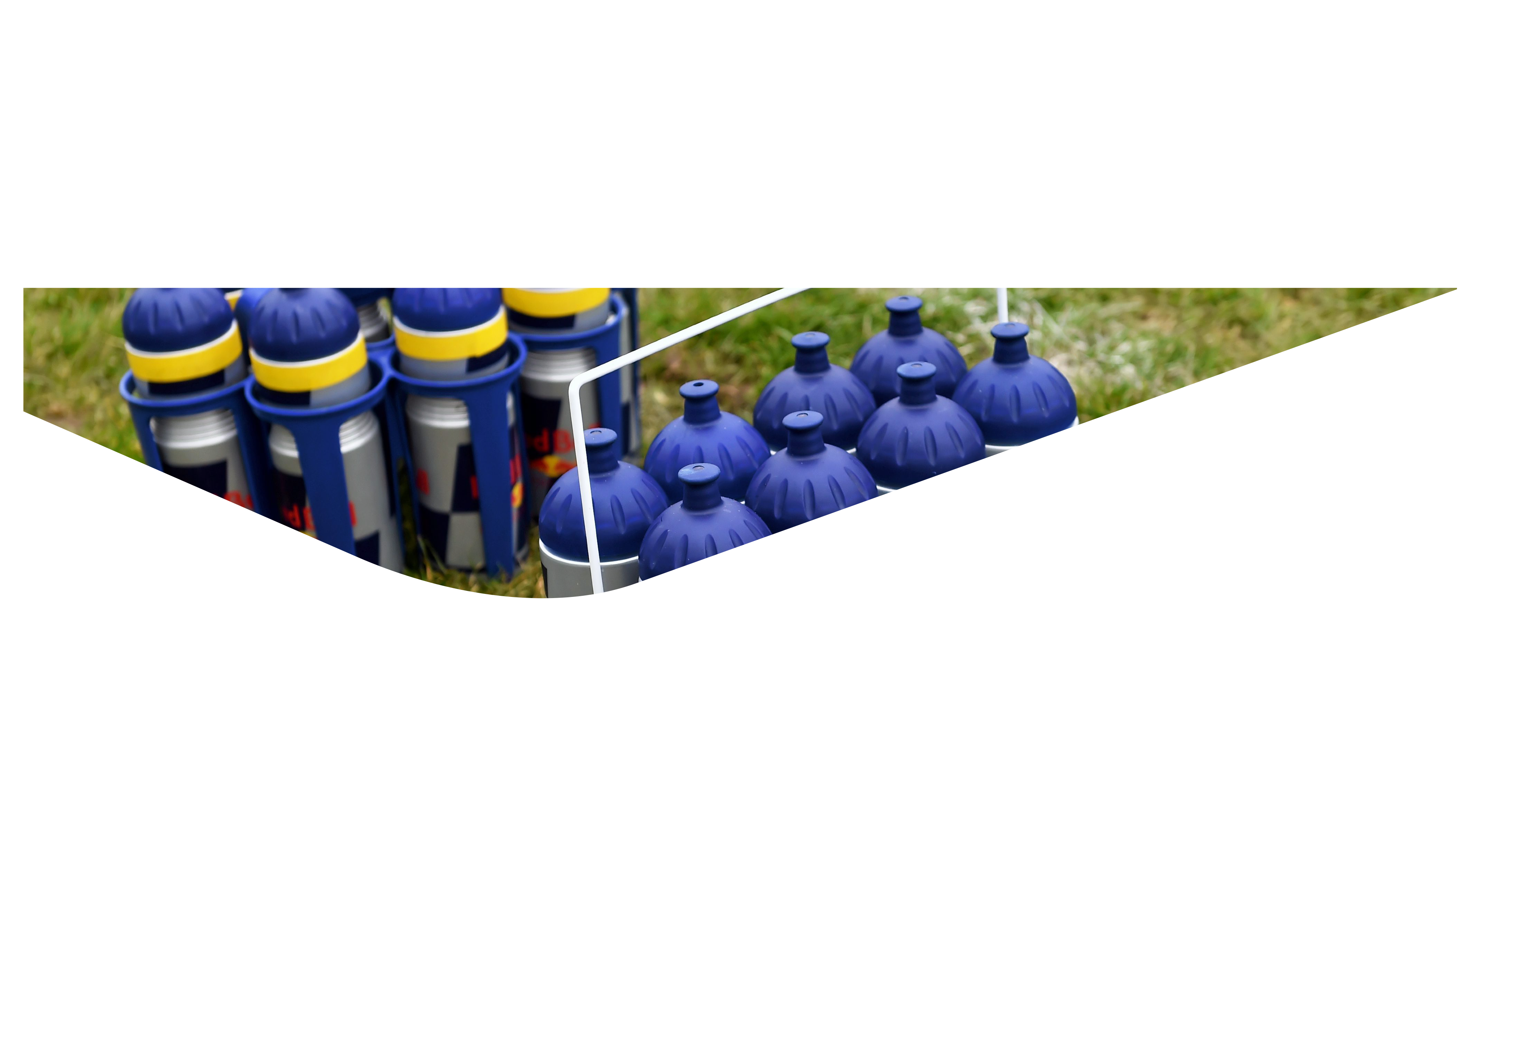
Lifestyle
Workload, Recovery & Nutrition for Youth/Adult
GAA Award 1

Slide 19
LIFESTYLE -
managing players workload

Slide 20
GAA Award 1 – Lifestyle-Workload, Recovery & Nutrition
  Identify key workload issues and how they relate to the developing Youth/Adult players
  Identify key recovery periods and their importance to the development of Youth/Adult players
  Identify key nutritional periods and how they relate to the development of Youth/Adult players

Slide 21
YOUNG PLAYERS in the GAA are being expected to train 12 times in 9 days and could be part of 10 teams at peak periods during the year.
The practice ‘is unsustainable’, according to Micheal Martin, head of the GAA’s minor review workgroup who published their document which looked at the level of minor activity and the issue of burnout in the GAA

Slide 22
Lifestyle - Youth
What do you do as a Coach if your Player is playing on…
Club U16 team
Club Minor team
School Junior hurling team (U16)
School Senior hurling panel
County Development Squad
How many of us as Coaches communicate with the other Coaches that a Player may have?
How many of us know when our Players are playing or training?
Who has responsibility?
What happens if no-one takes responsibility for this?

Slide 23
Active Lifestyle- Adult
What do you do as a Coach if your Player is playing on…
Club U.21 team
College Fitzgibbon Team
Club Senior Team
County U. 21 Squad
How many of us as Coaches communicate with the other Coaches that a Player may have?
How many of us know when our Players are playing or training?
Who has responsibility?
What happens if no-one takes responsibility for this?
Numerous training sessions
Numerous Coaches
Overlapping Competitions
Teams at different parts of their playing season

Slide 24
KEY RECOVERY PERIODS

Slide 25
REST AND RECOVERY
Players need to recover adequately from training or games to be able to enhance performance in the next session or game
Recovery involves
Replacing fluids and energy
Reducing muscle damage
Reducing psychological symptoms of fatigue, such as anxiousness and irritability

Slide 26
Daily Recovery Tips
Sleep
7-9 hours
Avoid phone before bed
Quality Nutrition
Nutrient dense delicious food
Try to cook/prepare yourself
Plan some ‘YOU’ time
Watch a film, read a book or listen to music
Daily Recovery Rating(Player Wellness Diary)
Aches/pains (lack of)
Appetite
Mood

Slide 27
Weekly Recovery Tips
Massage
Local physio or masseuse
Foam roller or tennis ball
Light Aerobic Work
Walk or cycle
Stretch
Activation/Mobility
Yoga or Pilates
Hydrotherapy
Bath with Epsom salts
Ice Bath
Swim (Stretches in pool)

Slide 28
The importance of adequate recovery from training and games cannot be over emphasised. Building periods for recovery into a training programme is as important as incorporating proper progression.
Rest and Recovery

Slide 29
NUTRITIONAL
PERIODS

Slide 30
Nutrition and Body Fuelling for Sport
Food is composed of nutrients which are essential to players if they are to maintain optimal performance. These nutrients underpin the importance of having a well-balanced diet.

Slide 31
Important Nutritional Periods and Body Fuelling for Sport
3 Key Time Periods -
Pre-Exercise
During Exercise
Post Exercise

Slide 32
Important Nutritional Periods and Body Fuelling for Sport
3 Key Time Periods – Pre-Exercise
Ensuring that a player is properly fueled and hydrated before a game/training session
A light meal of Carbohydrates, some Protein and low Fat e.g. Cereal, Beans on Toast, Banana Sandwiches, Pasta, Chicken
Water or a Sports Drink
Some players suffer from nerves and may not be able to eat. Ensure that they have sufficient fluids!

Slide 33
Nutrition and Body Fuelling for Sport
Fluid and Hydration
Dehydration has a direct relationship to Reduced Performance levels.
The aim is to match sweat loss with fluid intake
Sports Drinks replace fluid, electrolytes (sodium, potassium etc) plus Carbohydrates
Thirst is a poor indicator of dehydration – by the time you’re thirsty, you’re already dehydrated
Caffeine and Alcohol are detrimental in excess as they have a diuretic effect

Slide 34
Notes:
Change colour urine chart

Slide 35
GAA Award 1 – Lifestyle Outcomes Review
By the end of this Course participants will be able to:
  Identify key workload issues and how they relate to the developing Youth/Adult player
  Identify key recovery periods and their importance to the development of Youth/Adult players
  Identify the key nutritional periods and how they relate to the development of Youth/Adult players

Slide 36
Conclusion

Slide 37
COACH EDUCATION STRUCTURE

Slide 38
COACHING RESOURCES

Slide 39
THANK YOU

