Slide 1

Participant Feedback
Rules and Planning
GAA Award 1 Course

Slide 2
GAA Award 1 – Participant Feedback, Rules & Planning
By the end of this Module participants will be able to:
  Define Performance Analysis & Participant Feedback
  Identify a number of methods of analysing perfomances in Gaelic Games
  Utilise a number of strategies for analysing performances in Gaelic Games
  Demonstrate a knowledge and understanding of the structure of the Playing Rules of football/Hurling
  Identify the structure for planning an effective coaching session
  Identify the benefits of effective planning for coaches in order to challenge the players

Slide 3
The OTú Model – Participant Feedback
What do we mean by Participant Feedback?
The recording of factual information to help the coach, player and team identify strengths and areas where improvement is required if the player and subsequently the team is to achieve its full potential.
Feedback on performance
Evidence
Key Events

Slide 4
What Methods can we use for
Performance Analysis…
1. Coach Review
2. Hand Notation System
3. Video Analysis
4. Phone/Tablet System e.g Dartfish
5. Coach and Team review / meeting

Slide 5
List Two Advantages & Two Disadvantages of each of these methods of Performance Analysis?

Slide 6
ADVANTAGES/DISADVANTAGES
 | ADVANTAGES | DISADVANTAGES
1 | Immediate/Direct | Bias/One persons view/Emotional
2 | Practical/Factual – easy to use/Record/ specific areas | Can have a narrow focus/Time constraints/Miss key play/
3 | Accurate/Visual/Playback/ See patterns of play | Time consuming Cost/Miss off the ball movements/
4 | Accurate – wide focus-Detailed/individual player | Costly/Need for training/Equipment/ Computer Malfunction
5 | Everyone can contribute/Openness/Clear the air/Goal setting | Conflict/Lack of Honesty/If not chaired properly (tendency to ‘ramble') Row

Slide 7
Why do we need the Playing Facts?
Playing Facts Encourages Participant Feedback

Slide 8
KEY
MEASUREMENTS

Slide 10
What Playing Facts should we look for ?
Skill Performance – which skills are performed
Scores – from play
Scores – from frees
Frees won
Breaking Ball – Won
Kick outs won
Personal Fouls
Shots Short or to Keeper
Technical Fouls
Frees conceded
Puck outs lost

Slide 11
Recording the Playing Facts
Identify what you want to analyse
Is this information actionable?
Player | Frontal Block | Scores from Play | Puck Outs Won/Lost | Breaking Ball Won/Lost
1
2 |  |  | 3
3
4 |  | 2

Slide 12
Recording the Playing Facts
Identify what you want to analyse
Is this more actionable? Why?
Player | Gls | Pts | Wide | Shorts | Frees For | Frees Against | Puckouts Won/Lost | Breaking Ball Won/Lost
1
2
3
4

Slide 13
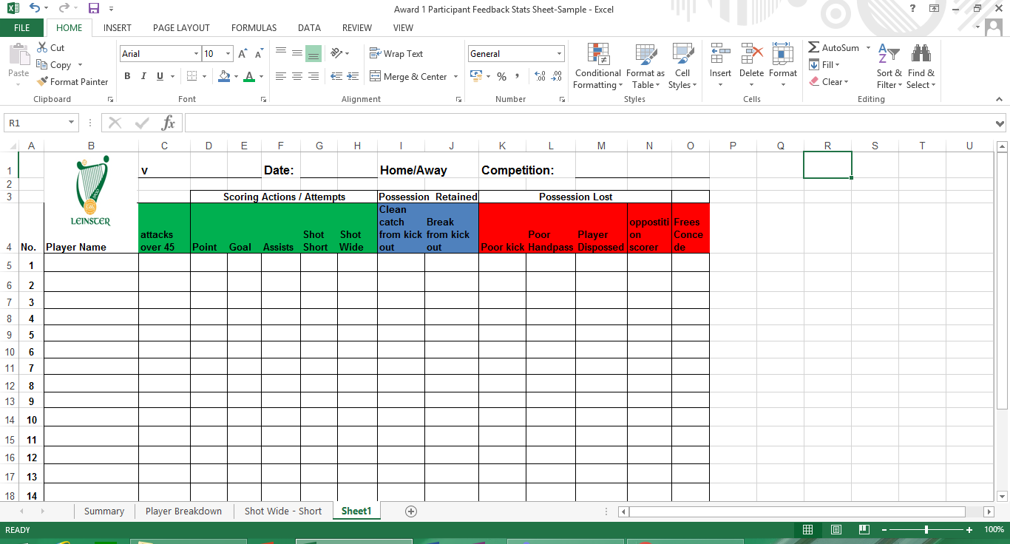

Slide 14
Recording the Playing Facts
Shot Map/ Puck Out Map -
Is this actionable?

Slide 15
How, Where and When to use Playing Facts?
1. During a Match
2. Half Time
3. After a Game
4. Post Match Review

Slide 16
During a game
1. Take notes/ Receive information from note taker
2. Analyse Performance
3. Change Tactical Ploys
4. Make positional changes
5. Make relevant substitutions

Slide 17
Immediatley after the game
1. Keep comments short and honest - not confrontational.
2. Emphasise the positive aspects of the performance
3. Gather/Listen to Factual Information
4. Talk to mentors & selectors about planning next session
5. Arrange a team meeting prior to next training if it is appropriate

Slide 18
Post Match Review
1. Planned meeting in advance at the appropriate time.
OPEN DISCUSSION CHAIRED BY COACH
Key Elements:
Everyone encouraged to contribute in a forthright manner.
Constructive criticism for the good of the team.
Cover positive and negative.
GIVE STATISTICAL ANALYSIS (as appropriate)
A. Statistics Sheet (Handout)
B. View video footage.
4. SET GOALS

Slide 19
How does analysis of the Playing Facts work in practice

Slide 20
Taking Action from the Playing Facts?
In your group, analyse the playing facts provided and plan your actions for the given scenario
Group 1 – Half Time – Identify actions to be taken as part of the team talk and any changes to be made
Group 2 – Full Time – Identify what needs to be worked on in the following coaching sessions. Outline so possible solutions to problems identified
Group 3 - Half Time – Identify actions to be taken as part of the team talk and any changes to be made
Group 4 - Full Time – Identify what needs to be worked on in the following coaching sessions. Outline so possible solutions to problems identified

Slide 21
“Without data your just another person with an opinion”
W.E. Deming Data Scientist

Slide 22
Playing Rules & Effective Planning
GAA Award 1

Slide 23
Rules Outcome
By the end of this Course participants will be able to:
Demonstrate a knowledge and understanding of the structure of the Playing Rules of football/Hurling
Complete a sample of questions on Gaelic Football/Hurling rules to help develop your knowledge

Slide 24
The Structure of the Rules

Slide 25
The Structure of the Rules
The Play
This Rule states what a player may do
Set Play
This Rule states how play is started and re-started at the beginning of the first half and second half and throughout the game.
Scores
This rule deals with matters relating to scores.

Slide 26
The Structure of the Rules
Technical Fouls
‘To ‘foul’ the ball, or any other foul that is not aggressive or dissenting.’
Aggressive Fouls
‘To physically or verbally abuse any player or official.’
Dissent
‘To disagree openly with any official about any decision.’

Slide 27
Knowledge of Playing Rules
It should be the goal of every Coach to compete within the Rules of the Game
Coaches should be aware of the rules as they relate to the performance of skills.
Complete the following 10 questions with your partner in 10 mins
To be a Referee the pass score is 90%
How many would qualify to be a Referee

Slide 28
Link to access
2019 Official Guide Part 1
2019 Official Guide Part 2
www.gaa.ie/the-gaa/rules-regulations/

Slide 29
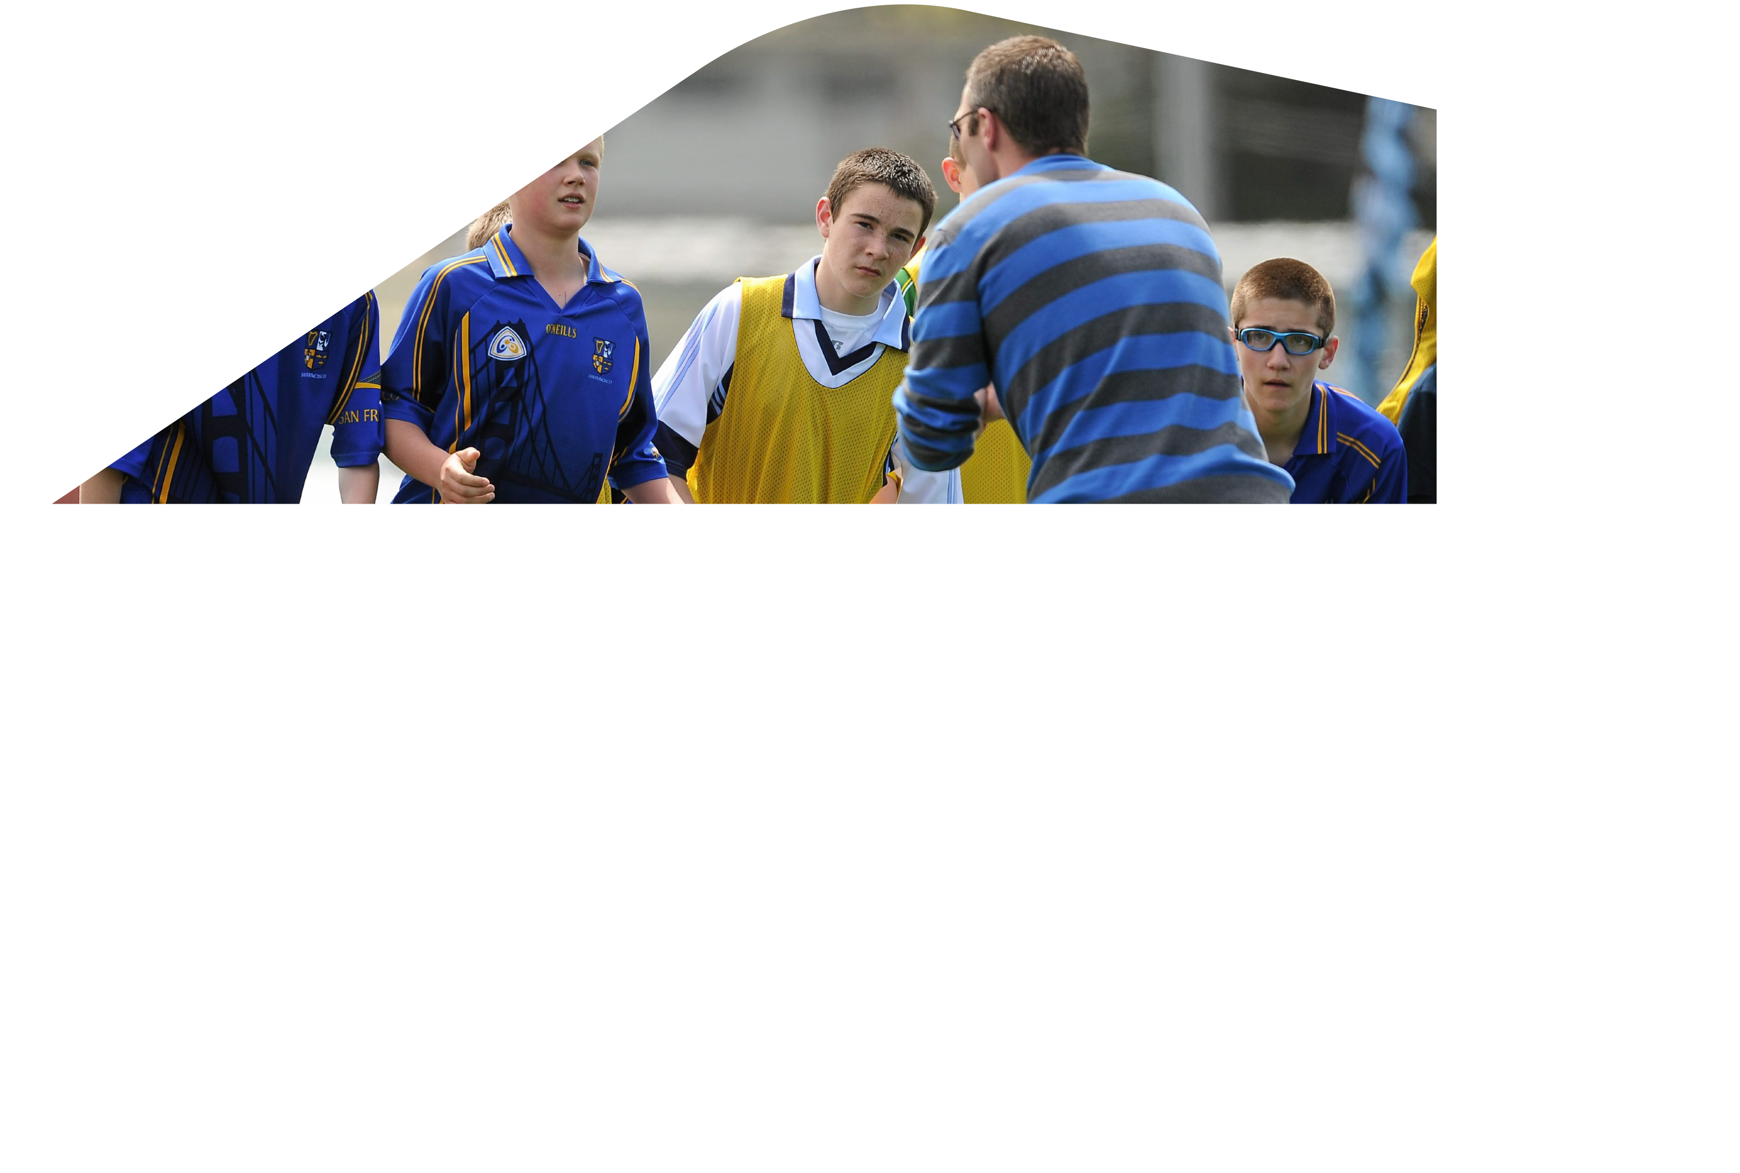
Effective Planning for a CoachingSession
  Identify the structure for planning an effective coaching session
  Identify the benefits of effective planning for coaches in order to challenge the players

Slide 30
Effective Planning for a Coaching Session
Helping to Plan…..
Do we plan each session before we get to the pitch?
Do we consult our assistants or fellow coaches to ensure they know what’s going to happen at the session?
Do we arrive at the pitch and then decide?
Planning a coaching session:
Allows for structured, challenging and a rewarding coaching sessions which shows that the coach is competent and can meet the needs of all players.

Slide 31
Effective Planning for a Coaching Session
Planning a coaching session:
In groups, take a flip chart sheet.
Group 1
Pre-planning:
  What does a coach have to plan for to make sure the session can take place?
Group 2
Adaptability:
Are we able to adapt our session plan to best meet the demands of our players
Group 3
Reflection:
  What’s important after each session?

Slide 32
Effective Pre-Planning for a Coaching Session
Group 1
Pre-planning:
Content of the session
  Activities to take place, skills to be developed
  Plan each section – warm up, game, skill development, cool down
  Map out the training area
Equipment required
Role of each coach in the session
  Does one coach take a particular part of the session or does everyone help out
How does this session fit into the overall coaching plan?
Safety considerations?

Slide 33
Effective Adaptability for a Coaching Session
Group 2
Adaptability
During the session:
Assess the players – provide corrective feedback
  Adapt and change as required
  Group management – dealing with issues – organisation
  Link stages warm up – body of session – cool down
  Different coaching styles during the session
  Safety Considerations

Slide 34
Reflecting on your Coaching Session
Group 3
Reflection:
  Review session with Players and Coaches
  Feedback to players
  Date of next session/game
  Injuries recorded
  Plan for next session
  Others….

Slide 35
Structure and Content of an Effective Coaching Session
Task
IN 10 MINS
In your groups plan a coaching session for an age group allocated by your tutor
Advantages of Games Based over Technique/Drills Based:
  As a coach you can develop technical proficiency, decision making and team play through games over a longer period of the session
  Match related fitness and movements developed through games

Slide 36
Effective planning will assist you to take a player where they can't take themselves
Thank you

Slide 37
GAA Award 1 – Participant Feedback, Rules & Planning Outcomes Review
By the end of this Module participants will be able to:
  Define Performance Analysis & Participant Feedback
  Identify a number of methods of analysing perfomances in Gaelic Games
  Utilise a number of strategies for analysing performances in Gaelic Games
  Demonstrate a knowledge and understanding of the structure of the Playing Rules of football/Hurling
  Identify the structure for planning an effective coaching session
  Identify the benefits of effective planning for coaches in order to challenge the players

